Slide 1
2022 NAHMMA Workshop
New Inspector Training:
Hazardous Waste Identification

Slide 2
Hazardous Waste Determination

Slide 3
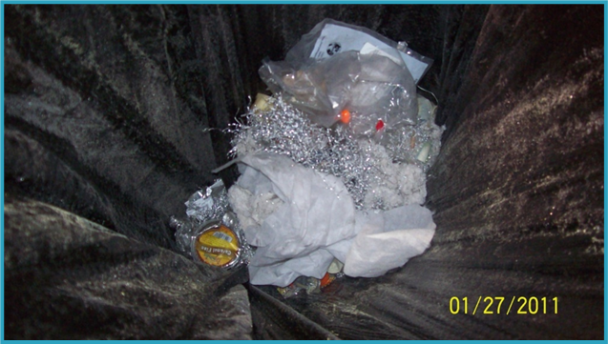
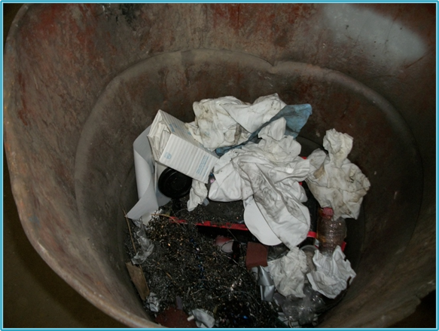
40 CFR 262.11 states “A person who generates a solid waste, as defined in 40 CFR 261.2, must make an accurate determination as to whether that waste is a hazardous waste…”
Is anything in the trash cans hazardous waste? You can’t tell just by looking.
Notes:
Metal millings in trash cans.

Slide 4
What is a Solid Waste?

Slide 5
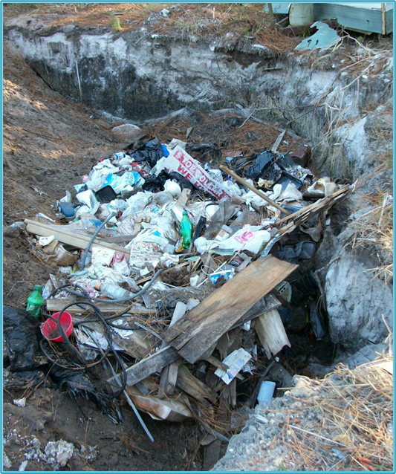
40 CFR 261.2 Definition of Solid Waste
A solid waste is any discarded material that is not excluded:
  under §261.4(a)
  by a variance granted under §§260.30 and 260.31
  by a non-waste determination under §§260.30 and 260.34.
Notes:
261.4 examples of excluded materials: domestic sewage, IW discharges subject to regulation under Clean Water Act, excluded scrap metal being recycled, shredded circuit boards being recycled, CRT tubes unless disposed of
260.30, 260.31, 260.34 – determined by the Administrator on a case by case basis

Slide 6
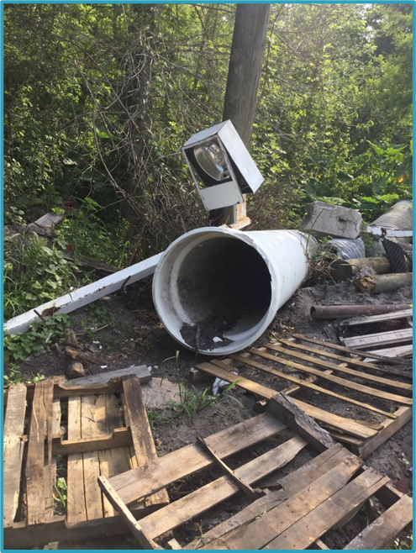
Solid Waste
40 CFR 261.2(a)(2) – Discarded Material
Any material that is:
  Abandoned
  Recycled (with some exceptions)
  Inherently waste-like
    Dioxin and Furan
  A military munition identified as solid waste in 40 CFR 266.202
Notes:
So we know from the previous slide that solid waste is a discarded material that is not excluded.
So what is a “Discarded Material?”
261.2(b) - Materials are solid waste if they are abandoned by being: disposed of; or burned/incinerated; or accumulated, stored, or treated (but not recycled) before or in lieu of being abandoned by being disposed of, burned or incinerated; or sham recycled

Slide 7
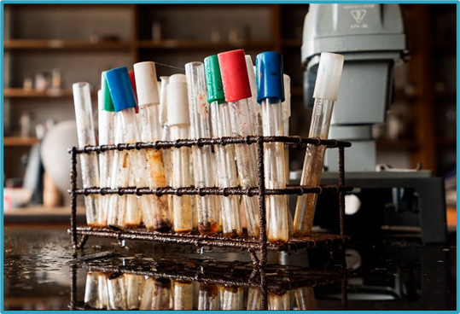
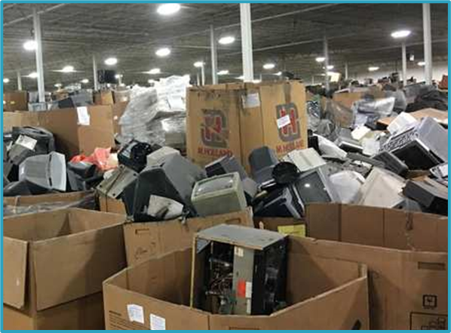
Solid Waste
40 CFR 261.2(b) – Abandoned Material
Any material that is:
  Disposed of
  Burned or incinerated
  Accumulated, stored, or treated (but not recycled) before or in lieu of being abandoned by being disposed of, burned/incinerated
  Sham recycled
Notes:
So – One of the ways a material is “discarded” is by being abandoned.
That’s defined too.
261.2(b) - Materials are solid waste if they are abandoned by being: disposed of; or burned/incinerated; or accumulated, stored, or treated (but not recycled) before or in lieu of being abandoned by being disposed of, burned or incinerated; or sham recycled
Sham recycling is not legitimate recycling as defined in 260.43 i.e. catalytic converter recycling of precious metals may be sham recycling

Slide 8
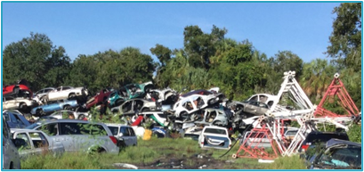
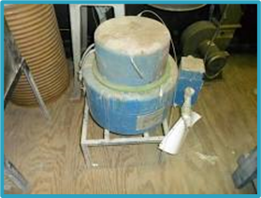
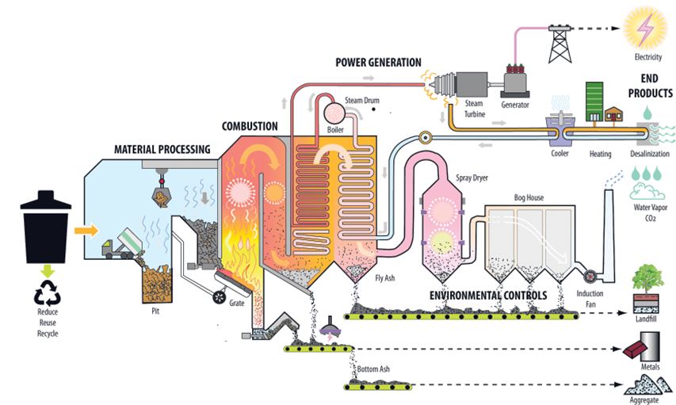
Solid Waste
40 CFR 261.2(c) – Recycled Material
Any material that is recycled, or accumulated, stored or treated before recycling, if it is:
  Used in a manner constituting disposal
  Burned for energy recovery
  Reclaimed
  Accumulated speculatively
Notes:
Applies to wastes in column 1 in Table 1 under 261.2
land applied or used to produce products that are applied to or placed on the land
Examples of “use constituting disposal:
- using waste like materials as fill or cover material, as an ingredient in fertilizers, or construction materials (concrete, road base, etc.)

Slide 9
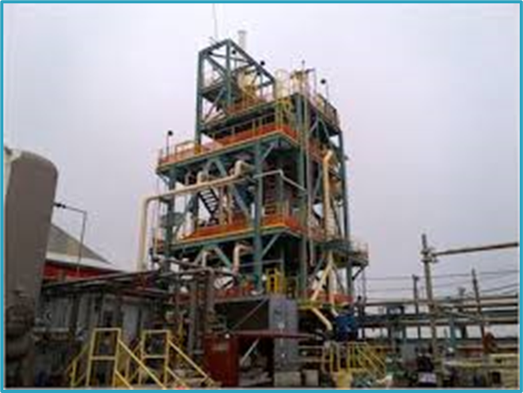
Solid Waste
40 CFR 261.2(d) – Inherently Waste-Like Material
The following materials are solid waste when recycled:
  F020, F021, F022, F023, F026, and F028
  Secondary materials fed to a halogen acid furnace
Notes:
F020
Wastes (except wastewater and spent carbon from hydrogen chloride purification) from the production or manufacturing use (as a reactant, chemical intermediate, or component in a formulating process) of tri- or tetrachlorophenol, or of intermediates used to produce their pesticide derivatives. (This listing does not include wastes from the production of Hexachlorophene from highly purified 2,4,5-trichlorophenol.)
(H)
F021
Wastes (except wastewater and spent carbon from hydrogen chloride purification) from the production or manufacturing use (as a reactant, chemical intermediate, or component in a formulating process) of pentachlorophenol, or of intermediates used to produce its derivatives
(H)
Note for F020 and F021: unless used as an ingredient to make a product at the site of generation
F022
Wastes (except wastewater and spent carbon from hydrogen chloride purification) from the manufacturing use (as a reactant, chemical intermediate, or component in a formulating process) of tetra-, penta-, or hexachlorobenzenes under alkaline conditions
(H)
F023
Wastes (except wastewater and spent carbon from hydrogen chloride purification) from the production of materials on equipment previously used for the production or manufacturing use (as a reactant, chemical intermediate, or component in a formulating process) of tri- and tetrachlorophenols. (This listing does not include wastes from equipment used only for the production or use of Hexachlorophene from highly purified 2,4,5-trichlorophenol.)
(H)
F026
Wastes (except wastewater and spent carbon from hydrogen chloride purification) from the production of materials on equipment previously used for the manufacturing use (as a reactant, chemical intermediate, or component in a formulating process) of tetra-, penta-, or hexachlorobenzene under alkaline conditions
(H)
F028
Residues resulting from the incineration or thermal treatment of soil contaminated with EPA Hazardous Waste Nos. F020, F021, F022, F023, F026, and F027

Slide 10
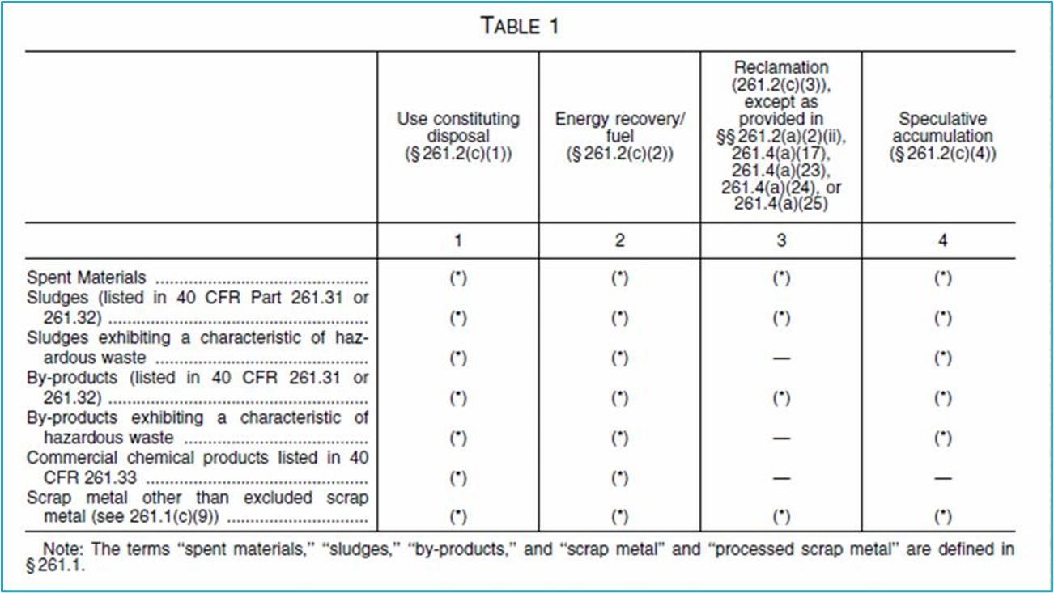
What is a Solid Waste?
Notes:
This brings us to Table 1
Spent material: solvents, filters
Sludges: Sludge means any solid, semi-solid, or liquid waste generated from a municipal, commercial, or industrial wastewater treatment plant, water supply treatment plant, or air pollution control facility exclusive of the treated effluent from a wastewater treatment plant. (260.10)
By-products: 40 CFR 261.1(c)(3): A “by-product” is a material that is not one of the primary products of a production process and is not solely or separately produced by the production process. The term does not include a co-product that is produced for the general public's use and is ordinarily used in the form it is produced by the process.
Listed by-products are regulated as solid waste when reclaimed but characteristic by-products are not. Both kinds of by-product are regulated as solid waste when used in a manner constituting disposal; burned for energy recovery, used to produce a fuel, or contained in fuels; or accumulated speculatively (Section 261.2, Table 1).
Examples are process residues such as slags or distillation column bottoms
Listed examples: K031 - By-product salts generated in the production of MSMA and cacodylic acid(T)
Characteristic example : aluminum slag/dross (D003)

Slide 11
What is NOT a Solid Waste?
40 CFR 261.2(e) – Materials that are NOT Solid Waste When Recycled
Any material is NOT a solid waste when it is recycled by being:
  Used/reused as ingredients to make a product (used as is, no treatment prior to use); or
  Used/reused as substitutes for commercial products; or
  Returned to the original process from which they are generated, w/o first being reclaimed or land disposed
Notes:
Basically – if you don’t have to do anything to it before you can use it / substitute it / re-work it it’s not waste
Documentation of claims that materials are not solid wastes or are conditionally exempt from regulation must be kept; i.e. contracts
Example: etching solutions sold to make micronutrients for agricultural industry; spent solvent used to make roofing compound

Slide 12
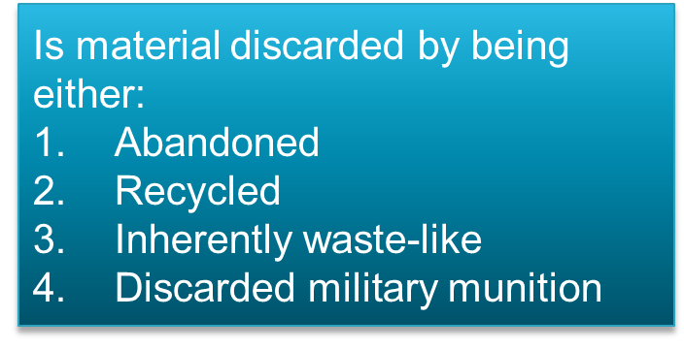




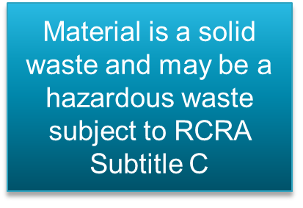
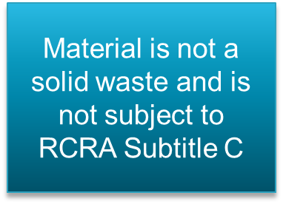
Solid Waste
Notes:
Recap of a solid waste

Slide 13
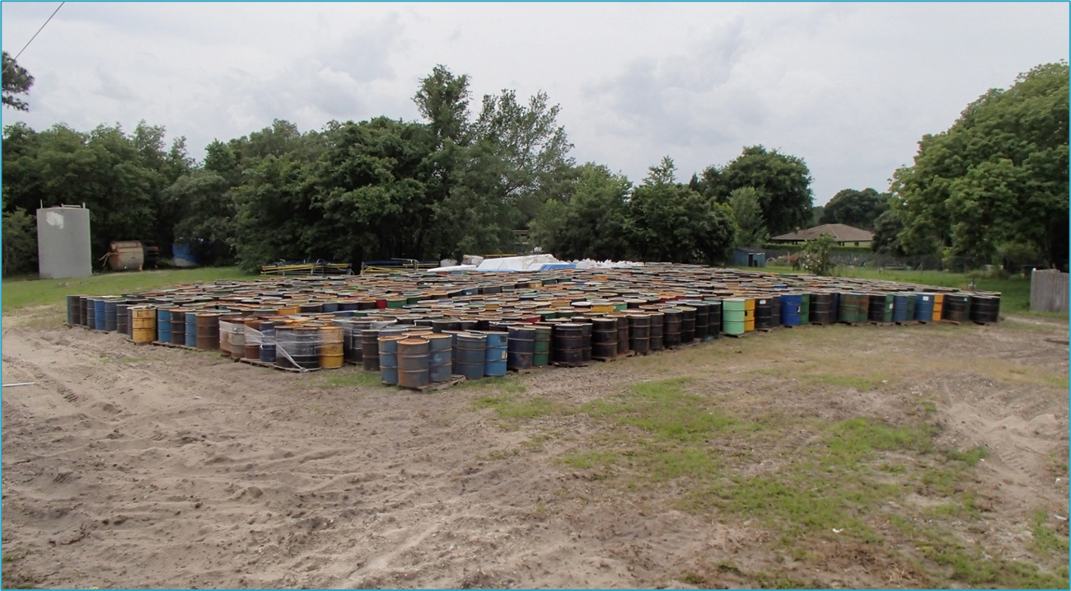
What is this stuff?
Notes:
Is this solid waste? Could be… could also not be solid waste.
It could be material that are intended to be reused
How long has this stuff been here?
Does the process still exist to reuse it?
Actually 1,000 drums in the picture – mine tailings from Canada

Slide 14

Solid Waste
So you have a solid waste, now what?
Notes:
Next you determine if it is hazardous waste.

Slide 15
What is a Hazardous Waste?

Slide 16
What is a Hazardous Waste?
40 CFR 261.3 Definition of Hazardous Waste
A solid waste is a hazardous waste if:
  It is not excluded from regulation as a hazardous waste under §261.4(b); and
  It meets certain other criteria
Notes:
Definition of a solid waste - 261.2(a)
261.4 examples of excluded materials: domestic sewage, IW discharges subject to regulation under Clean Water Act, excluded scrap metal being recycled, shredded circuit boards being recycled, CRT tubes unless disposed of

Slide 17
Hazardous Waste
40 CFR 261.3 Definition of Hazardous Waste
A solid waste is a hazardous waste if:
  It is not excluded from regulation as a hazardous waste under 261.4(b)
  -AND-
  Exhibits a characteristic of hazardous waste, or
  Is a listed hazardous waste, or
  Is a mixture of solid waste and a listed hazardous waste
Notes:
That brings us back to Hazardous Waste…
Definition of a hazardous waste 261.3

Slide 18
Characteristic Wastes
40 CFR 261 Subpart C:

Slide 19
Hazardous Waste
40 CFR 261 Subpart C:
Characteristics of Hazardous Waste
A solid waste, which is not excluded from regulation as a hazardous waste, is a hazardous waste if it exhibits any of the characteristics identified in this subpart.
  Ignitability [261.21]
  Corrosivity [261.22]
  Reactivity [261.23]
  Toxicity (TCLP) [261.24]
Notes:
Hazardous waste from a single waste stream can have many waste codes. A complete hazardous waste determination involves identifying all applicable waste codes.

Slide 20
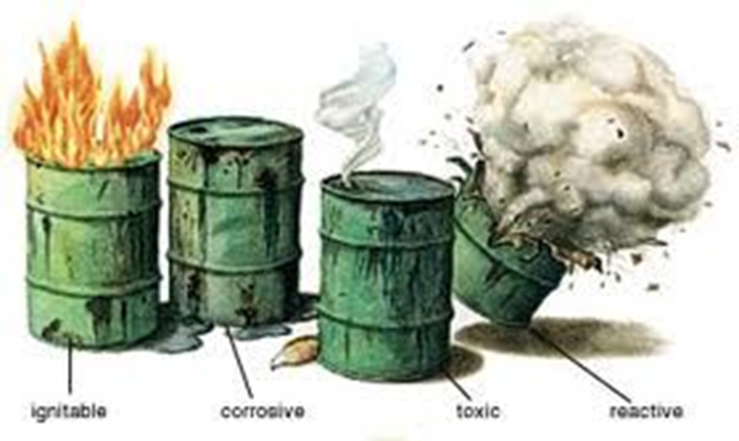
Characteristic Wastes – Subpart C
§262.11 sets forth the generator’s responsibility to determine whether his or her waste exhibits one or more of the characteristics identified in Subpart C.

Slide 21
Ignitability – D001
A solid waste exhibits the characteristic of ignitability if it has any of the following properties:
Flash point <140 °F [261.21(a)(1)]
  >24% alcohol
Capable of causing fire through friction, absorption of moisture or spontaneous chemical changes and, when ignited, burns so vigorously and persistently that it creates a hazard [261.21(a)(2)]
Ignitable compressed gas [261.21(a)(3)]
Oxidizer [261.21(a)(4)]
Notes:
It is a liquid, other than an aqueous solution containing less than 24 percent alcohol by volume and has flash point less than 60 °C (140 °F), as determined by a Pensky-Martens Closed Cup Tester, using the test method specified in ASTM Standard D 93-79 or D 93-80 (incorporated by reference, see §260.11), or a Setaflash Closed Cup Tester, using the test method specified in ASTM Standard D 3278-78 (incorporated by reference, see §260.11).
It is not a liquid and is capable, under standard temperature and pressure, of causing fire through friction, absorption of moisture or spontaneous chemical changes and, when ignited, burns so vigorously and persistently that it creates a hazard.
(3) It is an ignitable compressed gas.
(i) The term “compressed gas” shall designate any material or mixture having in the container an absolute pressure exceeding 40 p.s.i. at 70 °F or, regardless of the pressure at 70 °F, having an absolute pressure exceeding 104 p.s.i. at 130 °F; or any liquid flammable material having a vapor pressure exceeding 40 p.s.i. absolute at 100 °F as determined by ASTM Test D-323.
(ii) A compressed gas shall be characterized as ignitable if any one of the following occurs:
(A) Either a mixture of 13 percent or less (by volume) with air forms a flammable mixture or the flammable range with air is wider than 12 percent regardless of the lower limit. These limits shall be determined at atmospheric temperature and pressure. The method of sampling and test procedure shall be acceptable to the Bureau of Explosives and approved by the director, Pipeline and Hazardous Materials Technology, U.S. Department of Transportation (see Note 2).
(B) Using the Bureau of Explosives' Flame Projection Apparatus (see Note 1), the flame projects more than 18 inches beyond the ignition source with valve opened fully, or, the flame flashes back and burns at the valve with any degree of valve opening.
(C) Using the Bureau of Explosives' Open Drum Apparatus (see Note 1), there is any significant propagation of flame away from the ignition source.
(D) Using the Bureau of Explosives' Closed Drum Apparatus (see Note 1), there is any explosion of the vapor-air mixture in the drum.
(4) It is an oxidizer. An oxidizer for the purpose of this subchapter is a substance such as a chlorate, permanganate, inorganic peroxide, or a nitrate, that yields oxygen readily to stimulate the combustion of organic matter (see Note 4).
(i) An organic compound containing the bivalent -O-O- structure and which may be considered a derivative of hydrogen peroxide where one or more of the hydrogen atoms have been replaced by organic radicals must be classed as an organic peroxide unless:
(A) The material meets the definition of a Class A explosive or a Class B explosive, as defined in §261.23(a)(8), in which case it must be classed as an explosive,
(B) The material is forbidden to be offered for transportation according to 49 CFR 172.101 and 49 CFR 173.21,
(C) It is determined that the predominant hazard of the material containing an organic peroxide is other than that of an organic peroxide, or
(D) According to data on file with the Pipeline and Hazardous Materials Safety Administration in the U.S. Department of Transportation (see Note 3), it has been determined that the material does not present a hazard in transportation.

Slide 22
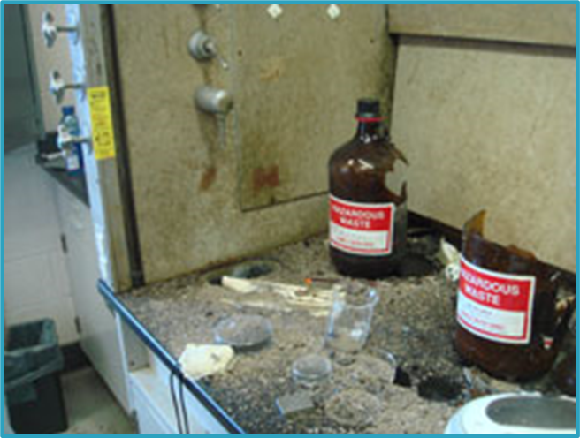
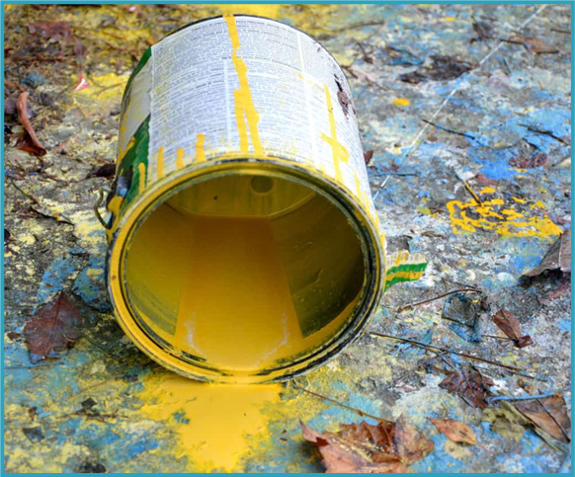
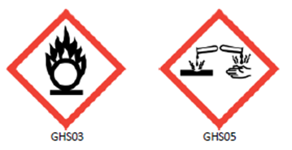
Ignitability – D001
Waste Solvent-Based Paint
Waste Oxidizer + Alcohol
Notes:
First pic is a fume hood in the UK:
Nitric acid collection container next to solvent collection container; student mistakenly added waste ethanol to waste nitric acid and then closed the container; explosion occurred almost immediately.
Nitric Acid is a strong oxidizer and is also D002.
Second pic is waste paint
Waste automotive paint is a common D001 HW

Slide 23
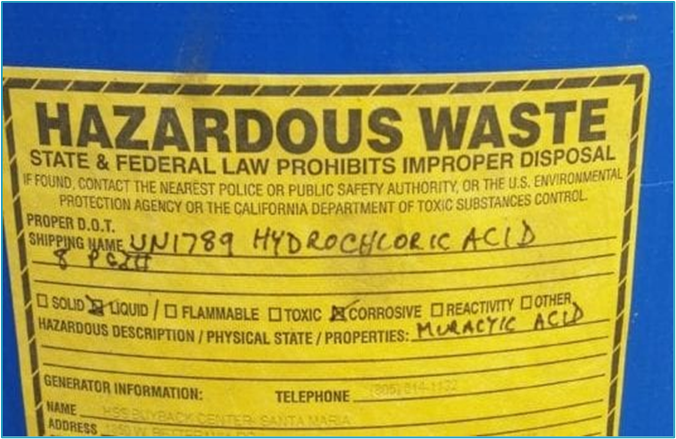
Corrosivity – D002
A solid waste exhibits the characteristic of corrosivity if it has either of the following properties:
Aqueous & pH of ≤2 or ≥12.5 [261.22(a)(1)]
Liquid & corrodes steel at a rate >0.25-inches per year at a test temp of 130 °F [261.22(a)(2)]
Notes:
(1) It is aqueous and has a pH less than or equal to 2 or greater than or equal to 12.5, as determined by a pH meter using Method 9040C in “Test Methods for Evaluating Solid Waste, Physical/Chemical Methods,” EPA Publication SW-846, as incorporated by reference in §260.11 of this chapter.
(2) It is a liquid and corrodes steel (SAE 1020) at a rate greater than 6.35 mm (0.250 inch) per year at a test temperature of 55 °C (130 °F) as determined by Method 1110A in “Test Methods for Evaluating Solid Waste, Physical/Chemical Methods,” EPA Publication SW-846, and as incorporated by reference in §260.11 of this chapter.

Slide 24
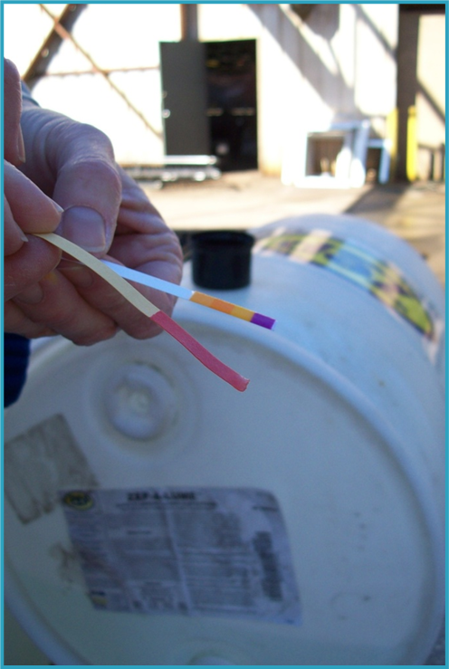
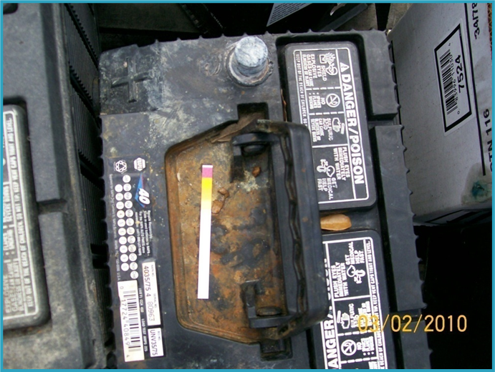
Corrosivity – D002
Notes:
D002 (and usually D008) waste from improper battery storage. Right photo is a facility that washes aluminum with an acid, generating a D002 hw.

Slide 25
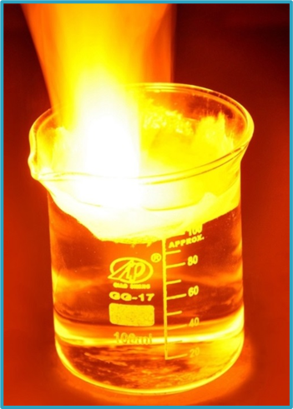
Reactivity – D003
A solid waste exhibits the characteristic of reactivity if it has any of the following properties:
Normally unstable and readily undergoes violent change without detonating [261.23(a)(1)]
Reacts violently with water [261.23(a)(2)]
Forms potentially explosive mixtures with
water [261.23(a)(3)]
When mixed with water, it generates toxic gases, vapors or fumes in a quantity sufficient to present a danger to human health or the environment [261.23(a)(4)]
Notes:
Sodium metal reacting w/ water

Slide 26
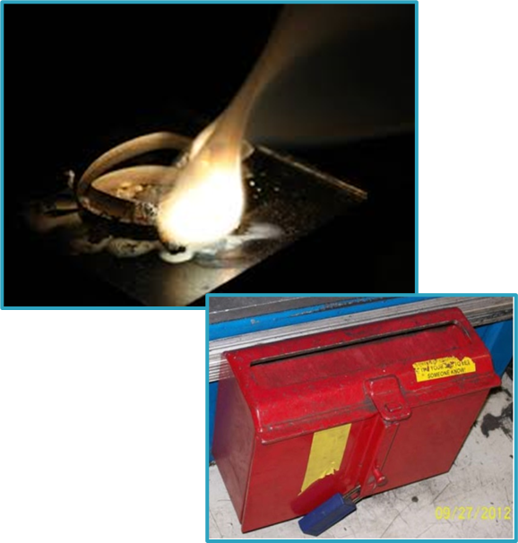
Reactivity – D003
A solid waste exhibits the characteristic of reactivity if it has any of the following properties:
Cyanide or sulfide bearing waste which, when exposed to pH between 2 and 12.5, can generate toxic gases, vapors or fumes [261.23(a)(5)]
Capable of detonation or explosive reaction if subjected to strong initiating source or heated under confinement
[261.23(a)(6)]
Readily capable of detonation or explosive
decomposition or reaction at STP [261.23(a)(7)]
Forbidden explosive or Division 1.1, 1.2, or
1.3 explosive as defined by DOT [261.23(a)(8)]
Notes:
We don’t have very many examples of D003 wastes.
Magnesium metal and air
Explosives magazine for airbag inflators pulled from assembly line at manufacturing facility
STP = standard temperature and pressure
A solid waste exhibits the characteristic of reactivity if a representative sample of the waste has any of the following properties:
(1) It is normally unstable and readily undergoes violent change without detonating.
(2) It reacts violently with water.
(3) It forms potentially explosive mixtures with water.
(4) When mixed with water, it generates toxic gases, vapors or fumes in a quantity sufficient to present a danger to human health or the environment.
(5) It is a cyanide or sulfide bearing waste which, when exposed to pH conditions between 2 and 12.5, can generate toxic gases, vapors or fumes in a quantity sufficient to present a danger to human health or the environment.
(6) It is capable of detonation or explosive reaction if it is subjected to a strong initiating source or if heated under confinement.
(7) It is readily capable of detonation or explosive decomposition or reaction at standard temperature and pressure.
(8) It is a forbidden explosive as defined in 49 CFR 173.54, or is a Division 1.1, 1.2 or 1.3 explosive as defined in 49 CFR 173.50 and 173.53.

Slide 27
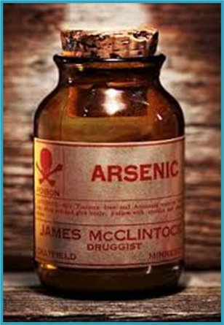
Toxicity - D004 through D043
A solid waste exhibits the characteristic of toxicity if the TCLP extract of a sample of the waste exceeds the regulatory threshold for at least one identified constituent.
Toxicity Characteristic Leaching Procedure =TCLP
  Test Method 1311 in SW-846
40 toxic constituents
8 heavy metals
Pesticides
Other organics
Notes:
A solid waste (except manufactured gas plant waste) exhibits the characteristic of toxicity if, using the Toxicity Characteristic Leaching Procedure, test Method 1311 in “Test Methods for Evaluating Solid Waste, Physical/Chemical Methods,” EPA Publication SW-846, as incorporated by reference in §260.11 of this chapter, the extract from a representative sample of the waste contains any of the contaminants listed in table 1 at the concentration equal to or greater than the respective value given in that table. Where the waste contains less than 0.5 percent filterable solids, the waste itself, after filtering using the methodology outlined in Method 1311, is considered to be the extract for the purpose of this section.
Maximum Concentration of Contaminants for Toxicity Characteristics
D004 Arsenic 7440-38-2 5.0
D005 Barium 7440-39-3 100.0
D018 Benzene 71-43-2 0.5
D006 Cadmium 7440-43-9 1.0
D019 Carbon tetrachloride 56-23-5 0.5
D020 Chlordane 57-74-9 0.03
D021 Chlorobenzene 106-90-7 100.0
D022 Chloroform 67-66-3 6.0
D007 Chromium 7440-47-3 5.0
D023 o-Cresol 95-48-7 200.0
D024 m-Cresol 108-39-4 200.0
D025 p-Cresol 106-44-5 200.0
D026 Cresol ---------- 200.0
D016 2, 4-D 94-75-7 10.0
D027 1, 4 Dichlorobenzene 106-46-7 7.5
D028 1, 2 Dichloroethane 107-06-2 0.5
D029 1, I Dichloroethylene 75-35-40 0.7
D030 2,4 Dinitrotoluene 121-14-2 0.13
D012 Endrin 72-20-8 0.02
D031 Heptachlor (and its epoxide) 76-44-8 0.008
D032 Hexachlorobenzene 118-74-1 0.13
D033 Hexachlorobutadiene 87-68-3 0.5
D034 Hexachloroethane 67-72-1 3.0
D008 Lead 7439-92-1 5.0
D013 Lindane 58-89-9 0.4
D009 Mercury 7439-97-6 0.2
D014 Methoxychlor 72-43-5 10.0
D035 Methyl ethyl ketone 78-93-3 200.0
D036 Nitrobenzene 98-95-3 2.0
D037 Pentachlorophenol 87-86-5 100.0
D038 Pyridine 110-86-1 5.0
D010 Selenium 7782-49-2 1.0
D011 Silver 7440-22-4 5.0
D039 Tetrachloroethylene 127-18-4 0.7
D015 Toxaphene 8001-35-2 0.5
D040 Trichloroethylene 79-01-6 0.5
D041 2, 4, 5-Trichlorophenol 95-95-4 400.0
D042 2, 4, 6-Trichlorophenol 88-06-2 2.0
D017 2, 4, 5-TP (Silvex) 93-72-1 1.0
D043 Vinyl chloride 75-01-4 0.2

Slide 28
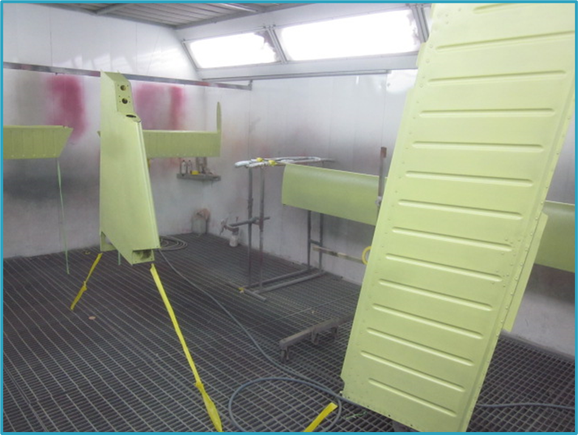
Toxicity - D004 through D043
Paint booth filters can become hazardous waste if the paints being used contain heavy metals
Notes:
Spent paint booth filters may be hw for heavy metals. Businesses that manufacture or coat aerospace parts often use strontium chromate primers that often make booth filters and other debris, such as masking materials, hazardous waste.

Slide 29
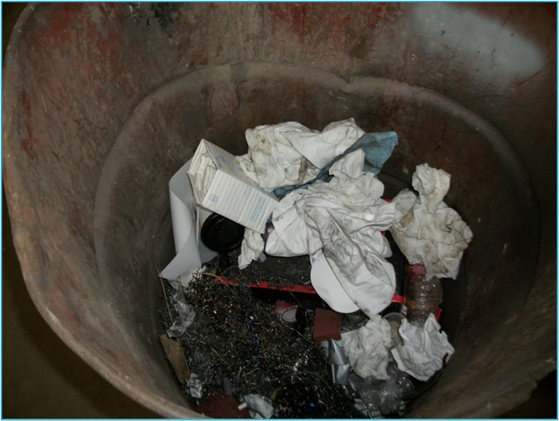

Toxicity - D004 through D043
Remember this trash can? These metal turnings are actually non-hazardous
But these are hazardous for chromium.
Notes:
The grey metal shavings are non-haz.
The shiny metal turnings in the trash can fail TCLP for chromium. They should be managed as hw or recycled as scrap metal.

Slide 30
Listed Wastes
40 CFR 261 Subpart D:

Slide 31
Hazardous Waste
40 CFR 261 Subpart D:
Lists of Hazardous Waste
A solid waste is a hazardous waste if it is listed in this subpart, unless it has been excluded from this list under §§260.20 and 260.22.
  Non-specific Sources (F codes) [261.31]
  Specific Sources (K codes) [261.32]
  Commercial Chemicals (P and U codes) [261.33]
Notes:
Hazardous waste from a single waste stream can have many waste codes. A complete hazardous waste determination involves identifying all applicable waste codes.

Slide 32
Listed Wastes – Subpart D
F-Listed - Non-specific Sources [261.31]
K-Listed - Specific Sources [261.32]
U-Listed –Unused Commercial Chemicals
P-Listed – Acutely Hazardous Unused
Commercial Chemicals [261.33]
§262.11 sets forth the generator’s responsibility to determine whether his or her waste meets any of the listing descriptions under subpart D.
Notes:
So the requirements for doing a HW det under 262.11 are to first determine if your SW is excluded, and then if it’s listed, and finally whether it’s characteristic.
So that’s why we’re starting with the Listed Wastes first.

Slide 33
F-Listed Wastes

Slide 34
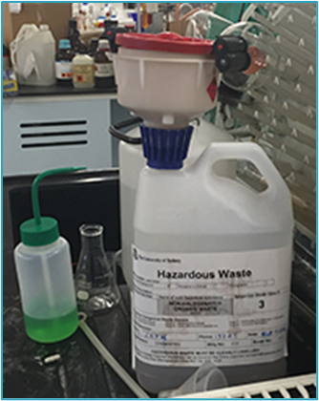
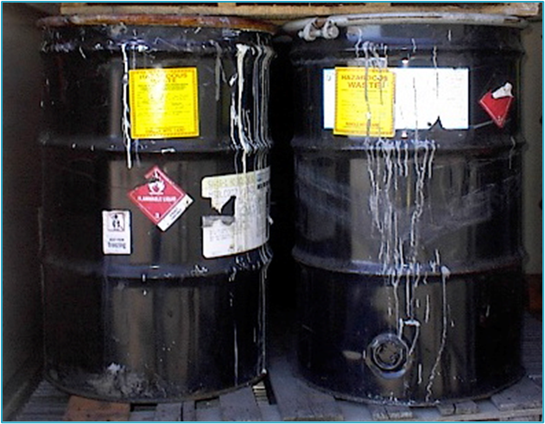
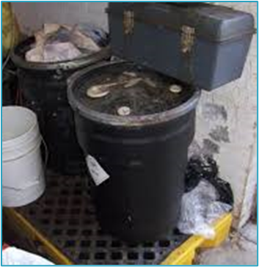
F-List: Non-Specific Sources
This list includes solid wastes from non-specific sources and common industrial and manufacturing processes [261.31]:
Notes:
These are all F-listed wastes:
The 55-gallons drums contain solvent waste from painting/coating operations – could be F005 and/ or F002 depending on what type of solvent or stripper is used
The smaller drum on the containment pallet contains solvent waste from drycleaning operations - F002 solvent
The lab collection jug contains solvent from laboratory operations – could be F005 and/ or F002 depending on what solvent they’re using
The point is they share the same waste codes but the processes by which the wastes were generated vary greatly.

Slide 35
F-List: Non-Specific Sources
Spent Solvent Wastes (F001 – F005)
Electroplating and Metal Finishing Wastes (F006 – F012, F019)
Dioxin Wastes (F020 – F023, F026 – F028)
  Acutely hazardous
Chlorinated Aliphatic Hydrocarbon Production Wastes (F024, F025)
Wood Preserving Wastes (F032, F034, F035)
Petroleum Refinery Wastewater Treatment Sludges (F037, F038)
Multisource Leachate (F039)

Slide 36
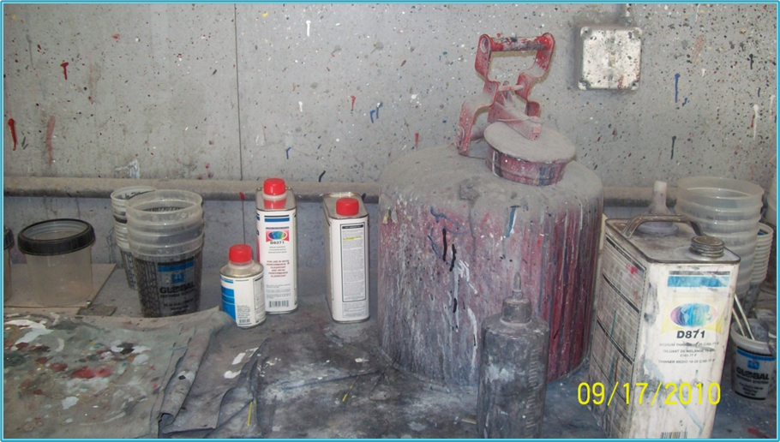
F-List: Spent Solvents
Tetrachloroethylene
Trichloroethylene
Methylene Chloride
Chlorobenzene
Acetone
Xylene
Methanol
Cresylic Acid
Toluene
Methyl Ethyl Ketone
Benzene
Pyridine
Notes:
Most commonly encountered type of listed waste.
Remember all of these chemicals have synonyms. An SDS may not use the same name used in the rule, and neither might the generator.
Examples: Tetrachloroethylene = perchloroethylene; methylene chloride = dimethyl chloride; acetone = 2-propanone; methanol = methyl alcohol
Also the language for the listings say solvents “containing, before use, a total of ten percent or more (by volume) of one or more of the above…solvents or those solvents listed…” in the listings for F001, F002, F004, or F005.

Slide 37
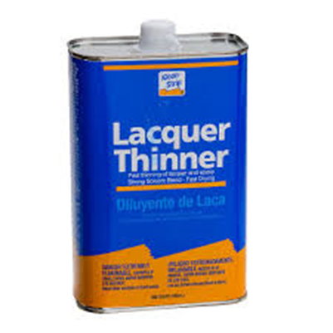
F-List: Spent Solvents
A Solvent Mixture is F-Listed if:
It contains a total of 10% or more (by volume) of one or more of those solvents listed in F001, F002, F004, and/or F005 before use [261.31]
Notes:
Also includes still bottoms from the recovery of these spent solvents

Slide 38
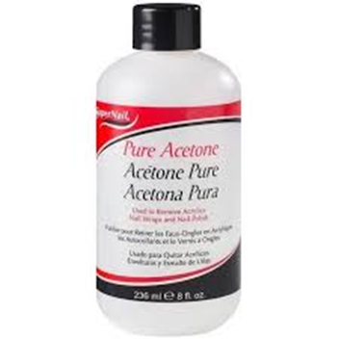
F-List: Spent Solvents
F003 Solvent Mixtures:
In order to have the F003 listing, a solvent mixture must be either 100% F003 listed solvent(s) or a mixture with at least 10% F001, F002, F004 and/or F005 listed solvent before use.
Notes:
Still bottoms that are from 100% F003 listed solvent would not carry the F003 listing if the material does not carry the characteristic of ignitability upon generation.
Facility has to file a one time LDR notification to the landfill if they are disposing of it – if facility is not VSQG

Slide 39
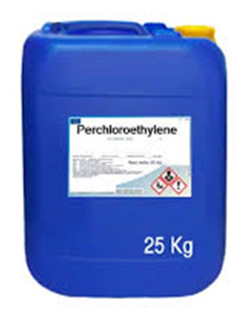
F-List: Spent Solvents
F001, F002, F004, & F005 Solvent Mixture Examples:
Solvent, before use, is 100% Tetrachloroethylene (Perchloroethylene) used in dry-cleaning
  Before use, solvent is pure and is used for its solvent properties
  EPA Waste Code F002
Notes:
Also D039 if not used for solvent properties

Slide 40
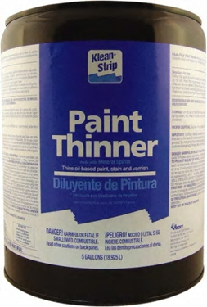
F-List: Spent Solvents
F001, F002, F004, & F005 Solvent Mixture Examples:
Solvent before use is 80% toluene and 20% mineral spirits and is used in painting (solvent)
  Before use, solvent is >10% toluene (F005)
  EPA Waste Code F005 & D001

Slide 41
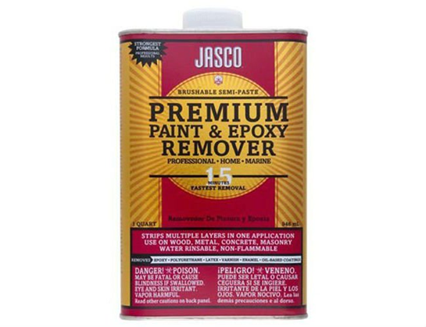
F-List: Spent Solvents
F001, F002, F004, & F005 Solvent Mixture Examples:
Solvent before use is 86% Mineral Spirits, 7% Toluene, and 7% Methylene Chloride
  Before use, solvent is 14% combined F002 and F005 solvents
  EPA Waste Codes F002, F005 & D001

Slide 42
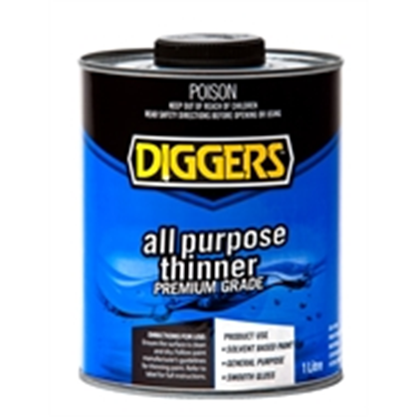
F-List: Spent Solvents
F003 Solvent Mixture Examples:
Solvent before use is 85% Acetone and 15% Xylene
  Before use, solvent is 100%
  combined F003 solvents
  EPA Waste Code F003 & D001

Slide 43
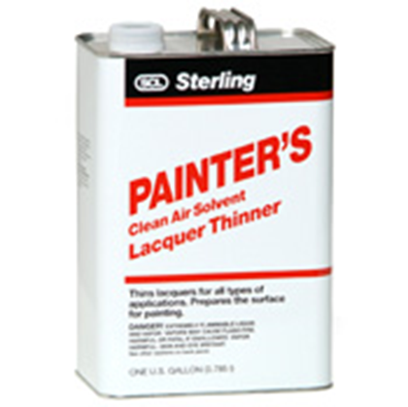
F-List: Spent Solvents
F003 Solvent Mixture Examples:
Solvent before use is 65% Acetone, 12% Toluene, and 23% Mineral Spirits
  Before use, solvent contains an F003 solvent, more than 10% F005 solvent
  EPA Waste Codes F003, F005 & D001

Slide 44
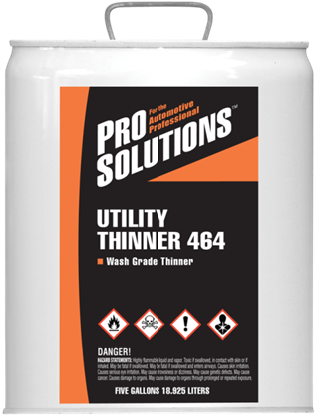
F-List: Spent Solvents
F003 Solvent Mixture Examples:
Solvent before use is 91% Acetone and 9% Methyl Ethyl Ketone
  Before use, solvent contains an F003 solvent, less than 10% F005 solvent, and has a flashpoint less than 140 °F
  Not F-listed, characteristic only
    D001, D035

Slide 45
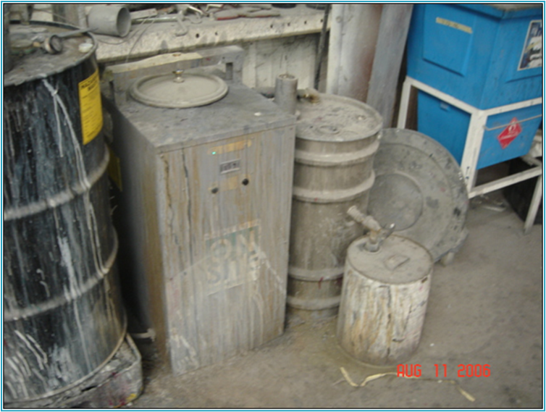
F-List: Spent Solvents
F003/F005 Still Bottoms
  If the flashpoint is <140 °F, then the still bottoms would be F003/F005 hazardous waste.
  The still bottoms are F005 hazardous waste if the flashpoint is ≥140 °F.
Notes:
This would have to be a mix of mineral spirits, MEK, and acetone, etc. Spent solvents that are F003/F005 waste are distilled. The recovered product is useable, and the still bottoms is a F003/F005 if the still bottoms flash <140 degrees. If they flash > 140 degrees, it is only a F005 hw.
Mixture rule applies [40 CFR 261.3(a)(2)(iv)].
NOTE: If the material is listed for ignitability, you do not have to add the D001 code. For example, F001 is listed for toxity. If it is also ignitable you will need to add D001.
F005 is listed for toxicity and ignitability; You do not need to add D001 to this waste stream.

Slide 46
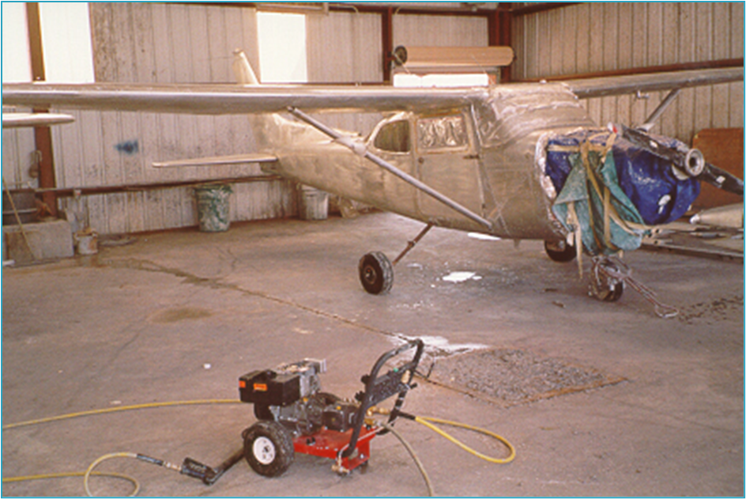
F-List: Spent Solvents
F002 Waste Paint Chips
Notes:
Methylene Chloride stripper generates F002 water/paint chips/debris.
Process includes spraying plane with stripper, pressure washing with water, collecting waste in sump.

Slide 47
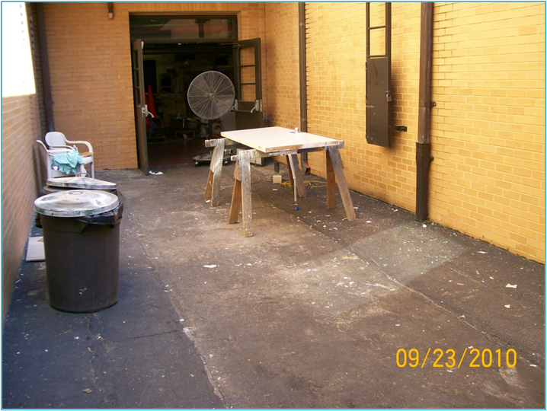
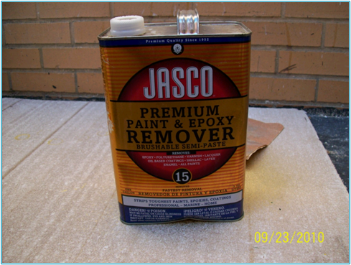
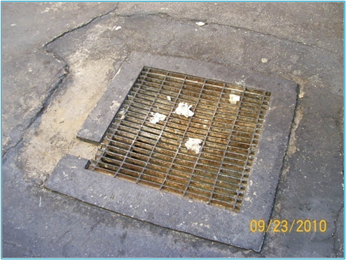
F-List: Spent Solvents
Are these paint chips hazardous waste?
Notes:
Methylene Chloride stripper generates F002 water/paint chips/debris.
So…yeah, they are HW

Slide 48
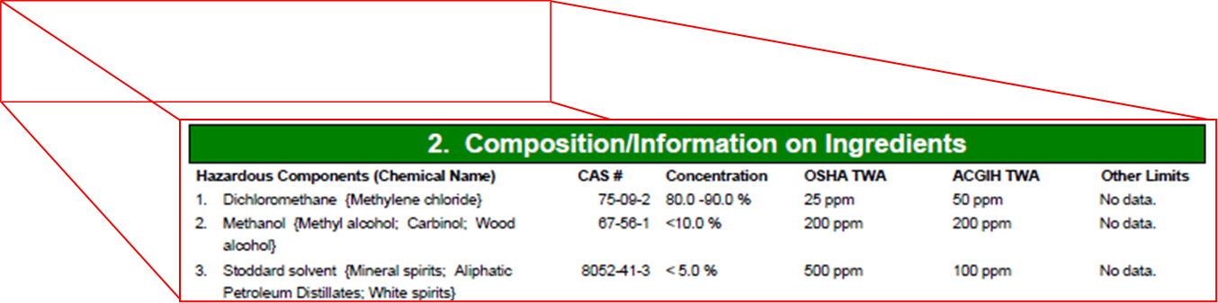
F-List: Spent Solvents
The paint chips are F002 hazardous waste.
Notes:
Product contained Methylene Chloride, so waste was F002 hw.

Slide 49
F-List: Solvent Contaminated Rags
Lacquer thinner used for cleanup often contains toluene and/or MEK resulting in F005 rags
Note:
The Excluded Solvent Contaminated Wipe Rule impacts this waste stream.
Notes:
Mixture rule applies [40 CFR 261.3(a)(2)(iv)]. The rags are only F005 because the solid rags would not be D001/F003 hw.
Excluded solvent contaminated wipes rule found under 261.4(a)(26) and (b)(18)

Slide 50
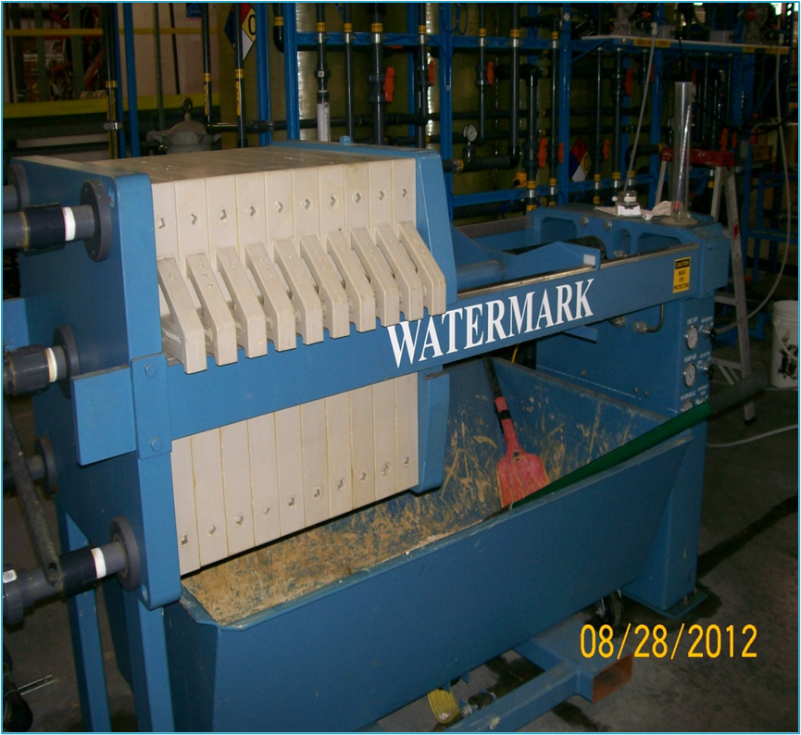
F-List: Plating Waste
F006: Wastewater treatment sludges from electroplating operations
Notes:
F006 waste from a sludge press.
F006 excludes sludges from sulfuric acid anodizing of aluminum, tin plating on carbon steel, zinc plating on carbon steel, Al or Zn-Al plating on carbon steel, cleaning/stripping assoc. with tin, zinc, and aluminum, and chemical etching milling of aluminum

Slide 51
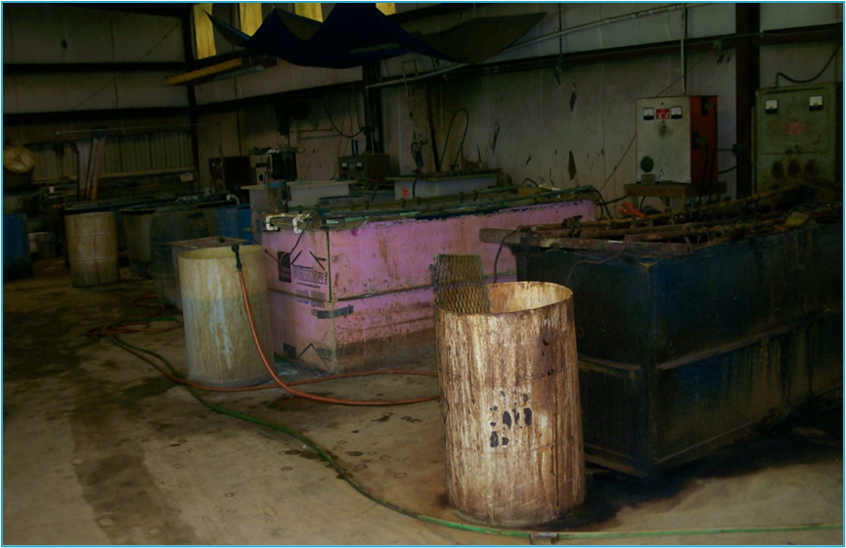
F-List: Plating Waste
F007:
Spent cyanide plating bath solutions from electroplating operations
Notes:
An example of F007 HW.
Note that this listing is for the spent bath; the previous listing is for waste generated from treatment of the wastewater

Slide 52
K-Listed Wastes

Slide 53
K-List: Specific Sources
This list includes solid wastes from specific sources [261.32]:
Wood preservation
Inorganic Pigments
Organic chemicals
Inorganic chemicals
Pesticides
Explosives
Petroleum Refining
Iron and Steel
Primary Aluminum
Secondary Lead
Veterinary Pharmaceuticals
Ink Formulation
Coking
Notes:
Specific Sources

Slide 54
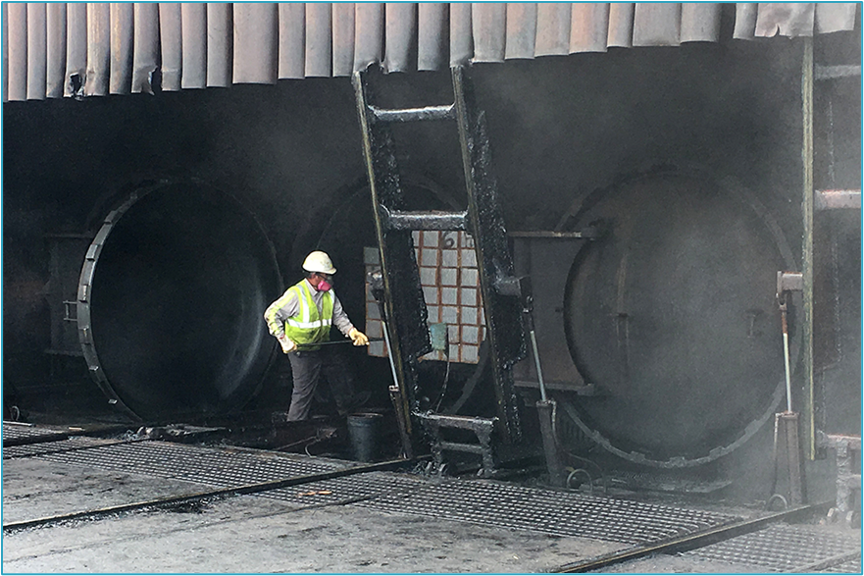
K-List: Specific Sources
K001:
Bottom sediment sludge from the treatment of wastewaters from wood preserving processes that use creosote and/or pentachloralphenol
Notes:
The photo is an example of a wood treatment cylinder using creosote. The man is shoveling up what is likely K001 HW

Slide 55
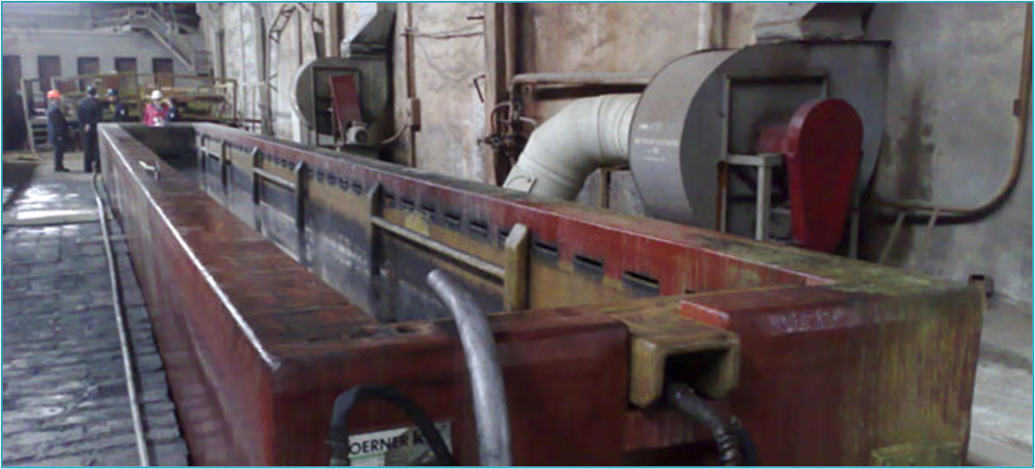
K-List: Specific Sources
K062: Spent pickle liquor generated by steel finishing operations
Notes:
The photo is an example of an K062 hazardous waste. Pickling is the removal of annealing oxides, mill scales, and chromium depleted zones. It is the final step in making stainless steel corrosion resistant.

Slide 56
P/U- Listed Wastes

Slide 57
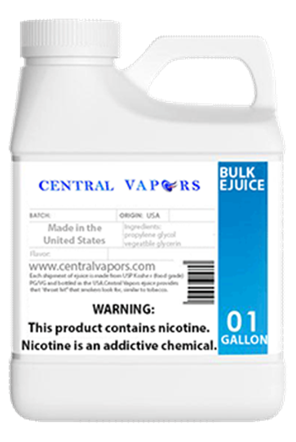
P/U-List: Discarded Commercial Chemical Products
These lists include pure or commercial grade formulations of specific unused chemicals [261.31]:
Unused chemical products
  Off-spec, unwanted, etc.
  Spills and associated debris
  Container residues
Does not include mixtures with more than one active ingredient
Acutely Hazardous (P-Listed)
Non-Acutely Hazardous (U-Listed)
Notes:
P and U wastes are products that have not been used that are to be discarded.

Slide 58



P/U-List: Discarded Commercial Chemical Products
Notes:
Distribution facilities or manufacturing facilities may generate damaged products or expired items
Commercial R&D Labs may have old chemicals
School labs have old chemicals

Slide 59

P/U-List: Discarded Commercial Chemical Products
Notes:
A community college that no longer performs experiments with these chemicals should do a hw det. on them.

Slide 60

P/U-List: Discarded Commercial Chemical Products
U-Listed waste on the ground
Notes:
A spill of a U waste should be managed as a U waste. May want to refer the cleanup to the FDEP waste cleanup or petroleum cleanup section.

Slide 61



P/U-List: Discarded Commercial Chemical Products
P/U-listed waste can be generated as a result of a laboratory clean-out or at hospitals/pharmacies.
Notes:
Common P wastes include some pharmaceuticals.

Slide 62


Unlisted: Discarded Commercial Chemical Products
A commercial chemical product may be characteristically hazardous even if it is unlisted.
Notes:
Off-spec or damaged items may be U or P hw, but they may also exhibit a characteristic and be D hw.

Slide 63
Listed Wastes – Additional Info
Each waste is listed for a reason. The hazard code is identified as follows:
  Ignitable Waste (I)
  Corrosive Waste (C)
  Reactive Waste (R)
  Toxicity Characteristic Waste (E)
  Acute Hazardous Waste (H)
  Toxic Waste (T)
The basis for the listing is in Part 261, Appendix VII, which identifies the constituents of the waste
  F006 – Cadmium, hex chromium, nickel, and cyanide
  K061 – Hex chromium, lead, and cadmium
Use 268.40 for LDR purposes

Slide 64
Listed Wastes – Additional Info
Mixture Rule:
A solid waste is a hazardous waste if it is a mixture of solid waste and one or more listed hazardous wastes [261.3(a)(2)(iv)]
Derived From Rule:
Unless and until it meets the criteria of 261.3(d), a hazardous waste will remain a hazardous waste [261.3(c)]
  Does not exhibit a characteristic [261.3(d)(1)]
  Successful petition to exclude or delist [261.3(d)(2)]

Slide 65

Process Unit – Blasting unit
This is a spent media collection container for a good-sized blasting unit.

Slide 66

Process Unit – Parts Washer
May or may not result in a hazardous waste
Capacity of the Unit?
What type of solvent?
What is washed?
Any other solvents in use?
How often is it emptied?
Notes:
The initial, unused parts washer solvent may be non-haz, but the spent solvent may be haz. Don’t forget about the filter. It may be haz.

Slide 67

Process Unit – Parts Washer
May or may not result in a hazardous waste
Different style than the previous unit, but essentially the same.

Slide 68

Waste vs. Empty Container

Slide 69

Waste vs. Empty Container
Certain conditions must exist in order for a container to be considered “RCRA empty” [261.7(b)(1)]:
Wastes have been removed using commonly employed practices for that type of container, e.g., pouring, pumping, and aspirating
- AND -
≤2.5-cm (1-inch) of residue remains
- OR –
≤3% by weight of the total capacity of the container remains if the container ≤119-gallons
- OR –
≤0.3% by weight of the total capacity of the container remains if the container is >119 gallons
Notes:
40 CFR 261.7(b)(1) A container or an inner liner removed from a container that has held any hazardous waste, except waste that is a compressed gas or that is identified as an acute hazardous waste listed in 261.31, 261.32, or 261.33(e) of this chapter is empty if: (i) All wastes have been removed that can be removed using the practices commonly employed to remove materials from that type of container, e.g., pouring, pumping, and aspirating, and (ii) No more than 2.5 centimeters (one inch) of residue remain on the bottom of the container or inner liner, or (iii) (A) No more than 3 percent by weight of the total capacity of the container remains in the container or inner liner if the container is less than or equal to 119 gallons in size; or (B) No more than 0.3 percent by weight of the total capacity of the container remains in the container or inner liner if the container is greater than 119 gallons in size.

Slide 70

Questions?

