Slide 1


Slide 2
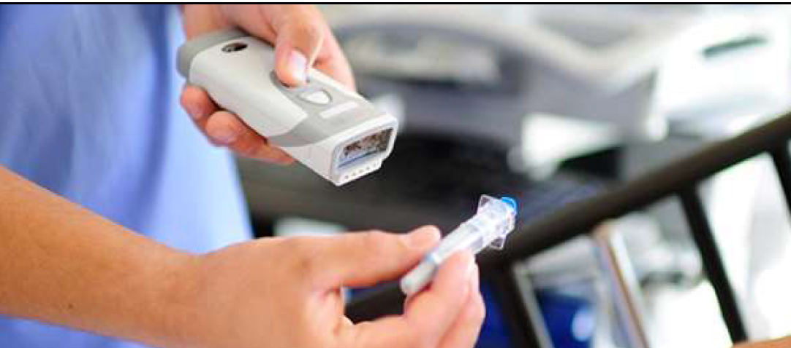
Subpart – p the rule!
Jessica Lopez Environmental Scientist III
Small Quantity Generator Program, Waste Division
Environmental Protection Commission of Hillsborough County
Lopezj@epchc.org

Slide 3
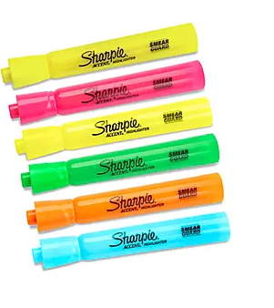

Highlights
The Rule
Definitions from this subpart (266.500)
    Healthcare
    Pharmaceuticals & the different types
    Empty containers (266.507)
    Nicotine changes.
    Conditional exemptions (266.506)
Prohibition of Sewering (266.505).
Applicability of the Rule (266.501)
  Requirements for VSG, those other than VSQGs.
VSQGs (266.504)
  Hazardous waste pharmaceuticals & non-pharmaceutical hazardous waste
Standards for Healthcare facilities managing hazardous waste pharmaceuticals.
  Noncreditable (266.502) & Potentially creditable (266.503)
Reverse Distributors (266.508, 266.509, 266.510)

Slide 4

The Rule
  Subpart P
  eCFR :: 40 CFR Part 266 Subpart P -- Hazardous Waste Pharmaceuticals
  Effective in the State of Florida on August 21, 2019.
  Florida Rule 62-730.186, FAC, Universal Pharmaceutical Waste, has been repealed.
  Hazardous Waste Pharmaceuticals (new acronym): PHARM
  The SQG Programs
  Implements specific industry & waste.
  Reduces the risk waste pharmaceuticals
  entering the environment.
RCRA Hazardous Waste Resources | McCoy White Papers (mccoyseminars.com)

Slide 5
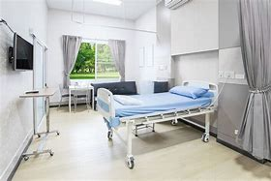
Definitions 266.500
Healthcare facility
Pharmaceutical (many types)
  Hazardous waste pharmaceutical
  Non-creditable hazardous waste pharmaceutical
  Potentially creditable hazardous waste pharmaceutical
  Evaluated hazardous waste pharmaceutical
  Non-hazardous waste pharmaceutical
  Household waste pharmaceutical
  Non-pharmaceutical hazardous waste
VSQs, SQGs,LQGs, Reverse Distributors
https://www.ecfr.gov/current/title-40/chapter-I/subchapter-I/part-266/subpart-P/section-266.500

Slide 6

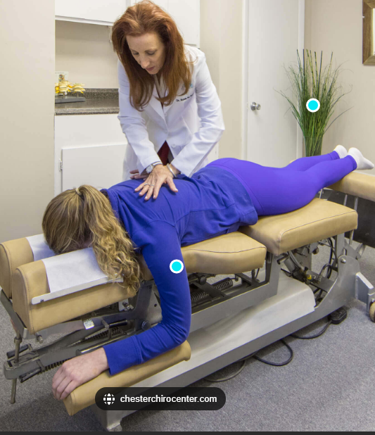
Defines Healthcare facility in 266.500 (1)(2)
Means any person that is lawfully authorized to
Provide
  Preventative
  Diagnostic
  Therapeutic
  Rehabilitative
  Maintenance
  Palliative care
  Counseling Service, assessment or procedure with respect to the physical or mental condition, or functional status…
    Human or animal or that affects the structure or function of the human or animal body…Or
Distribute, sell, or dispense
  Pharmaceuticals
  OTC pharmaceuticals
  Dietary supplements
  Homeopathic drugs
  Prescription pharmaceuticals

Slide 7
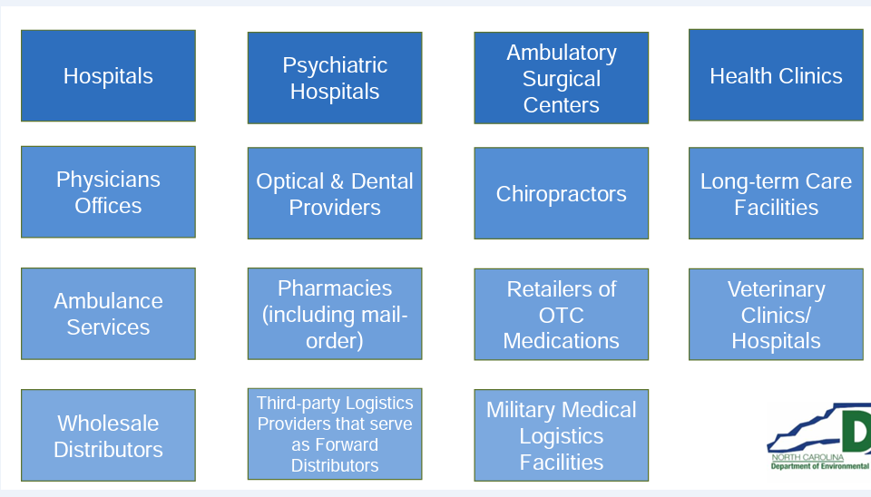
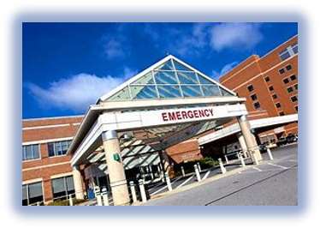
Examples of healthcare facilities

Slide 8

Definition of Healthcare facility does not include in 266.500(2)
Reverse distributors (subject to Subpart P)
Pharmaceutical manufacturers
Reverse logistics centers
40 CFR 266.500 “Healthcare facility”

Slide 9
Facilities other than healthcare in 266.501 - Applicability
Hazardous waste pharmaceuticals generated or managed by these entities:
Facilities Other than healthcare facilities
  Are NOT subject to this subpart.
  Subject to 40 CFR 262 for Hazardous Wastes including Hazardous Waste pharmaceuticals.

Slide 10
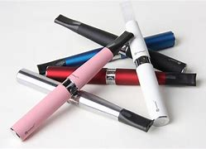
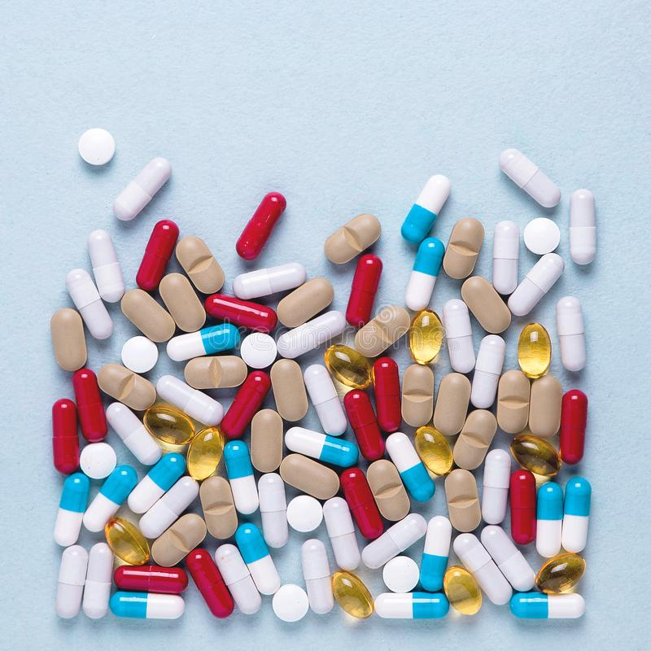
Defines Pharmaceutical in 266.500
Means
Any drug & Dietary supplement for use by humans or other animals .
Any electronic nicotine delivery system
  (electronic cigarette or vaping pen)
Any liquid nicotine/e-liquid packaged for retail sale for use in electronic nicotine delivery systems
  (pre-filled cartridges or vials).
Includes but not limited to…
  Dietary supplements
  Prescription drugs
https://www.ecfr.gov/current/title-40/chapter-I/subchapter-I/part-266/subpart-P

Slide 11
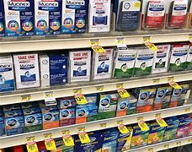
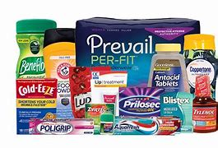
Pharmaceutical Definition continues 266.500
Investigational new drugs
Pharmaceuticals remaining in non-empty containers
PPE contaminated with pharmaceuticals
Clean-up material from spills of pharmaceuticals
Over-the-counter drugs
Homeopathic drugs
Compounded drugs

Slide 12

Defines hazardous waste pharmaceuticals in 266.500
  Hazardous waste pharmaceutical means
    Solid waste (261.2)
    Exhibits one or more characteristics identified in part 261subpart C or listed in part 261 subpart D.
    Non-creditable hazardous waste pharmaceutical
      Prescription hazardous waste pharmaceutical
        that does not get manufacturer credit.
      Nonprescription hazardous waste pharmaceutical
        that does not get use/reused or reclaimed
    Potentially creditable hazardous waste pharmaceutical
      Prescription hazardous waste pharmaceutical
        that has manufacturer credit.

Slide 13

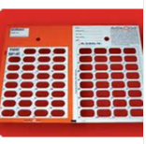
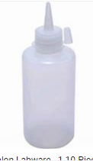
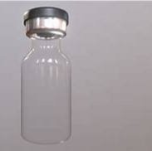
Defines Empty containers 266.507
Empty means:
  Pharmaceuticals have been removed from the container using the practices commonly used to remove materials from the type of containers.
Container means:
  Stock bottle, dispensing bottle, vial, or ampule ( not to exceed 1 liter or 10,0000 pills)
    Ex. Warfarin (P001) bottle, allows it to be discarded without triple rinsing provided certain criteria are met.
  Unit-dose container (i.e. unit-dose packet, cup, wrapper, blister pack, or delivery devise).
    Ex. Syringes: contents have been removed by fully depressing the plunger.
Notes:
Considered empty and the residues are not regulated as Hazardous Waste

Slide 14
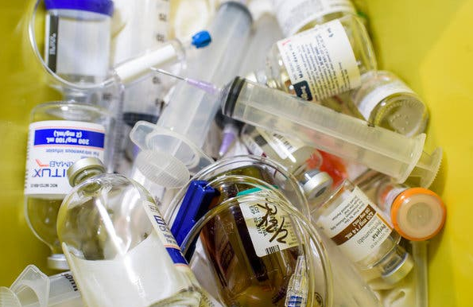
hazardous waste pharmaceuticals in ‘not so’ empty containers 266.507
Hazardous Waste Pharmaceutical residues
Syringes, Intravenous (IV) bags and Other containers, including delivery devices
  if it is NOT empty, unused, partially administered
    Must be placed with its remaining Hazardous Waste pharmaceutical into a container that is managed and disposed as:
    Non-creditable Hazardous Waste Pharmaceutical (266.507).

Slide 15
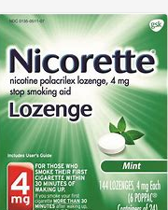
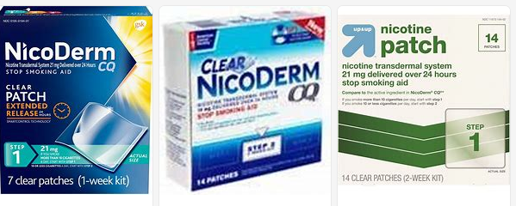
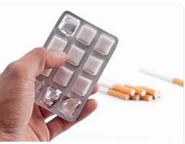
Pharmaceuticals with Nicotine
Hazardous Waste Pharmaceutical
  Nicotine continues to be a listed, acute hazardous waste with the hazardous waste code P075. (i.e., Prescription pharmaceutical).
Nonhazardous waste pharmaceutical
  Nicotine replacement therapies (i.e., Nonprescription nicotine patches, gums, and lozenges) are NO longer included in the P075 listing for nicotine and are no longer considered hazardous waste.
https://www.federalregister.gov/documents/2019/02/22/2019-01298/management-standards-for-hazardous-waste-pharmaceuticals-and-amendment-to-the-p075-listing-for
Notes:
Anyone who generates or manages discarded FDA-approved OTC nicotine replacement therapies (patches, gums, and lozenges) is also affected by the amended to P075 listing for nicotine that is also part of this final rule.

Slide 16

Defines nonhazardous pharmaceuticals that are also solid waste in 266.500
  Nonhazardous waste pharmaceutical
    Solid waste not listed and does not exhibit a characteristic (40 CFR 261).
    NOT subject to Hazardous Waste management (40 CFR Part 260 Subtitle C).
    A Healthcare facility may manage them according to Subpart P-266.502(c), 266.503(a).
  Household waste pharmaceutical (exclusion)
    Solid waste as defined in 40 CFR 261.2.
    But excluded from being a Hazardous Waste under own household HW exclusion (40 CFR 261.4(b)(1)).

Slide 17
Defines Nonhazardous pharmaceutical that are also not solid waste in 266.500
Used/Reused or Reclaimed pharmaceuticals = NOT SOLID WASTE = NOT HAZARDOUS WASTE
Defines Used/Reused or Reclaimed Pharmaceuticals as
  A pharmaceutical
    Not a solid waste, as defined in 261.2 and therefore not a hazardous waste pharmaceutical
    If, Legitimately used/reused (e.g. lawfully donated for its intended purpose) or reclaimed.
  An over-the-counter pharmaceutical, dietary supplement, or homeopathic drug
    Not a solid waste, as defined in 261.2, and therefore not a hazardous waste pharmaceutical
    Legitimately used/reused (e.g. lawfully redistributed for its intended purpose) or reclaimed.
    (definition found under the definition of Hazardous waste pharmaceutical!)

Slide 18

Hazardous waste pharmaceuticals conditionally exempt
ALSO are Controlled Substances/ Pharmaceuticals are Exempt from 40 CFR parts 262 through 273
  Hazardous Waste Pharmaceuticals listed on a schedule of controlled substances by the DEA (in 21 CFR part 138).
  Household Waste Pharmaceuticals that are collected in a take-back event, collected by an authorized collector that comingles with controlled substances.

Slide 19
Hazardous waste pharmaceuticals conditionally exempt requirements 266.506
266.506(a)(2) Conditional exemptions
Listed as controlled DEA substances.
Collected in a take-back event.
266.506(b) Conditions for exemption
Hazardous waste pharmaceuticals must be managed in a certain way.
  Sewer prohibition compliance (266.505).
  Collection & destruction according to DEA methods.

Slide 20
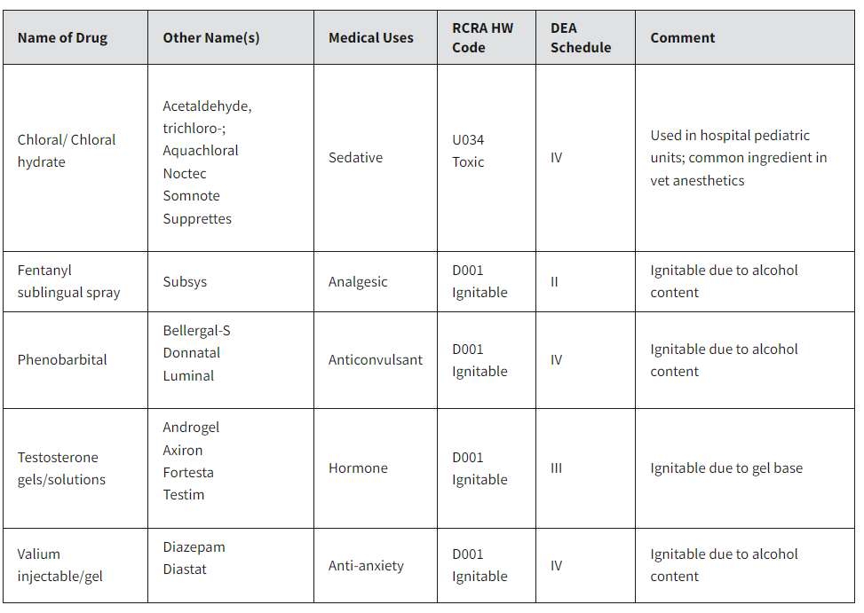
dea controlled substances
Conditionally exempted 266.506(a)
Notes:
EPA is aware of a handful of pharmaceuticals that are both a RCRA hazardous waste and a DEA controlled substance.
Here are some examples……

Slide 21
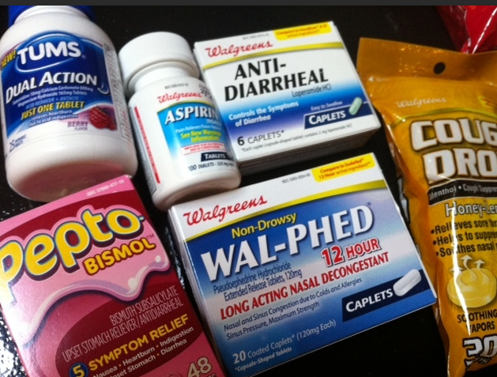

How the rule applies to pharmaceuticals –
NOT subject to hazardous waste management except as specified -266.501(g)
Pharmaceuticals not subject to 40 CFR 260 thru 273 Hazardous Waste Management
  Pharmaceuticals that are Not a Solid Waste because they are legitimately used/reused and reclaimed (261.2).
    Ex. nonprescription pharmaceuticals and unsold retail items (Mccoy’s)
  Over-the-counter (OTC) pharmaceutical & Dietary supplement, homeopathic drugs that are Not a Solid Waste that has reasonable expectation of being legitimately used/reused or reclaimed (261.2).
  Recalled pharmaceuticals during corrective action.
    It becomes HWPharms after it is sent for destruction.
  Part of court order or judicial proceedings and during investigation.
    Until after the order a decision is made to discard.
  Investigational new drugs during investigation.
    Until a decision is approved for destruction.
  Household waste pharmaceuticals including:
    Those collected in a take back event and complies with conditional exemption.
https://www.ecfr.gov/current/title-40/chapter-I/subchapter-I/part-261/subpart-A/section-261.2
https://www.ecfr.gov/current/title-40/chapter-I/subchapter-I/part-266/subpart-P

Slide 22

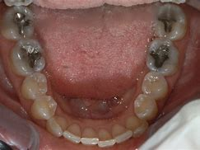
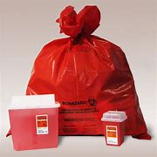
Pharmaceutical does not include
Dental amalgam
Sharps

Slide 23
Applicability 266.501(a-g)
Who is considered a Very Small Quantity Generator (VSQG) including Long-term care facilities (266.501 (a)(b)).
  Their requirements.
Facilities other than VSQGs: SQGs and LQGs (266.501 (c)(d)).
  Their requirements.
Reverse Distributors (266.501(c)(e)).
  Their requirements.
Facilities Other than health care (mentioned in previous slide)(266.501 (f)).
Pharmaceuticals not subject to definition of solid waste (266.501(g))
  (mentioned in previous slides).

Slide 24
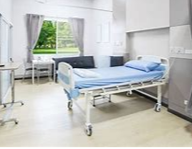
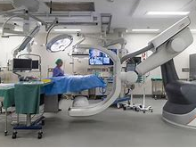
Facilities that are affected by subpart - p
All Healthcare facilities
Very Small Quantity Generators
Small Quantity And Large Quantity Generators
Reverse Distributors

Slide 25
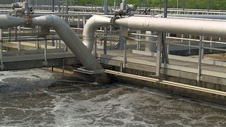
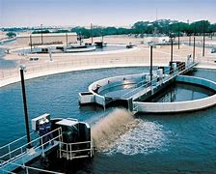
Sewering prohibition 266.505
All healthcare facilities are prohibited from discharging
Hazardous Waste Pharmaceuticals to a sewer system that passes through to publicly-owned treatment works (POTW) including:
VSQGs
Reverse distributors
SQGs and LQGs

Slide 26

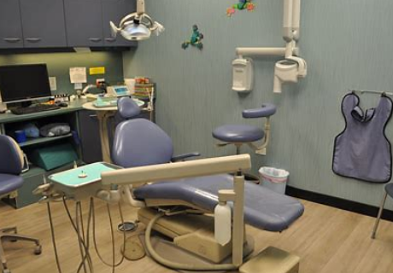
How the rule appies to Very small quantity generator (VSqg) in 266.501(a)(b)

Slide 27
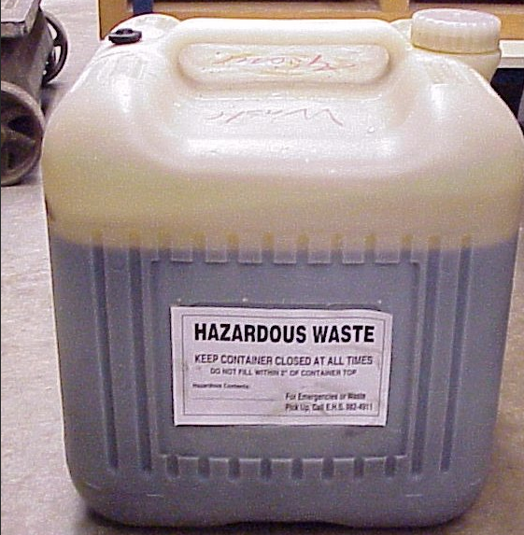
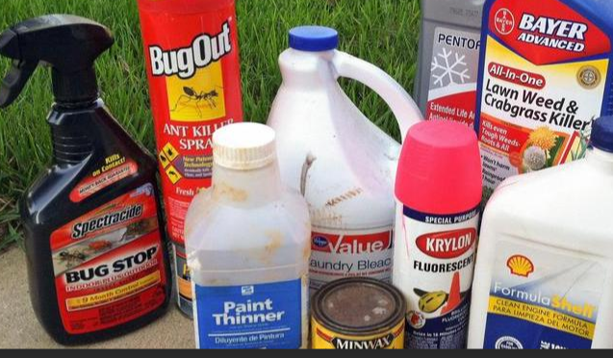
Determining a Vsqg first
A healthcare facility considered a VSQG for Non-pharmaceutical hazardous waste management.
  -Generates less than 220 lbs of non-acute hazardous waste in a calendar month (per 261.31 or 261.33).
  -Generates less than 2.2 lbs of acute hazardous waste listed in 261.31 or 261.33 per a calendar month.
Notes:
WHO IS A VSQG

Slide 28
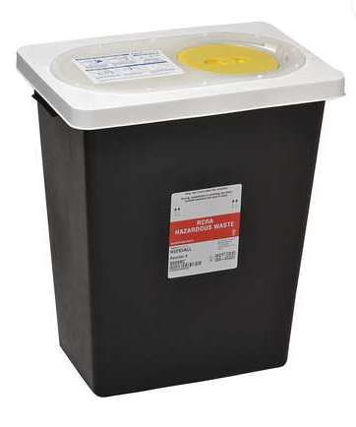
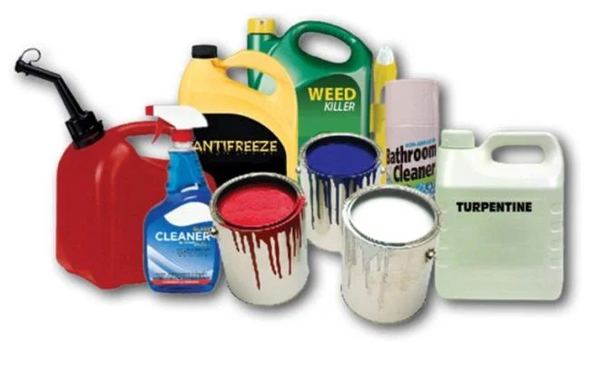
VSQGs are subject to 40 CFR 262.14
When counting all of its Hazardous Waste remain subject for:
  Hazardous waste pharmaceuticals.
  Non-pharmaceutical hazardous waste.
https://www.ecfr.gov/current/title-40/chapter-I/subchapter-I/part-262/subpart-A/section-262.14

Slide 29
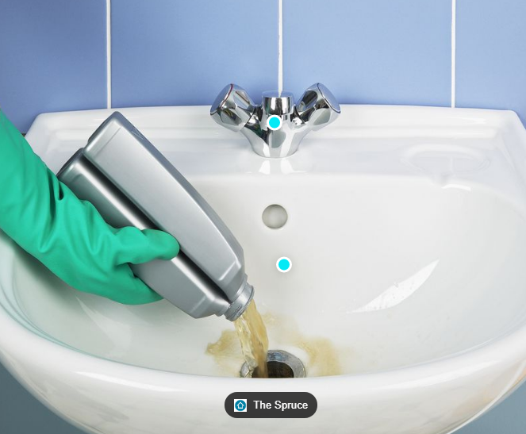
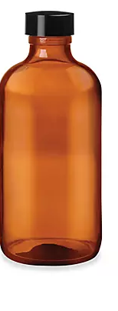
Vsqgs in 266.501(a)(b)
VSQGs are NOT subject to Subpart P EXCEPT for the following:
266.505 - The sewering prohibition of hazardous waste pharmaceuticals. None down the drain
266.507 - Properly manage residues of hazardous waste pharmaceuticals in empty containers.
266.504 - The optional provisions of VSQGs to opt-in to Subpart P .
  266.504(a) May send HW pharmaceuticals and non-pharmaceuticals HW that are potentially creditable HW pharm to a reverse distributor.
  266.504(b)May send their Hazardous waste pharmaceuticals and non- pharmaceutical Hazardous waste to an off-site healthcare facility.
https://www.ecfr.gov/current/title-40/chapter-I/subchapter-I/part-266/subpart-P

Slide 30
Long-term care facilities in 266.504
266.504(c) – Long-term care facilities that are VSQGs
Standard on how to manage both HWPharms and non-pharmaceutical hazardous waste.
266.504 (d) – Long-term care facilities with 20 beds or fewer.

Slide 31
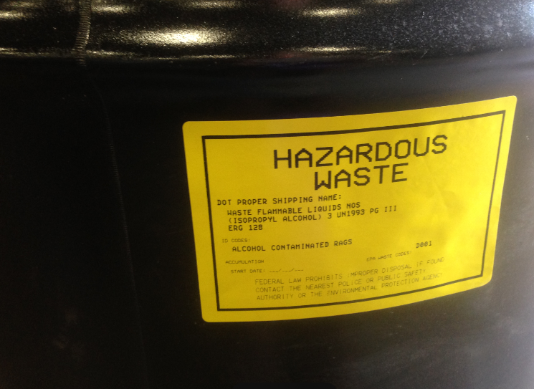
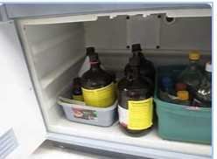
VSQGs & Episodic generation provision of
40 cfr 262 Subpart L
VSQGs
  A healthcare facility that is a VSQG for both HWPharms and nonpharmaceutical hazardous waste can use the episodic generation provision (Part 262, Subpart L) for all of its hazardous waste, including its HWPharms.
    CAN NOT be operating under Subpart P can use episodic generation.
No to SQGs and above
  A healthcare facility operating under Subpart P for its HWPharms
  May NOT use the episodic generator standards of part 262 Subpart I with respect to its HW Pharms.
https://www.ecfr.gov/current/title-40/chapter-I/subchapter-I/part-262/subpart-L
Notes:
Only VSQGs are allowed.

Slide 32
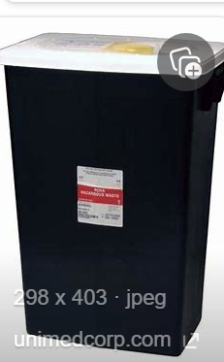

How the rule applies to
Facilities fully subject to subpart p

Slide 33
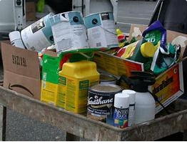
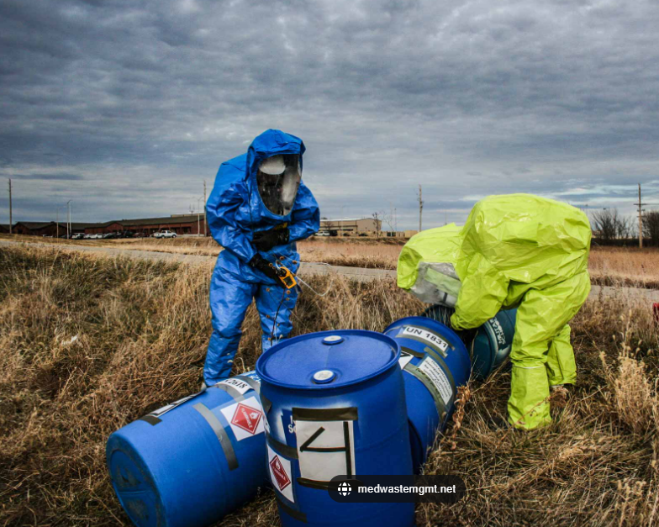

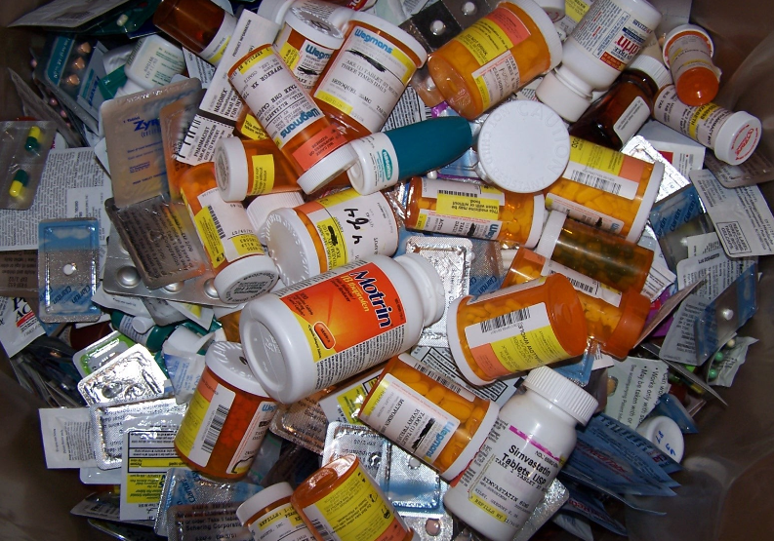
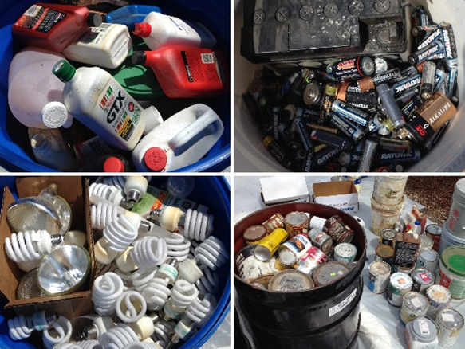
Small Quantity Generators (SQG)
Large Quantity Generators (LQG)
&
Reverse Distributors (RD)

Slide 34
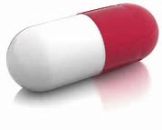
Defines Reverse distributors in 266.500
Anyone that receives prescription pharmaceuticals that are
potentially creditable hazardous waste pharmaceuticals
for the purposes of facilitating or verifying manufacturer credits.
Depending on the functions performed, this could include:
    Forward distributors (drug wholesalers and distributors)
    Manufacturers
    Third-party logistics
Notes:
Not defined as Healthcare as defined in Subpart P.
However…
Subpart P defines Reverse Distributors
and defines Specific sections on this Rule!
266.506
266.507
266.508
266.509

Slide 35
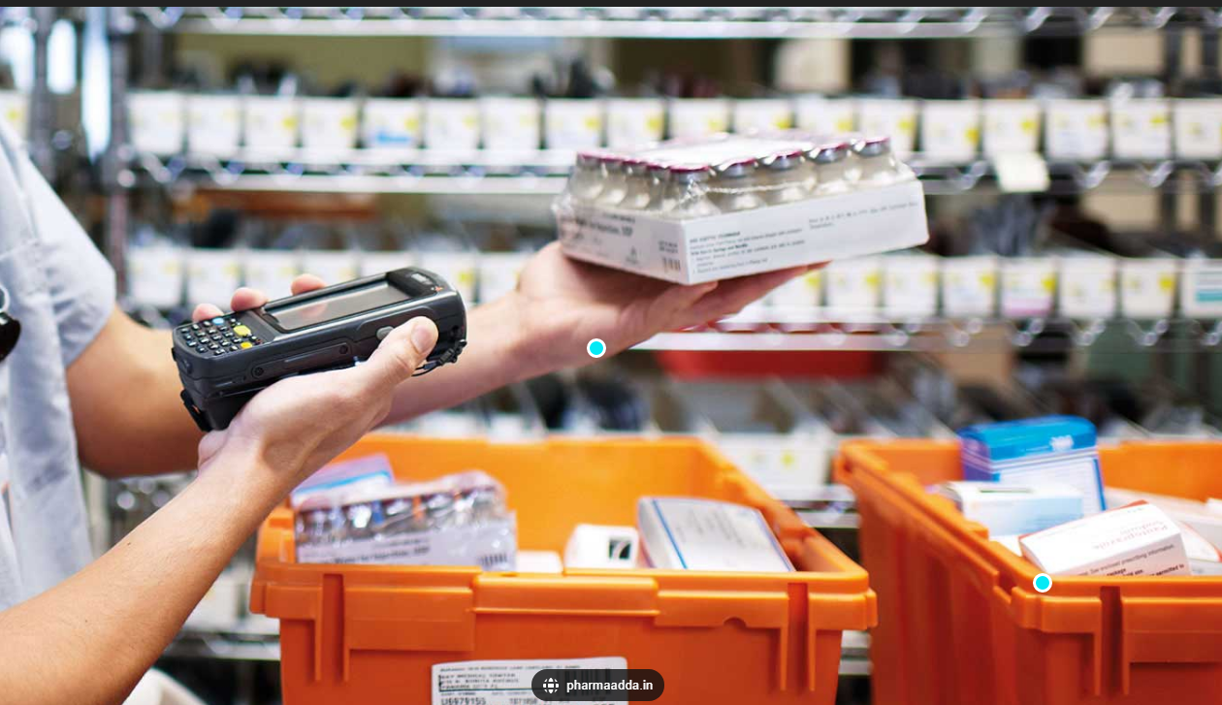
Reverse Distributors
& their requirements
How the rule applies
266.501 Applicability
Requirements:
266.508 Shipping “FROM A” reverse distributor.
266.509 Shipping “TO A” reverse distributor.
266.510 Standards “AT A” reverse distributor.

Slide 36
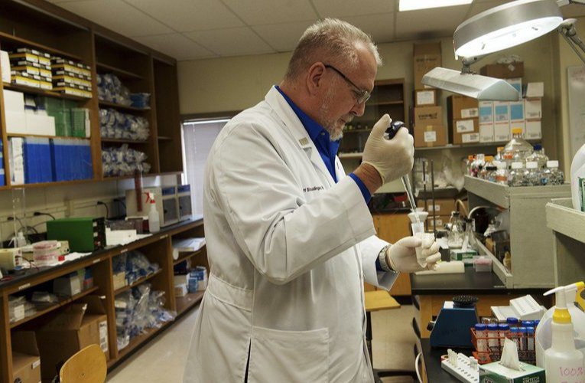
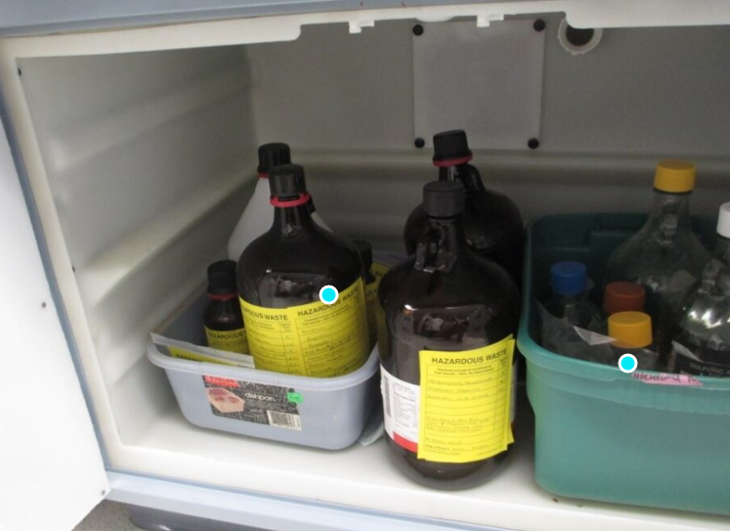
Determining SQgs & LQGs first
Healthcare facility considered SQG and LQG generators for their
Non-pharmaceutical hazardous waste management
  -Generates more than 100-kg(220-lbs) of non-acute hazardous waste in a calendar month.
  -Generates 2.2 lbs of acute hazardous waste listed in 261.31 or 261.33 in a calendar month.
  -Generates 220 lbs of any residue or contaminated soil, waste, or other debris from a cleanup of pharmaceuticals.
Opting out of Subpart P in favor of traditional hazardous waste
management under Part 262 is NOT an option.

Slide 37
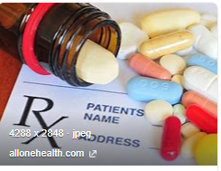
How the rule applies to healthcare facilities such as sqgs, & lqgs in 266.501(d)(1)(2)
With the exception of VSQG, a healthcare facility is subject to the following:
For the management of
  Non-creditable hazardous waste pharmaceuticals
Directly to a TSD facility & more stringent Subpart P.
  Potentially creditable hazardous waste pharmaceuticals
1. If they are not destined for a reverse distributor(266.502,266.505,266.508).
  Potentially creditable hazardous waste pharmaceuticals (prescription) 266.501(d)(2)
2. If destined for a reverse distributors (266.502(a), 266.503, 266.505, 266.507, 266.509)

Slide 38

Managing Non-creditable hazardous waste pharmaceutical 266.502

Slide 39
Defines Non-creditable hwpharms 266.500
DOES NOT GET CREDIT/ DOES NOT GET USED/REUSED OR RECLAIMED
Prescription hazardous waste pharmaceutical that does not have a reasonable expectation to be eligible for manufacturer credit or a
Nonprescription hazardous waste pharmaceutical that does not have a reasonable expectation to be legitimately used/reused or reclaimed.
This includes but is not limited to:
investigation drugs
free samples of pharmaceuticals received by healthcare facility
residues of pharmaceuticals remaining in empty containers
contaminated PPE
floor sweeping
cleanup material from spills of pharmaceuticals.

Slide 40
Applicable rules 266.501(d)(1)
Noncreditable & Potentially Creditable HWPharms NOT DESTINED to a Reverse Distributor
266.502 – Standards for managing non-creditable HWPharms
266.505 – Sewer Prohibition
266.508 – Shipping non-creditable & evaluated HWPharms from a RD

Slide 41
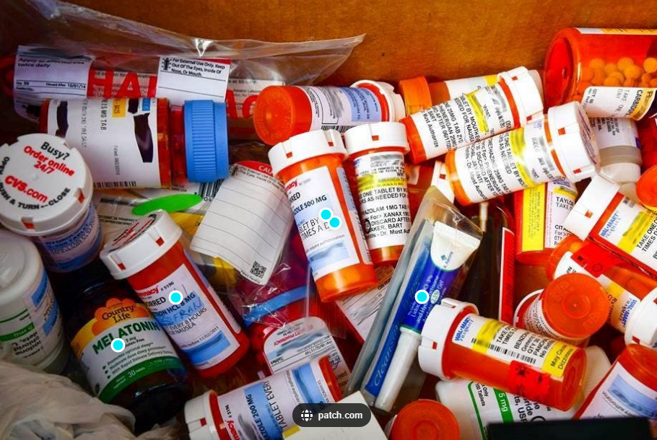
Non-creditable hwpharm 266.502 requirements
Must
Perform hazardous Waste Determination for non-creditable pharmaceuticals.
Notify using the EPA form 8700-12.
Ensure training of personnel.
Store in a container that is: Structurally sound, compatible with its contents and lacks evidence of leakage, spillage, or damage that could cause leakage under reasonably conditions.
Labeling containers.
Maximum accumulation of 1 year or less without a permit.
Land disposal restrictions.
Manage rejected shipments of non-creditable hazardous waste pharmaceuticals.
Reporting: Not subject to biennial reporting under 262.41 with respect to non-creditable HWPharms managed under Subpart P.
Record Keeping: keep manifest for a minimum of 3 years.
Response to spills.
Accepts non-creditable HWPharms from VSQGs (266.504).

Slide 42
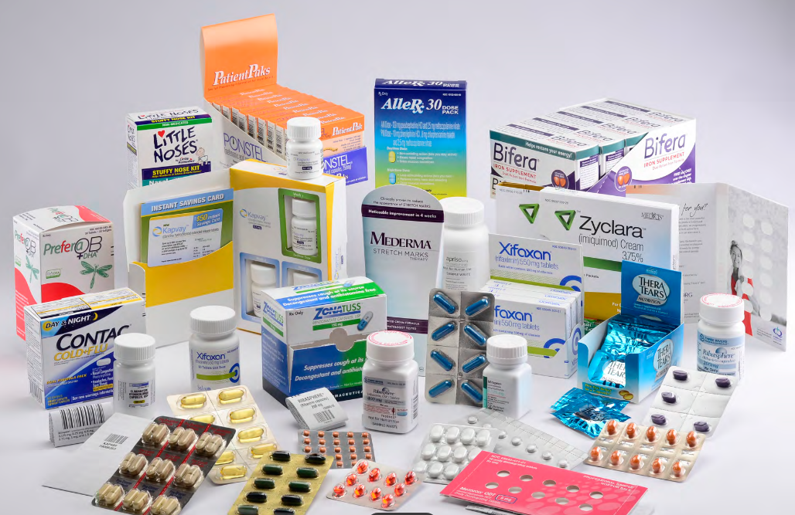
Potentially creditable hazardous waste pharmaceuticals 266.503

Slide 43
Defines potentially creditable hwpharms 266.500
DOES GET CREDIT
Prescription hazardous waste pharmaceutical that has a reasonable expectation to receive manufacturer credit and is
In original manufacturer packaging.
Undispensed.
Unexpired or less than 1 year past expiration date.
Does not include
  Evaluated hazardous waste pharmaceutical
    (Prescription HWPharm evaluated by RD & will not be sent to another RD) or…
  Nonprescription pharmaceuticals
    (these can be reused=not solid waste, or sent as non-creditable..JLopez):
    OTC drugs
    homeopathic drugs
    dietary supplements

Slide 44

potentially creditable-Hazardous waste pharmaceuticals 266.503
Must
  Perform waste determination.
  May accept potentially creditable HWPharms from VSQGs (266.504).
  Prohibited from sending hazardous waste other than potentially creditable hazardous waste pharmaceuticals to a Reverse Distributor.
  Not subject to biennial reporting requirements.
  Recordkeeping
    To a reverse distributor: Keep for 3 years from the date of shipments and the confirmation of delivery.
    Be available upon request by an inspector.

Slide 45
Applicable rules
Only Potentially creditable Prescription HWPharms IF DESTINED FOR A Reverse Distributor
(YES! To RD)
266.502(a) Notification, Withdrawal
266.503 – Standards for Hazardous Waste Pharmaceuticals
266.505 – Sewer Prohibition
266.507 – Residues of Hazardous Waste Pharmaceuticals in empty containers
266.509 – Shipping to a reverse distributor

Slide 46
Applicable rules
Potentially creditable Prescription HWPharms NOT DESTINED for a Reverse Distributor.
266.502 – Standards for managing non-creditable HWPharms
266.505 – Sewer Prohibition
266.508 – Shipping requirements

Slide 47

The rule – the end! ☺
Resources & Credits
The Rule:
eCFR :: 40 CFR Part 266 Subpart P -- Hazardous Waste Pharmaceuticals
Frequent Questions about the Management Standards for Hazardous Waste Pharmaceuticals and Amendment to the P075 Listing for Nicotine Final Rule | US EPA
FDEP’s Pharmaceutical Waste Management for Businesses website: https://floridadep.gov/waste/permitting-compliance-assistance/content/pharmaceutical-waste-management-businesses-and
McCoy’s White Paper Guide to New Hazardous Waste Pharmaceutical Regs
FDEP’s Subpart P Handouts:
Subpart P FAQs - Healthcare Retailers | Florida Department of Environmental Protection
Subpart P FAQs - Medical Providers | Florida Department of Environmental Protection
Subpart P FAQs - Reverse Distributors | Florida Department of Environmental Protection
EPC Handout: List of Potentially Hazardous Waste Pharmaceuticals when Discarded.
This Photo by Unknown Author is licensed under CC BY

Slide 48
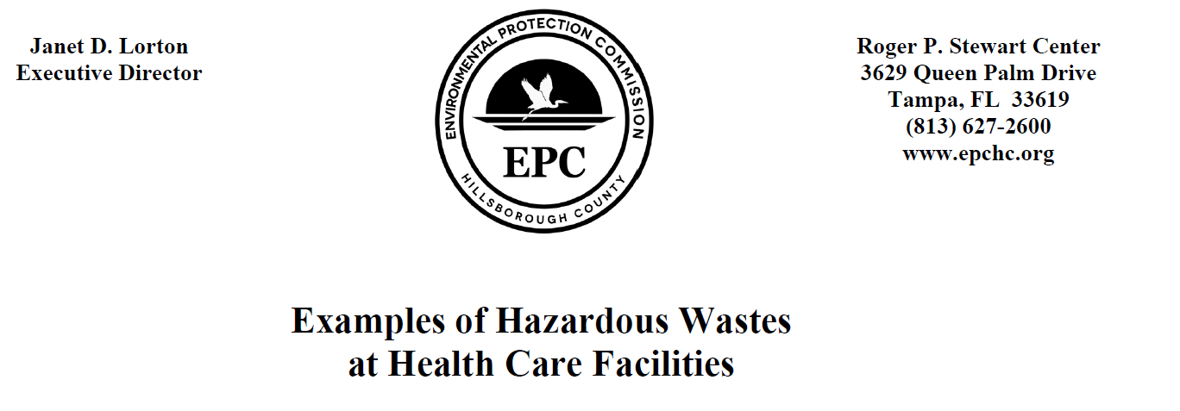
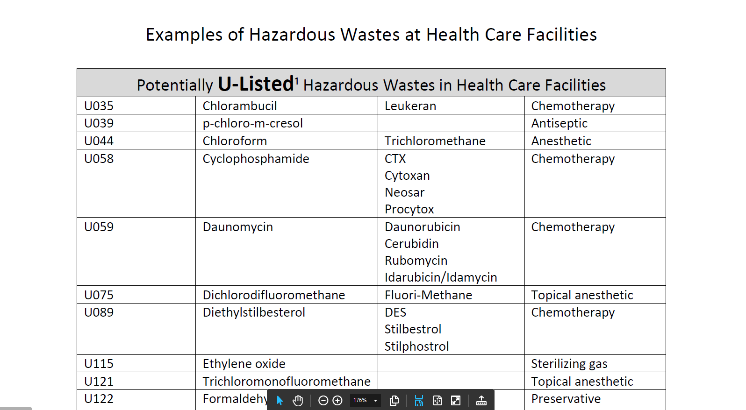

Slide 49
