Slide 1


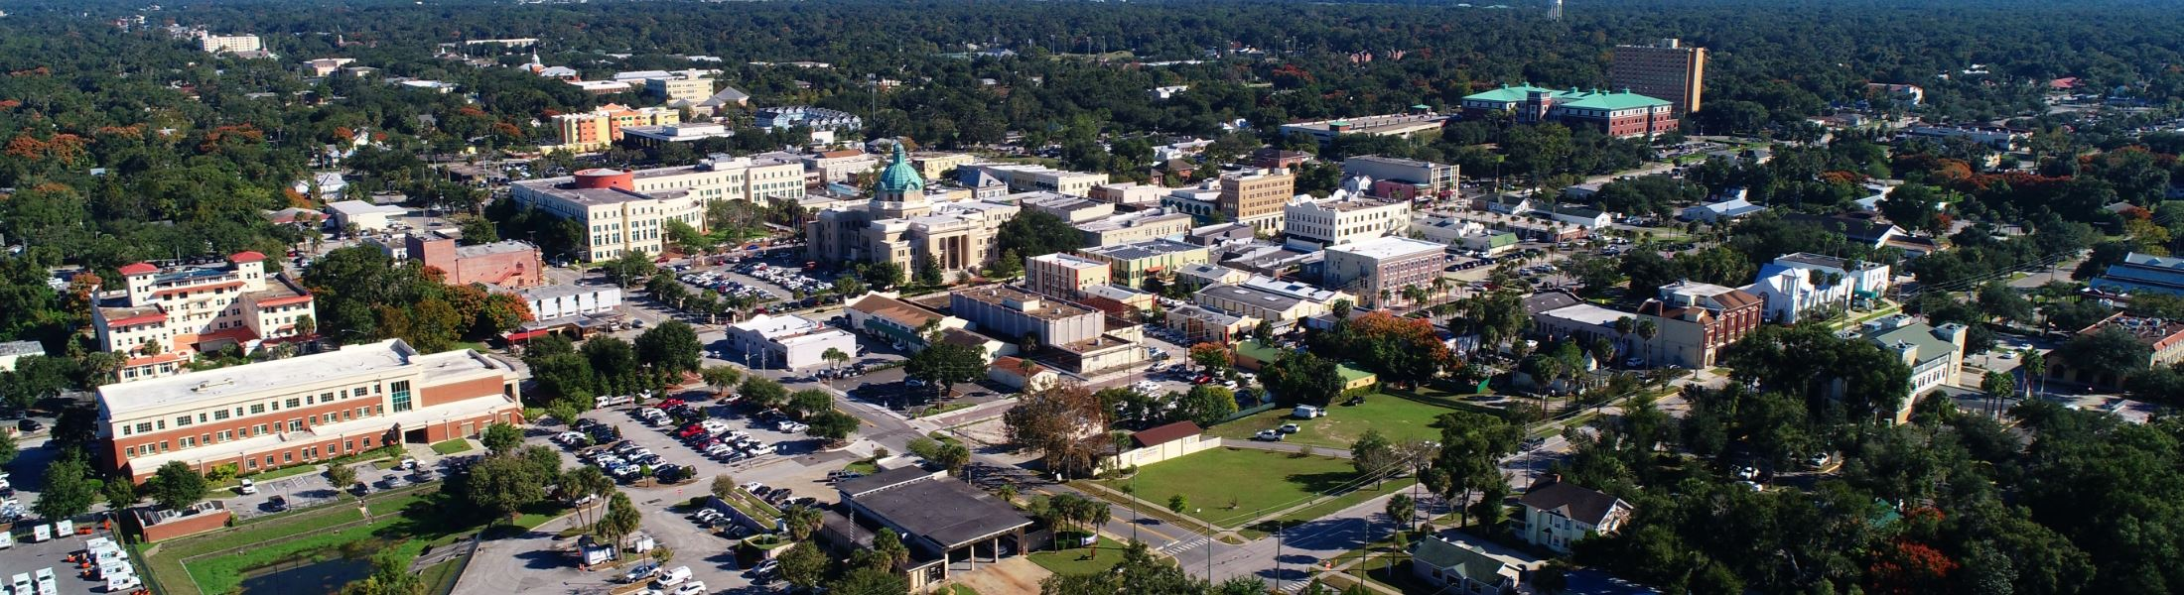
NAHMMA Florida Chapter Workshop
So, You Found an SQG—Now What?
May 15, 2023

Slide 2
Originally prepared by :
Andrea.Stermer@ncdenr.gov
919-270-3871
Updated by Sondra McCulloch
Environmental Specialist II
Volusia County Environmental Management
smcculloch@volusia.org
386-736-5927, Ext 12074

Slide 3
Topics
What is a Small Quantity Generator (SQG)?
Very Small Quantity Generator (VSQG) regulations versus SQG
SQG regulatory requirements, including:
  Documentation required
  Emergency Preparedness and Prevention
  Container Management (including Satellite vs. Central Accumulation Areas or Hubs)
Notes:
What is a Small Quantity Generator (SQG)?
We are going to compare Very Small Quantity Generator (VSQG) regulations versus SQG
We will look at SQG regulatory requirements, including documentation required, Emergency Preparedness and Prevention, and Container Management (including Satellite vs. Central Accumulation Areas or Hubs)

Slide 4
Not Included in the Presentation
Does not include every SQG requirement (but most are covered)!
Does not include regulations pertaining to tanks, drip pads, or containment buildings
Does not have the episodic generation requirements (40 CFR 262.16(f))
Notes:
We are not going to cover in this session every SQG requirement, especially due to time constraints. We will not include regulations pertaining to tanks, drip pads, or containment buildings or discuss episodic generation requirements.

Slide 5
What is a Small Quantity Generator?
40 CFR 260.10
A facility will be a SQG if they:
  Generate more than 220 pounds but less than 2,200 pounds of non-acute hazardous waste in a calendar month* and
  Less than or equal to 2.2 pounds of acute hazardous waste and
  Less than or equal to 220 pounds of any residue or contaminated soil, water, or other debris resulting from the cleanup of a spill, into or on any land or water, of any acute hazardous waste listed in §261.31 or §261.33(e)
  If a VSQGs accumulates more than 2,200 pounds of hazardous waste at any time it will now be an SQG
  *Note: This can also happen if a facility does a chemical cleanout and exceeds the generation amount that is allowed in a calendar month unless approved for episodic event.
Notes:
What is a Small Quantity Generator? A facility will be a SQG if they: Generate more than 220 pounds but less than 2,200 pounds of non-acute hazardous waste in a calendar month* and Less than or equal to 2.2 pounds of acute hazardous waste and Less than or equal to 220 pounds of any residue or contaminated soil, water, or other debris resulting from the cleanup of a spill, into or on any land or water, of any acute hazardous waste listed in §261.31 or §261.33(e)
If a VSQGs accumulates more than 2,200 pounds of hazardous waste at any time it will now be an SQG *Note: This can also happen if a facility does a chemical cleanout and exceeds the generation amount that is allowed in a calendar month unless approved for episodic event.

Slide 6

vs.
VSQG
SQG
Requirement | Very Small Quantity Generator (VSQG) | Small Quantity Generator (SQG)
Notify of HW activity and obtain EPA ID number | Not required | Required (40 CFR 262.18(a) and (b))
Re-notification of HW activity | Not required | Every 4 years starting in 2021 (40 CFR 262.18(d)(1)
Maximum accumulation time limits | No time limit | 180 days in CAA (270 days if waste is shipped 200 miles or more) (40 CFR 262.16(b) through (d)
Maximum on-site waste accumulation | 2,200 pounds non-acute at any time | 13,200 pounds at any time (40 CFR 262.16(b)(1))
Hazardous waste determination | Required (40 CFR 262.11(a) through (d)) | Required (40 CFR 262.11)
Marking/labeling containers/tanks | Not required (recommended to identify content) | Required on each container and tank (40 CFR 262.15)
Accumulation start date marking/labeling | Not required | Date must be visible for inspection on each CAA container or log for tanks (40 CFR.16(b))
Notes:
There are also requirements for HW tanks, but they are not covered in this presentation.

Slide 7
vs.
VSQG
SQG
Requirement | Very Small Quantity Generator (VSQG) | Small Quantity Generator (SQG)
Use of manifest to ship waste off-site | Not required (but documentation of proper disposal required by F.A.C. in Florida) | Required (40 CFR 262.20-262.23)
Use transporters with EPA ID numbers | Not required | Required (40 CFR 262.18(c))
Prepare LDR notification/certifications | Not required | Required (40 CFR 262.16(b)(7) ref. 40 CFR 268)
Exception reports | Not required | Required (40 CFR 262.42(b))
Waste minimization | Not required | Good faith effort required (40 CFR 262.27(b))
Personnel training | Not required | Basic training required (40 CFR 262.16(b)(9)(iii))
Emergency Preparedness and Prevention including emergency arrangements | Not required | Required (40 CFR 262.16(b)(8) and (9)) and 62-730.160(4), F.A.C (Florida))

Slide 8
vs.
VSQG
SQG
Requirement | Very Small Quantity Generator (VSQG) | Small Quantity Generator (SQG)
Contingency plan and emergency procedures | Not required | Basic planning required (40 CFR 262.16(b)(9))
Weekly inspections | Not required | Required for CAAs (40 CFR 262.16(b)(2)(iv); 62-730.160(3) F.A.C.
Maintain records, prepare/file records | Disposal records required in Florida (62-730.030(2)), FAC (Not required by federal regulations) | Required (40 CFR 262.11(f), 262.40(a, c, d), 262.42(b), 262.43, 262.44)
Allowable classes of facilities to receive off-site shipment | Permitted or interim status HW facilities HW recycling facilities State-permitted, licensed, or registered municipal or industrial waste facilities 40 CFR 262.14(a)(5) A LQG under the control of the same person as VSQG must meet conditions in 40 CFR 262.14(a)(5)(viii) HHW with VSQG authorization | Permitted or interim status HW facilities HW recycling facilities 40 CFR 260.10 “Designated Facility”

Slide 9
Hazardous Waste Determination
40 CFR 262.11(a-e)
A person who generates a solid waste must make a determination if the waste is hazardous or not at the point of waste generation, before any dilution, mixing, or alteration in any manner – whether it is intentional or as exposure to the environment or other factors which might change the RCRA classification.
Knowledge of the waste may be used for this determination. This needs to include the origin, composition, process, and if any hazardous waste characteristics are present.
If the waste is listed as hazardous, a delisting petition may be filed.
Determination procedure needs to be documented in the records for this waste.
Notes:
A person who generates a solid waste must make a determination if the waste is hazardous or not at the point of waste generation, before any dilution, mixing, or alteration in any manner – whether it is intentional or as exposure to the environment or other factors which might change the RCRA classification. An example of this would be a fiberglass boat or pool manufacturer allowing styrene-based products to air dry and then claiming it is not hazardous since it is a nonhazardous solid. This product is hazardous as a liquid at the point of waste generation due to the properties of styrene and needs to be stored in a closed drum or container and not allowed to harden by venting to the surrounding atmosphere, commonly called a hotbox in the industry.
Besides using Safety Data Sheets, knowledge of the waste may be used for this determination. This needs to include the origin, composition, process, and if any hazardous waste characteristics are present.
If the waste is listed as hazardous, a delisting petition may be filed. I have never encountered this. Has anyone here ever worked with a company that has filed a petition?
Determination procedure needs to be documented in the records for this waste.

Slide 10
Hazardous Waste Determination
40 CFR 262.11(f)
The records must include (but are not limited to):
The results of any tests, sampling, waste analyses
Records documenting the tests, sampling and analytical methods used to demonstrate the validity/relevance of such tests;
Records are consulted in order to determine the process by which the waste was generated, the composition of the waste and the properties of the waste; and
Records which explain the knowledge basis for the generator's determination as described in paragraph (d)(1) of 40 CFR 262.11.
Keep records for 3 years from the last date of shipment.
Notes:
The records must include (but are not limited to):
The results of any tests, sampling, waste analyses
Records documenting the tests, sampling and analytical methods used to demonstrate the validity/relevance of such tests;
Records are consulted in order to determine the process by which the waste was generated, the composition of the waste and the properties of the waste; and
Records which explain the knowledge basis for the generator's determination as described in paragraph (d)(1) of 40 CFR 262.11.
These records must be kept for a minimum of 3 years from the last date of shipment. I typically let the businesses know that three years is a minimum, so that if the rules change, they will be prepared. Even FDEP’s site uses the phrase of a minimum of three years.

Slide 11
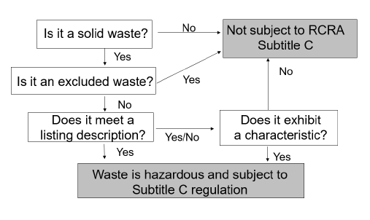
Perform Proper HW Determination
40 CFR 262.11
Notes:
It is the generator’s responsibility to perform a proper waste determination. These are the 4 questions that should be asked, in this order.
Question 1 – is it a solid waste—can be liquid, gas, or solid (there are a few exclusions from the definition of a SW like certain materials recycled in a certain manner—use/reuse); Question 2 – it is exempt (e.g. HHW); Question 3 – Is it listed 261.31-261.33 has the F, K, U, P lists; Question 4 – is it characteristic (ignitable, corrosive, reactive, toxic). They should keep documentation on waste determinations. Can be generator knowledge, might be able to use SDSs, but may need analytical testing, such as a TCLP. For those that are new, TCLP stands for Toxic Characteristic Leaching Procedure. Both TCLP and Waste Extraction Test (WET) are test methods used in certain states, like California, to determine whether a waste is a toxic hazardous waste.

Slide 12
EPA Identification Numbers
40 CFR 262.18(a-c)
A generator must not treat, store, dispose of, transport, or offer for transportation, hazardous waste without having received an EPA identification number from the EPA Administrator.
Once received, the EPA ID number will remain with the property and not be given to the hazardous waste transporter or any other facility that may not have their own ID number.
Notes:
A generator must not treat, store, dispose of, transport, or offer for transportation, hazardous waste without having received an EPA identification number from the EPA Administrator.
Once received, the EPA ID number will remain with the property and not be given to the hazardous waste transporter or any other facility that may not have their own ID number.
Only a VSQG does not need an EPA ID number unless they are doing episodic generation. A SQG cannot handle HW unless they have an EPA ID number.

Slide 13
Re-notification Requirements
40 CFR 262.18 (d)
  SQGs must renotify FDEP every four years by September 1st of each year the re-notification is required
  Florida Administrative Code Application link:
  https://www.flrules.org/gateway/reference.asp?No=Ref-02074
  FDEP Hazardous Waste Regulation Page:
  https://floridadep.gov/waste/permitting-compliance-assistance/content/summary-hazardous-waste-regulations
  EPA Guidance Document:
    https://www.epa.gov/hwgenerators/re-notification-requirement-small-quantity-generators
Notes:
SQGs must renotify FDEP every four years by September 1st of each year the re-notification is required. In Florida, we have the ability to file directly with Florida DEP instead of EPA for the renotification. EPA states on their site that if it is offered in the individual state, to do that instead of filing through EPA.

Slide 14
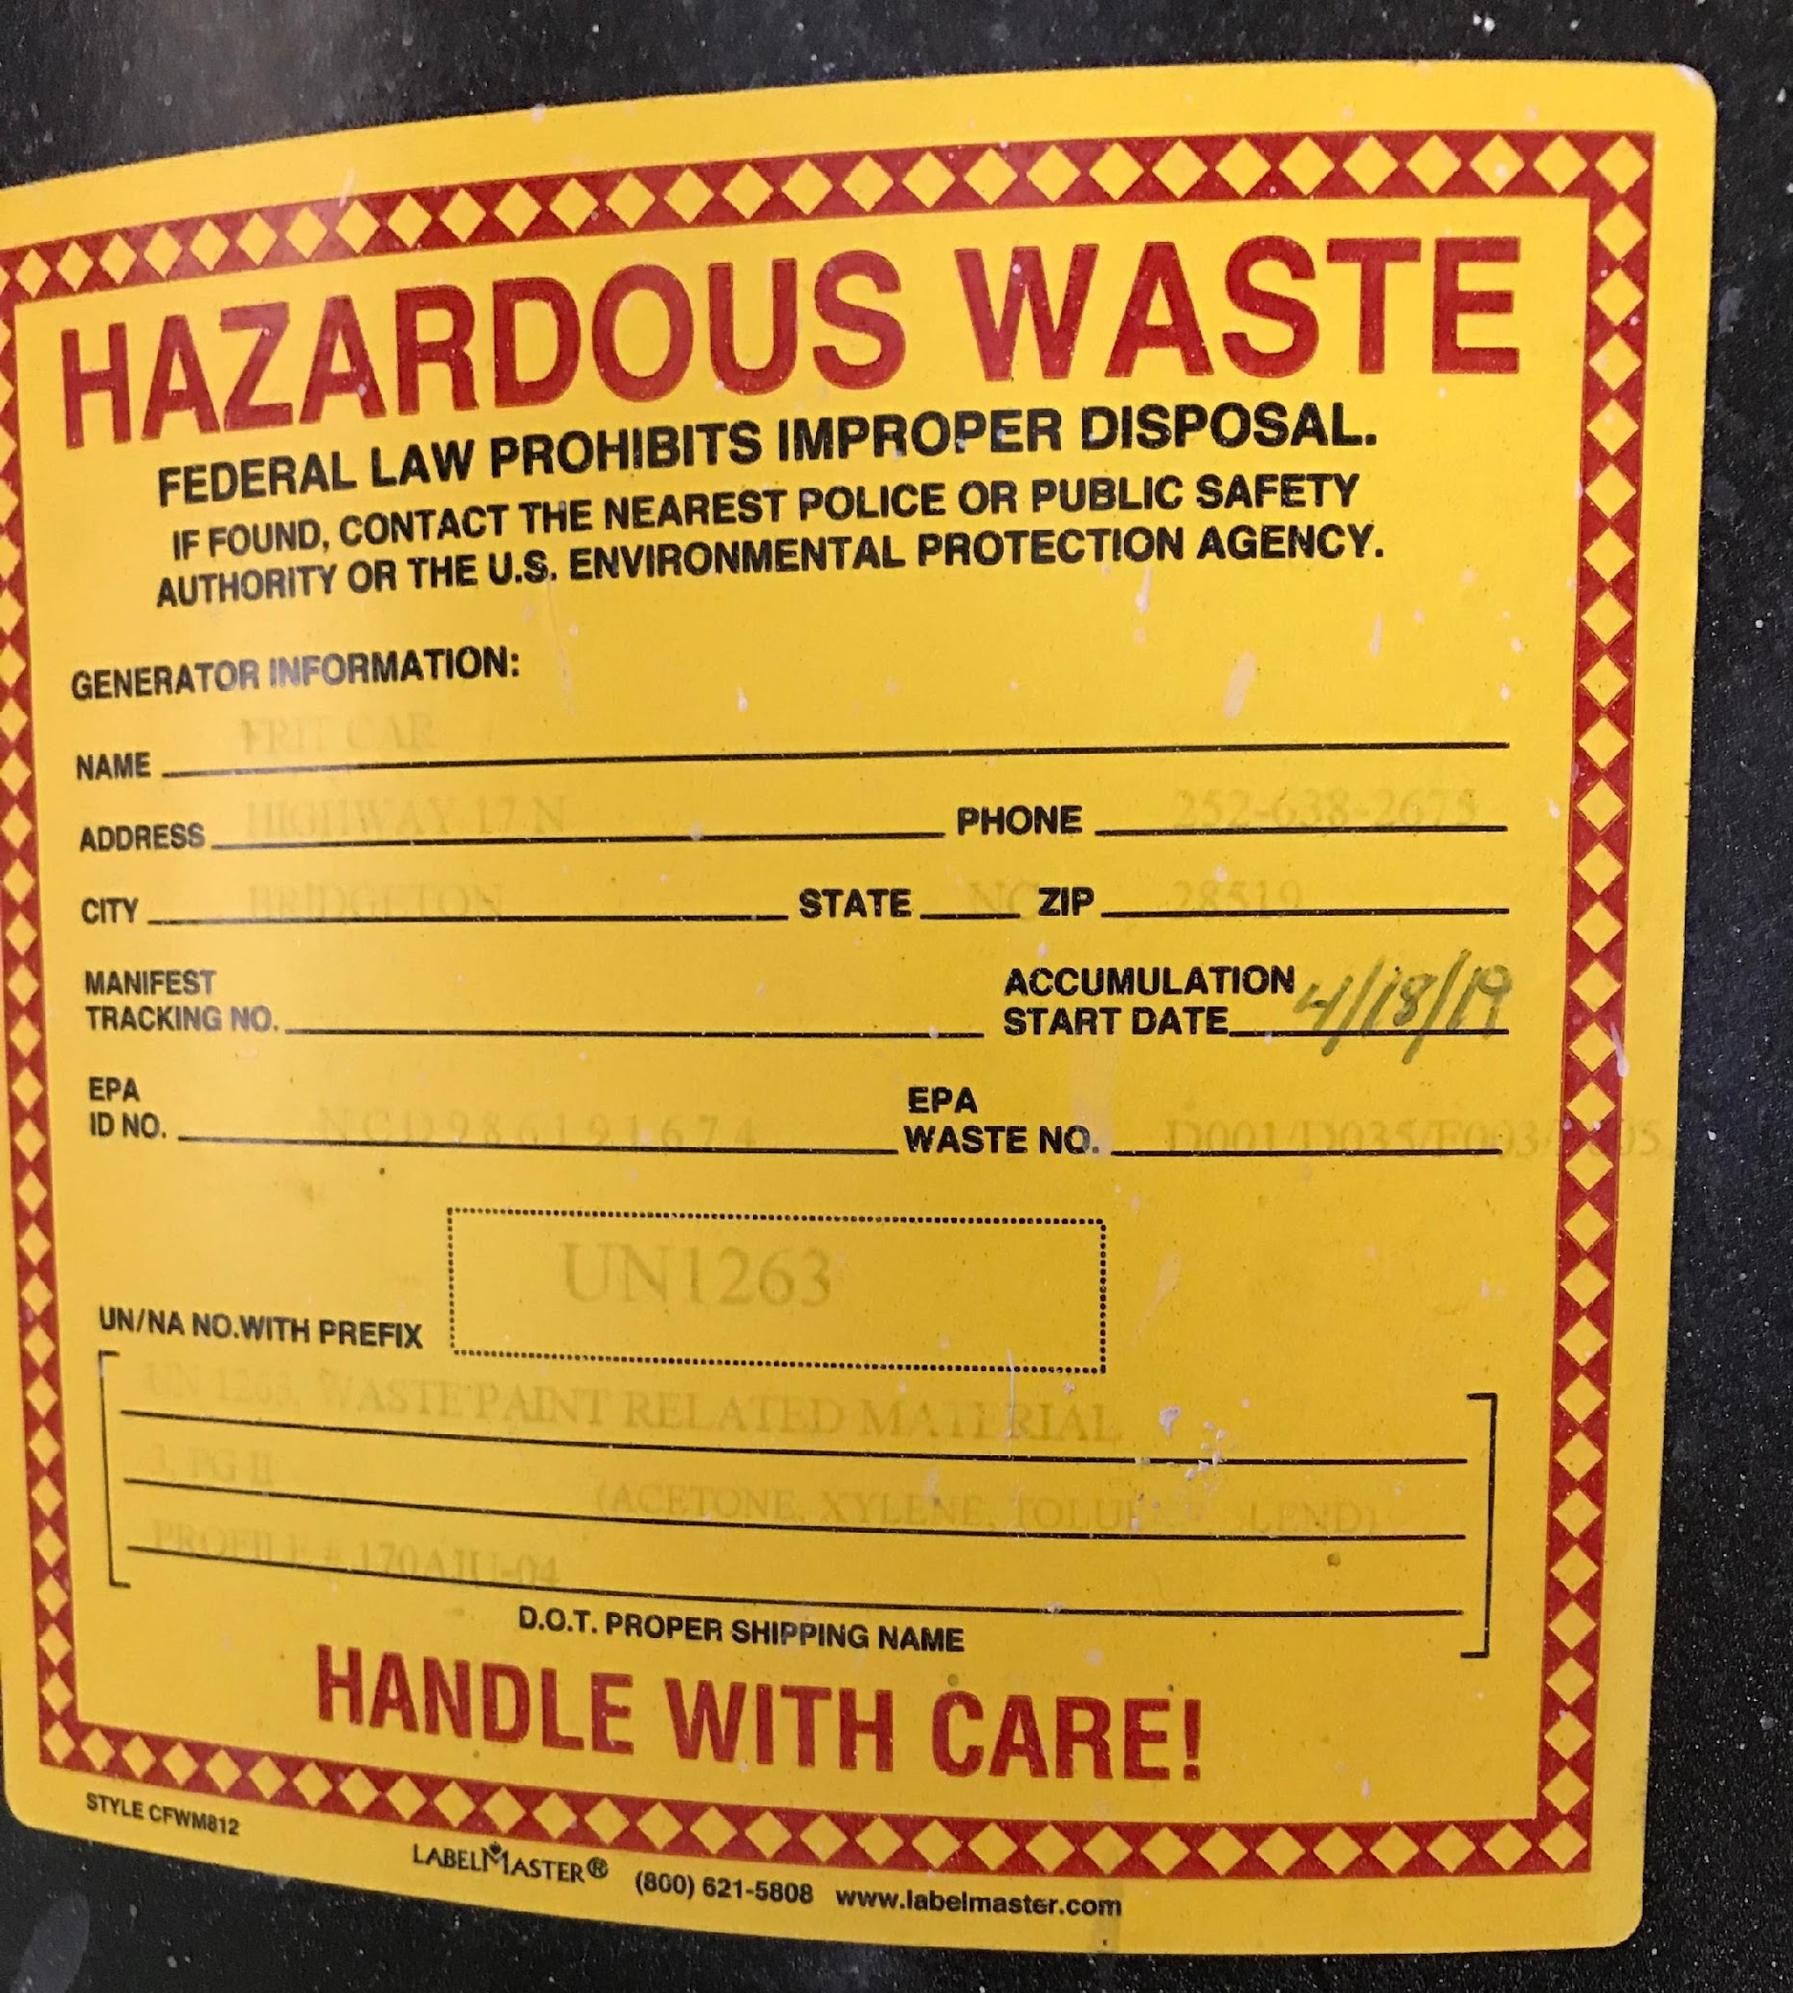
Maximum Accumulation Time Limits
40 CFR 262.16(b) through (e)
180 days (270 days if waste is shipped 200 miles or more to a TSD) [RO 13000]
Notes:
SQGs cannot exceed 180 days for Hazardous Waste accumulation. They lose the exclusions that allow them not have to be permitted. An SQG is allowed to accumulate waste onsite up to 270 days if there waste is shipped 200 miles or more for offsite treatment, storage, or disposal (even if an alternate TSDF is closer than 200 miles). An exception to this is if the waste must remain on site long due to unforeseen, temporary, and uncontrollable circumstances, but an extension must be applied for prior to the 180 days completion and is solely at the discretion of the Regional Administrator and is on a case-by-case basis. Also, if a shipment of hazardous waste is shipped to a designated facility and it is rejected and sent back to the business, then the time will be longer than 180 days. The signed manifest must be kept to show the return of the item and correction to the product must be made.
RO 13000

Slide 15
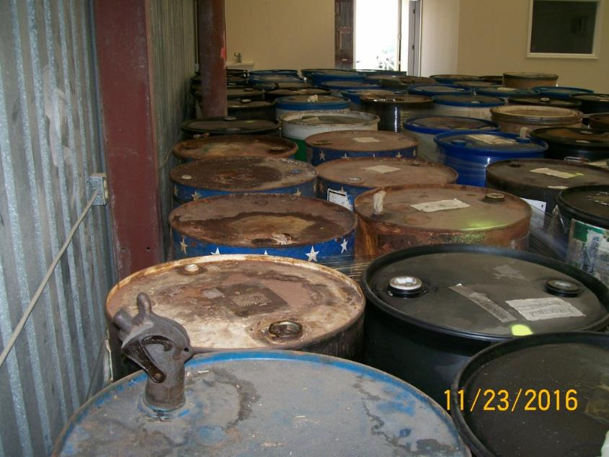
Maximum Onsite Waste Accumulation
40 CFR 262.16(b)(1)
No more than 13,200 pounds of hazardous waste at any time
Notes:
No more than 13,200 pounds of hazardous waste at any time. This is about 30 drums or less depending on weight; thanks to FDEP for this photo

Slide 16
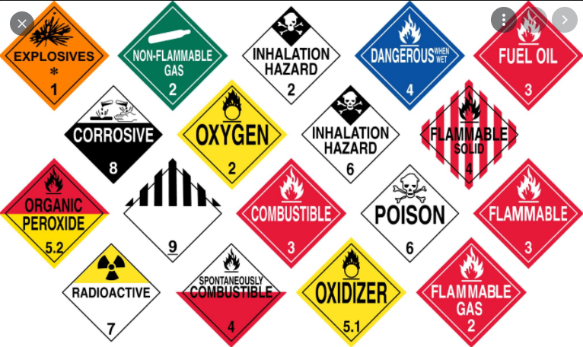
Pre-Transport Requirements
40 CFR 262.30 through 262.33
262.30 Packaging
262.31 Labeling
262.32 Marking
262.33 Placarding
Before transporting hazardous waste or offering hazardous waste for transportation off-site, a generator must comply with the applicable Department of Transportation regulations on packaging, labeling, marking, and placarding as defined in 49 CFR parts 172, 173, 178, and 179.
Notes:
Package the waste in accordance with Dept. of Transportation (DOT) regulations
Label each package in accordance with DOT
Mark each package in accordance with DOT and each container 119 gallons or less with the following:
Hazardous waste statement (HAZARDOUS WASTE-Federal Law prohibits improper disposal. If found, contact the nearest police or public safety authority or the US Environmental Protection Agency)
Generator’s Name and Address
Generator’s EPA ID number
Manifest Tracking Number
EPA Hazardous Waste Number(s) A generator may use bar coding to identify the US EPA Hazardous Waste Number. And certain lab packs that will be incinerated do not have to be marked with the EPA Hazardous Waste Number, unless they are D4-8, 10, or 11.
The waste generator must placard waste in accordance with DOT or offer the transporter the appropriate placards.

Slide 17

Approved TSDFs & Transporters
40 CFR 262.18(c)
SQGs must use Treatment, Storage, and Disposal facilities and Transporters with valid EPA ID numbers.
Notes:
SQGs must use Treatment, Storage, and Disposal facilities and Transporters with valid EPA ID numbers.

Slide 18
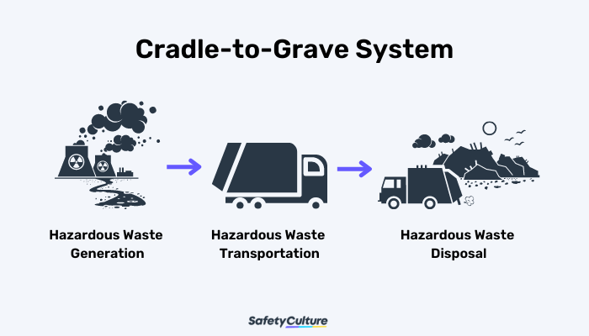
Hazardous Waste Manifest
40 CFR 262.20 through 262.23
The HW manifest may be the single most important document for a generator!
  “Cradle-to-Grave” mandated by Congress
  Manifests document the cradle to grave
Notes:
The HW manifest may be the single most important document for a generator! When generators ship hazardous waste offsite, they must use a hazardous waste manifest.
“Cradle-to-Grave” mandated by Congress in 1980; this means the generator is responsible for the hazardous waste when the waste is created until it has been disposed of properly
Manifests tracks hazardous waste from the time it leaves their facility until it reaches the Treatment Storage and Disposal facility.

Slide 19
Hazardous Waste Manifest (continued)
40 CFR 262.20 through 262.23
  The manifest clearly documents who, what, where, when, and how much has been sent
  Facilities (TSDs) mishandle, go bankrupt, etc. and the waste and/or contamination will have to be dealt with
Notes:
The manifest clearly documents who, what, where, when, and how much has been sent
Treatment, Storage, and Disposal Facilities or TSDs have been known to mishandle items, go bankrupt, etc. and the waste and/or contamination will have to be dealt with. If it is not tracked, the waste generator may have to pay for an environmental cleanup. Businesses must receive and keep a signed manifest from the TSD which indicates that they have received the items sent. This stops the responsibility of the business for those items shipped.
The only time SQGs are exempt from the manifesting requirement is when waste is waste reclaimed under a contractual tolling agreement, which means the waste goes offsite to be reclaimed, and then is returned to the facility.

Slide 20
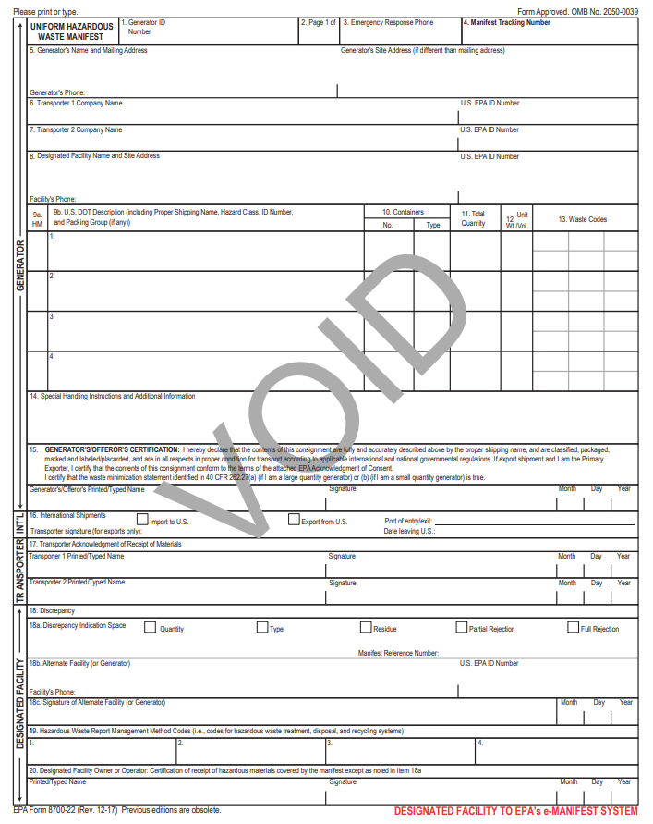
Box 15 - Generator’s Certification:
Generator must read, sign, and date the waste minimization certification statement (40 CFR 262.27)
Ensure the facility is keeping the signed completed copies with signatures from the generator, transporter and final designated facility.
*SIGNATURE INDICATES AGREEMENT
Notes:
Here is a copy of the uniform hazardous waste manifest. The EPA ID # stays with the physical location.
BEWARE WHEN the VENDOR PRE-TYPES IT WHICH IS NOW A REGULAR OCCURANCE. Tell the facility to check everything. FDEP looks at waste codes to see if anything looks out of the norm. Box 15 is where the generator signs. The business needs to know that by signing the manifest the facility is certifying that all of the information is correct. This certification also includes that the company is making efforts to minimize their waste. The person signing the manifest should CHECK IT OVER VERY CAREFULLY BEFORE He/She SIGNs. Ensure that the facility is keeping the signed completed copies with the all of the signatures from the generator, transporter, and final designated facility. Only this last signature protects him as it certifies that the cradle to grave requirements have been met.

Slide 21
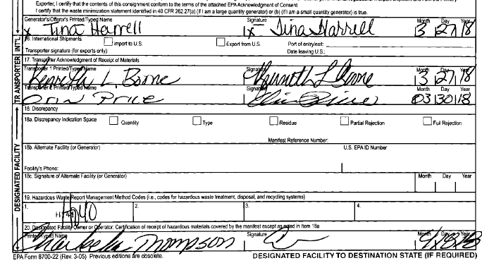
Exception Reporting
40 CFR 262.42(b)
A SQG who does not receive a copy of the manifest with the handwritten signature of the owner or operator of the designated facility within 60 days of the date the waste was accepted by the initial transporter must file an exception report to FDEP:
A legible copy of the manifest, and,
With some indication that the generator has not received confirmation of delivery.
Notes:
Exception reporting is in place to ensure that the waste has been properly delivered and that no waste is lost or unaccounted for. SQGs that do not receive a signed copy of the manifest from the designated facility, has to send a report to the state within 60 days of the date the waste was accepted by the initial transporter. We’re seeing this more with the backups at the HW incinerators. A legible copy of the manifest and a statement that they did not receive it should be sent to FDEP. On a side note, if the generator contacts the transporter and requests the missing signed manifest, sometimes it is just something that did not get mailed and they can email the proof which would eliminate this filing.

Slide 22
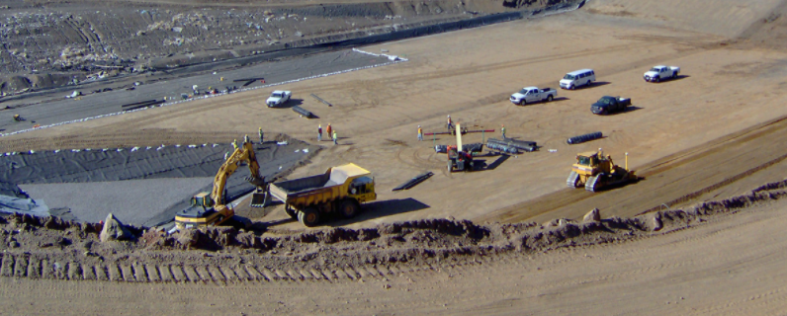
Land Disposal Restrictions Notification/Certification
40 CFR 268
Generator must issue a one-time notification to the Treatment Facility
  Generator certifies whether the waste meets the treatment standards; or that the Treatment, Storage, Disposal Facility will make the determination
  Generator must sign the certification
  LDR documents must remain
  on file for three years
Notes:
The Land Disposal Restrictions, or LDR program requires any HW or HW treatment residue destined for land disposal to be treated to reduce its toxicity. Whenever a generator sends a HW offsite, the initial shipment of the waste must be accompanied by an LDR notification. The purpose of the notification is to inform the receiving facility that the waste is subject to LDR requirements. In the case where a generator has not made the determination of whether the HW requires treatment to meet LDR treatment standards, the treatment facility must make this determination. The generator should ensure the paperwork provided to them by the transporter is correct before signing the notification/certificate and sending off the waste. Where it gets more complicated is when generators are treating their own hazardous waste and residues go onto the ground (including sediments from neutralization of corrosive material and still bottoms from solvent recycling). There are LDR paperwork requirements that the generator will have to complete and evaluate if the waste needs further treatment. Contact the state for more information if you see this at a facility.

Slide 23
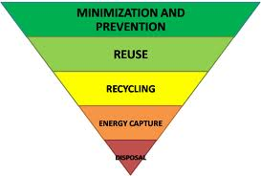
Waste Minimization
40 CFR 262.27(b)
A small quantity generator must certify that it has:
Made a good-faith effort to minimize their waste generation, and
Selected the best available and affordable waste management method.
Block 15 of manifest has a statement that the person signing is certifying waste minimization practices.
Notes:
A small quantity generator must certify that it has:
Made a good-faith effort to minimize their waste generation, and
Selected the best available and affordable waste management method.
Block 15 of manifest has a statement that the person signing is certifying waste minimization practices.
This picture has the most preferred method of waste minimization at the top to the least preferred at the bottom, which is disposal. Treatment is not waste minimization.

Slide 24
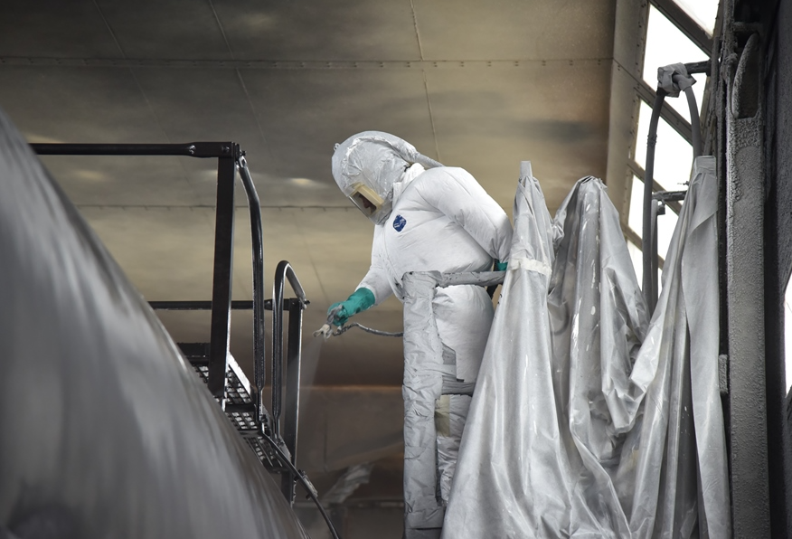
Personnel Training
40 CFR 262.16(b)(9)(iii)
The generator must ensure that all employees are thoroughly familiar with proper waste handling and emergency procedures, relevant to their responsibilities during normal facility operations and emergencies.
Notes:
The generator must ensure that all employees are thoroughly familiar with proper waste handling and emergency procedures, relevant to their responsibilities during normal facility operations and emergencies.
The requirements for training for SQG are much less stringent than an LQG. There is no requirement to document training, however, it is highly recommended since it is proof of meeting this requirement.
If an employee handling HW doesn’t seem to know what he/she is doing, we’ll ask if he/she has been trained. This is true of a LQG also.
It’s ok as the inspector to ask employees questions (e.g. how they do something)

Slide 25

Emergency Procedures – Emergency Coordinator
40 CFR 262.16(b)(9)(i)
The Emergency Coordinator(s):
At all times there must be at least one employee either on the premises or on call (i.e., available to respond to an emergency by reaching the facility within a short period of time)
They are responsible for coordinating all emergency response measures
This Photo by Unknown Author is licensed under CC BY-NC-ND
Notes:
Emergency Coordinators are mandatory. There must be at least on employee either on premises or on call and available to respond to an emergency at the facility within a short time. Emergency Coordinators cannot live in another state. They are responsible for coordinating all emergency response measure. The emergency coordinator must also be able to commit funds to the emergency if needed, such as to hire a response contractor.

Slide 26
Required Emergency Information
40 CFR 262.16(b)(9)(ii)
The SQG must post the following information next to telephones or in areas directly involved in the generation and accumulation of HW:
  The name and 24-hour emergency telephone number of the emergency coordinator and
  Location of fire extinguishers and spill control material, and, if present, fire alarm; and
  The telephone number of the fire department (unless the facility has a direct alarm).
Notes:
The SQG must post the following information next to telephones or in areas directly involved in the generation and accumulation of HW:
The name and 24-hour emergency telephone number of the emergency coordinator
Location of fire extinguishers and spill control material, and, if present, fire alarm; and
The telephone number of the fire department (unless the facility has a direct alarm).

Slide 27
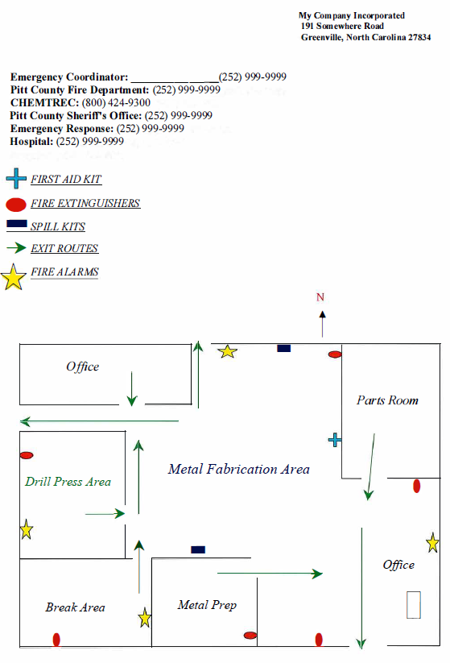
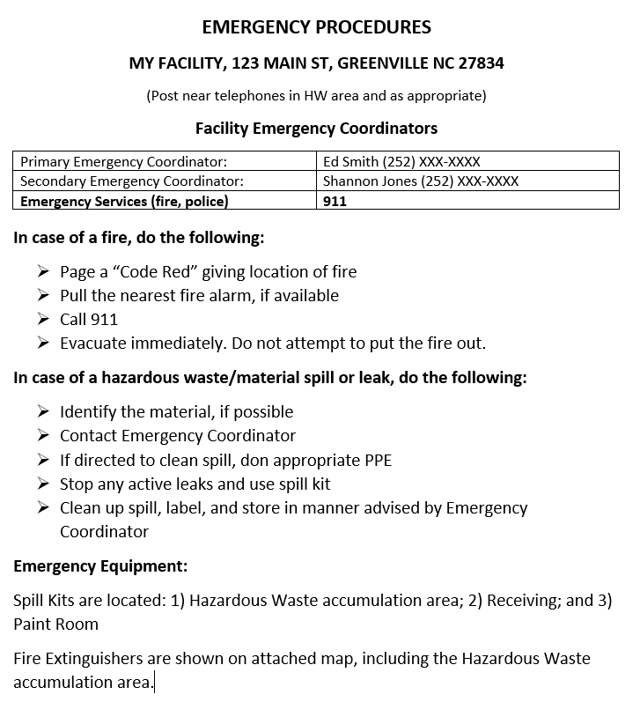
Emergency Info Posted
Notes:
Both of these examples satisfy the SQG required emergency information, when it is posted near a phone and/or where HW accumulates.
The name and emergency telephone number of the emergency coordinator; Location of fire extinguishers and spill control material, and, if present, fire alarm; and the telephone number of the fire department (unless the facility has a direct alarm).

Slide 28
Preparedness and Prevention
40 CFR 262.16(b)(8) and (9)
Maintenance and operation of facility
  Minimize the possibility of fire, explosion, or any unplanned or sudden release of hazardous waste
  Required equipment (where waste is generated or accumulated):
    Internal communications or alarm system (voice or signal)
    A device capable of summoning emergency assistance (telephone, two-way radio)
    Fire extinguishers, spill control equipment, and decontamination equipment
    Water at adequate volume and pressure or foam producing equipment
Notes:
Preparedness and prevention regulations and emergency procedures are in place to maintain the facility in a manner that minimizes the possibility of fire, explosion, or release of hazardous waste. There are required equipment needed where the waste is either generated or accumulated and includes access to communication or alarms, a way to summon emergency assistance through a phone or radio, fire extinguishers, spill control equipment, decontamination equipment, water or foam producing equipment. There is required aisle space for passage through – it is not a specific distance, but enough to allow unobstructed movement of personnel, fire protection equipment, etc. And of course the emergency procedures of contacting the emergency coordinator as we just discussed.

Slide 29

Preparedness and Prevention
40 CFR 262.16(b)(8) and (9)
Emergency Arrangements:
An SQG must attempt to make arrangements with the:
  Local Police Department
  Local Fire Department
  Other Emergency Response Teams
  Emergency Response Contractors
  Equipment Suppliers
  Local Hospitals
Taking into account the types and quantities of HW handled at the facility
Arrangements may be made with the LEPC, if determined to be the appropriate organization with which to make arrangements
Notes:
Must notify fire, police, and hospital at a minimum. Certain locations have ERT (Emergency Response Teams) that need to be contacted, possibly an emergency response contractor – it all depends on the types and quantities of hazardous waste at the facility. Local Emergency Planning Committee can be notified IF they are active and have members from these agencies represented.

Slide 30

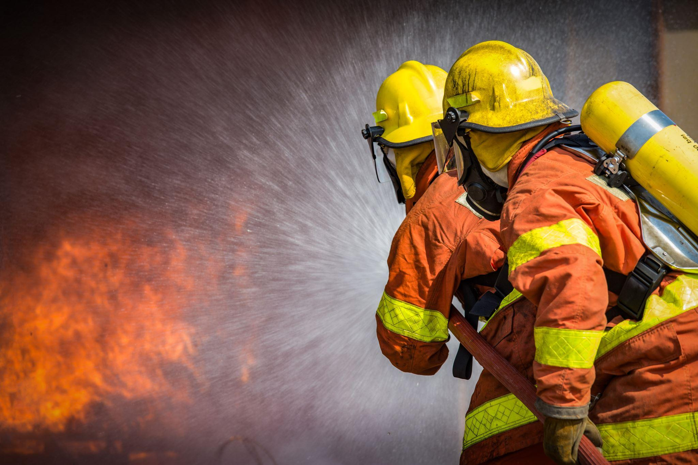
Emergency Arrangements (continued)
A generator shall maintain records documenting the arrangements with the local fire department as well as any other organization necessary to respond to an emergency.
There must be documentation listed in the operating record that either confirms such arrangements actively exist or, in cases where no arrangements exist, confirms that attempts to make such arrangements were made.
  Send certified mail return receipt, email confirmations, etc.
Notes:
A generator must maintain records which document the arrangements with the local fire department, police department, etc on who to contact in an emergency. There must be documentation listed in the operating record that either confirms such arrangements actively exist or, in cases where no arrangements exist, confirms that attempts to make such arrangements were made, such as certified mail return receipts, email confirmations, etc.

Slide 31
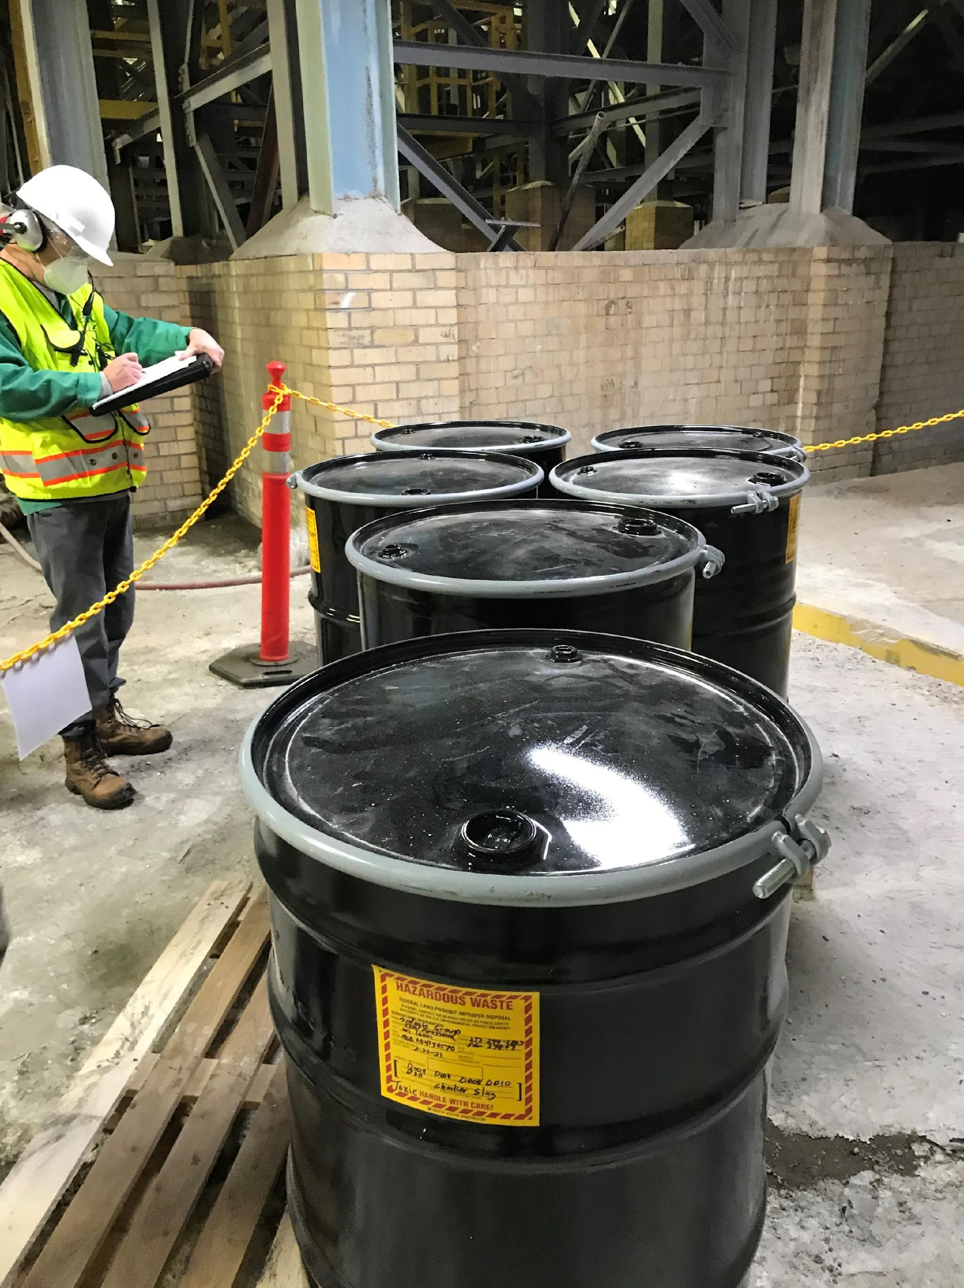
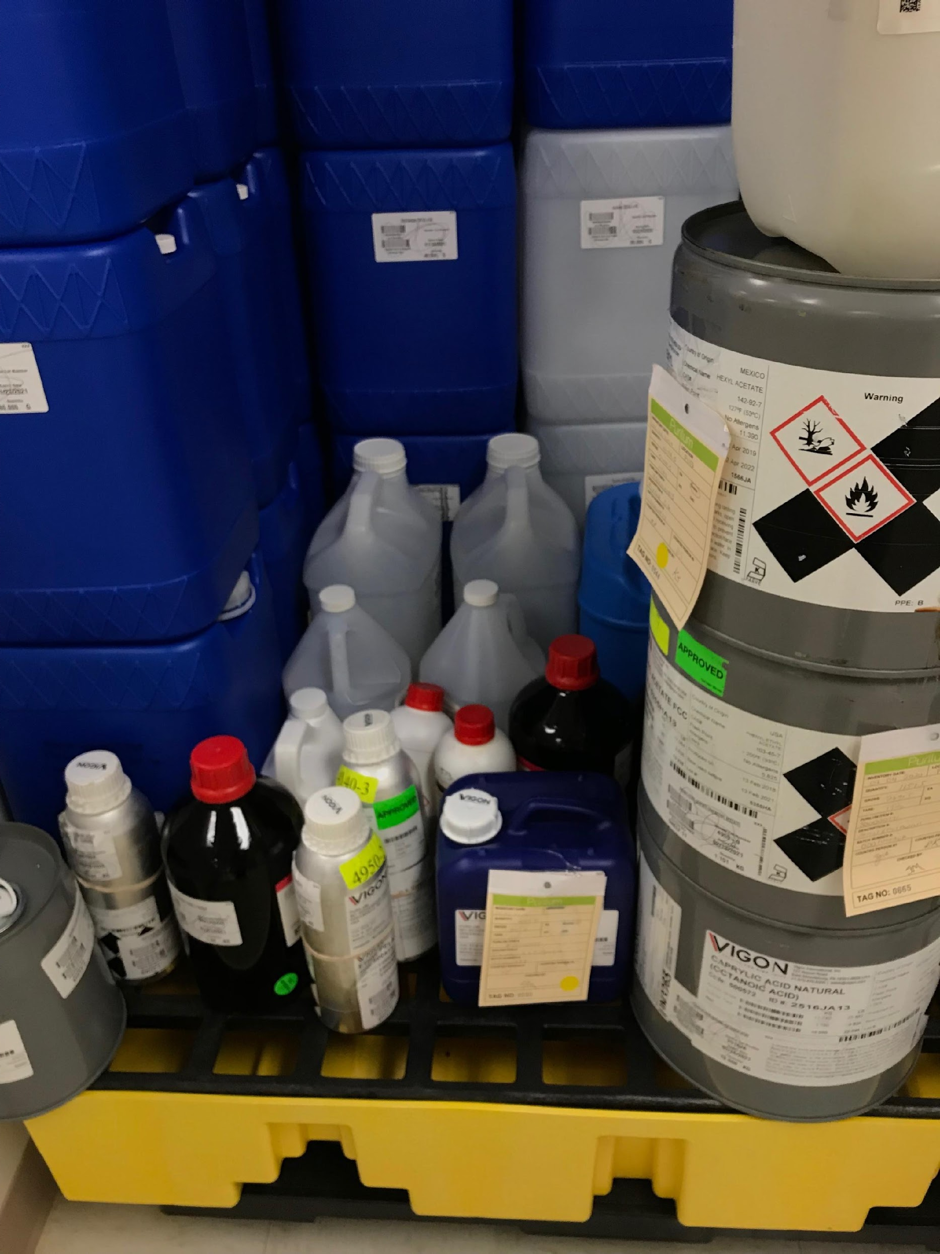
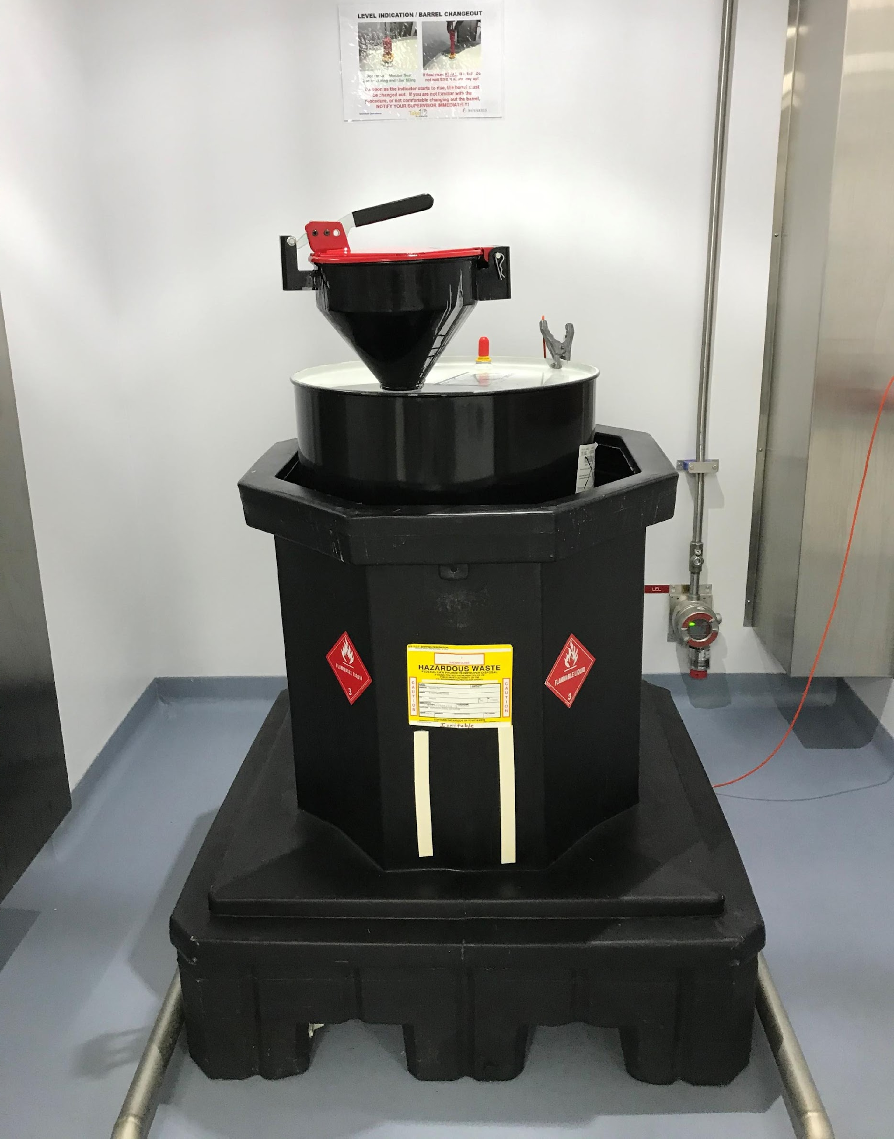
Container Management for Small Quantity Generators
Notes:
Left photo: pharma; center glass bottle manufacturer; right e-liquids and flavors manufacturer (P075)

Slide 32
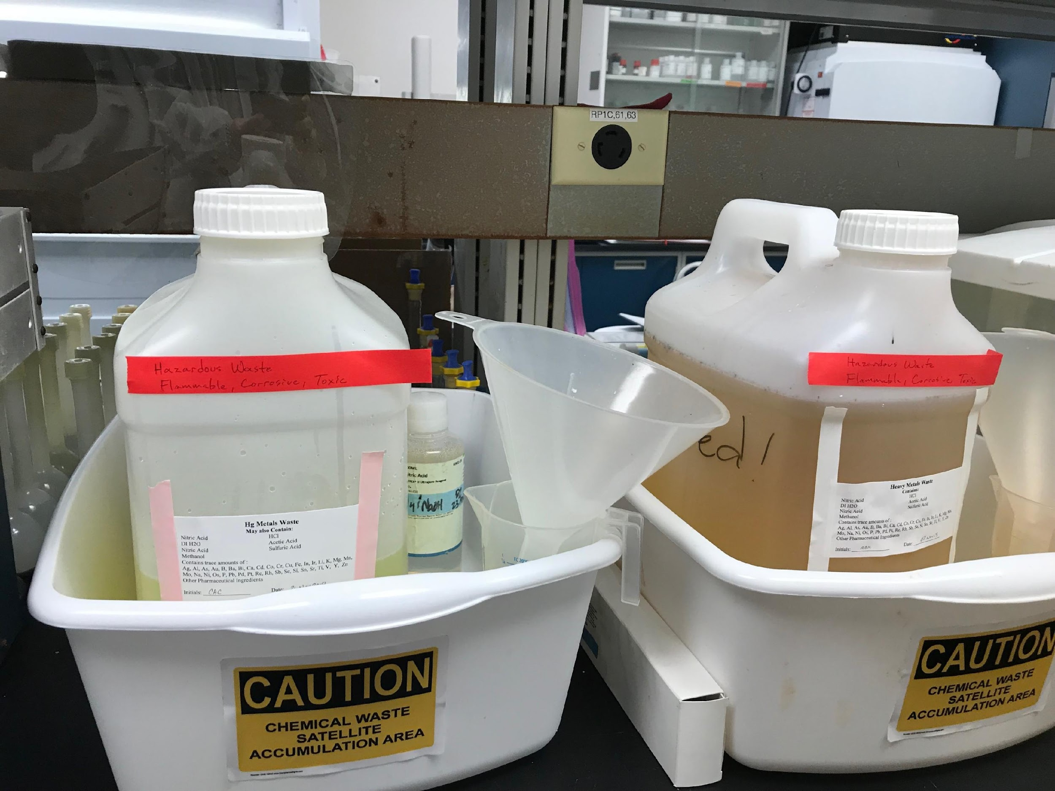
What is a Satellite Accumulation Area??
(40 CFR 262.15)
It is an “area” with a container(s) of hazardous waste that:
  Is where waste initially accumulates prior to removal to a central area (at or near the point of generation); and
  “is under control of the operator” of the process that generated the waste
SAAs do not have to be designated in any particular manner; however, it is good practice (signage, lines on the floor etc.). But the facility should know where/what they are!
Notes:
A Satellite Accumulation Area is an “area” with a container or containers of hazardous waste that is where waste initially accumulates prior to removal to a central area, so it is at or near the point of generation and “is under control of the operator” of the process that generated the waste. “Under control of the operator” means it is someone familiar with the operations that are generating the waste and is aware of or can attend to these operations and provides some measure of controlled access to the area.
Satellite Accumulation Areas do not have to be designated in any particular way but, it is good practice to do so such as having signage, lines on the floor, etc. The facility and workers should know where they are and what is kept there.

Slide 33
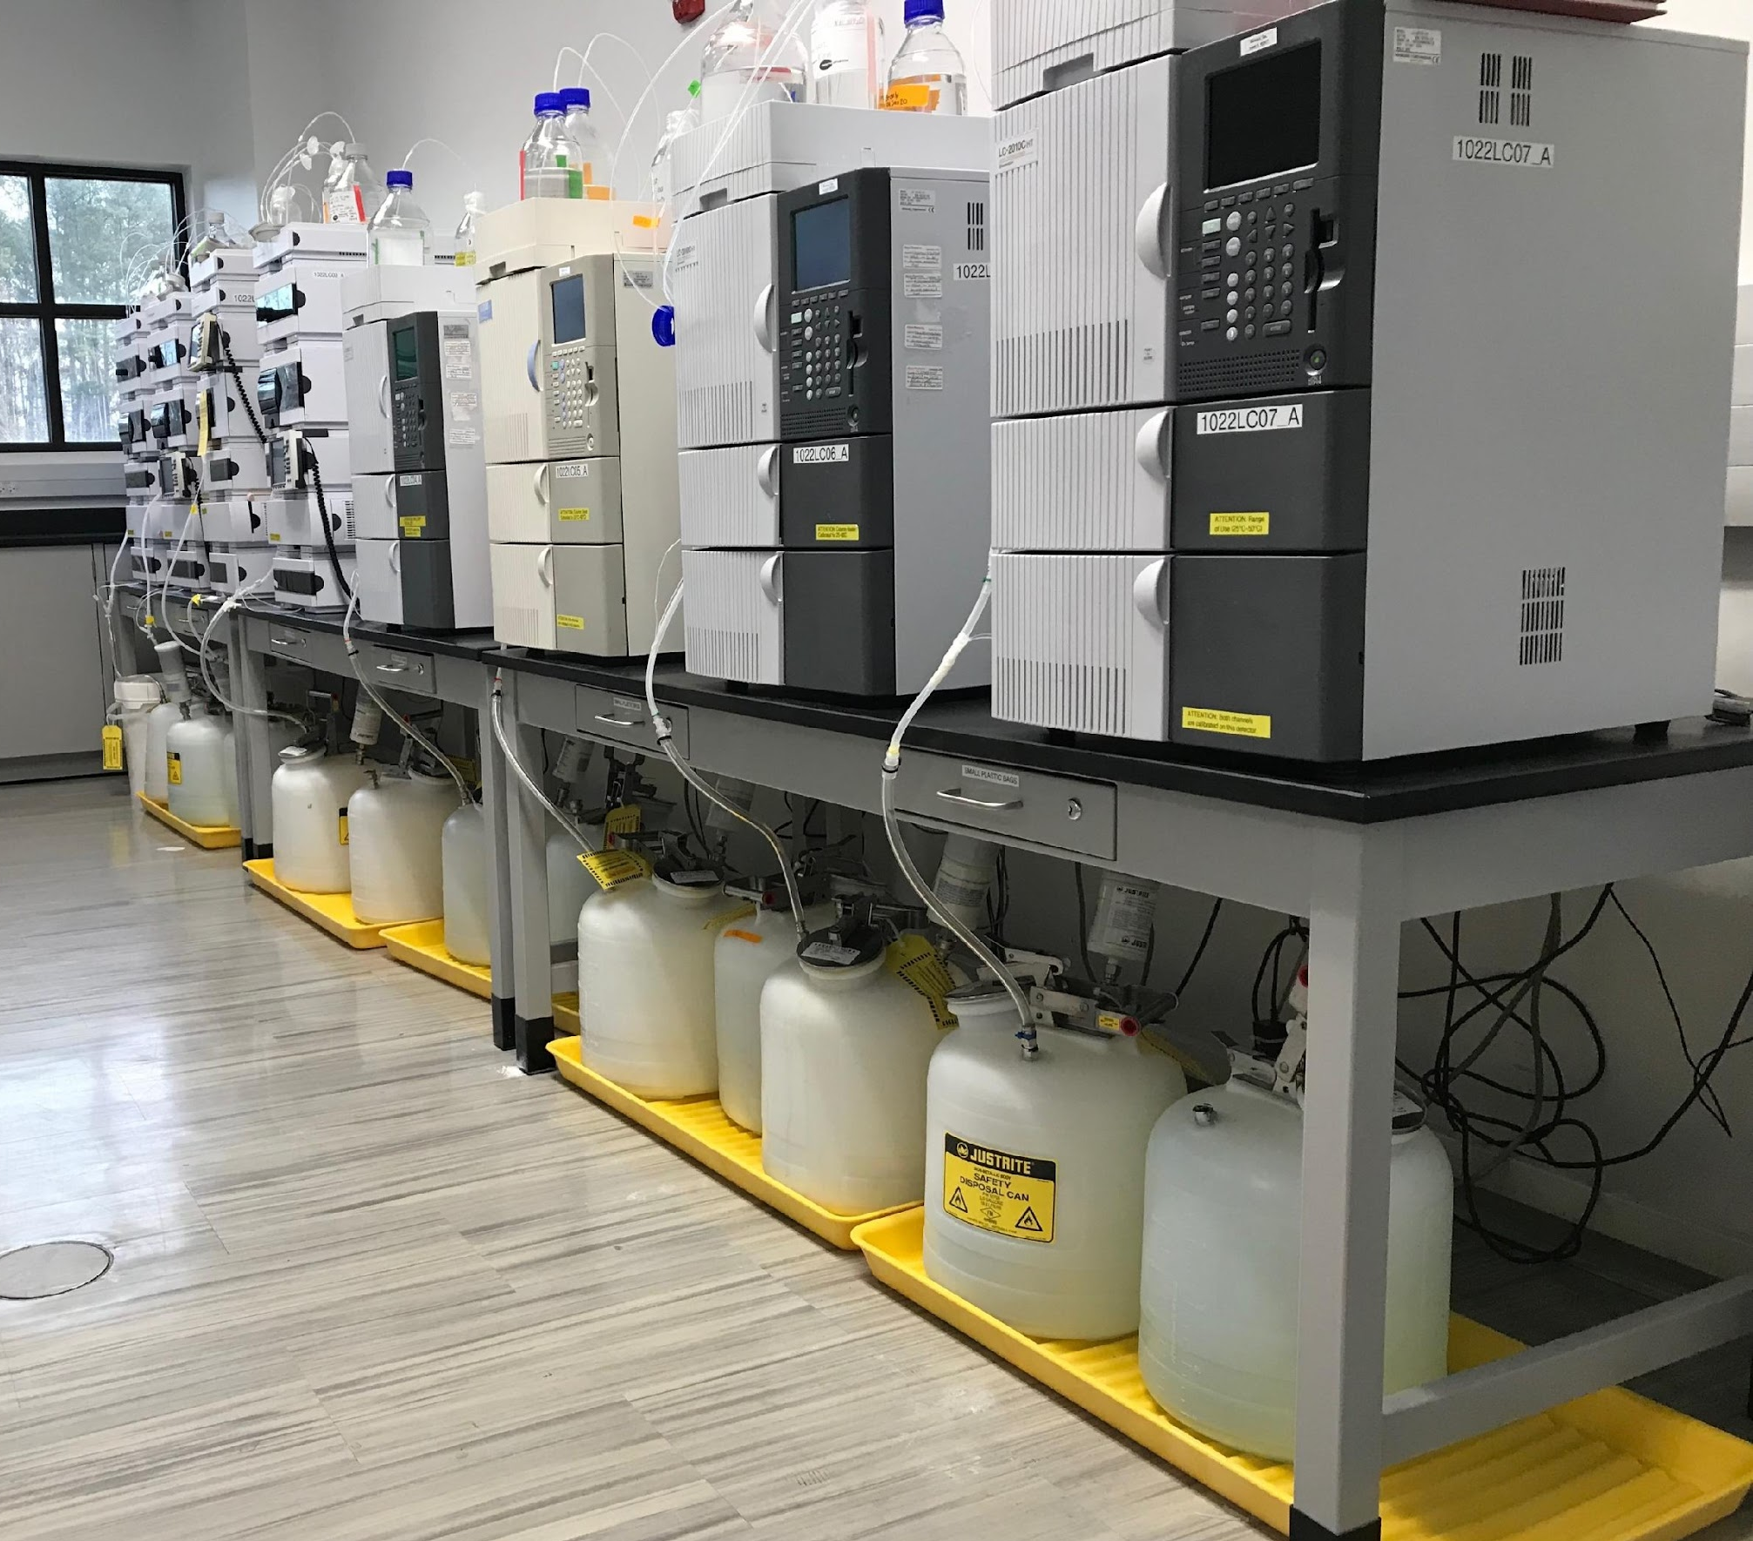
Satellite Accumulation Areas
(40 CFR 262.15)
FAQs about SAAs:
A SAA can have multiple containers (up to 55 gallons of total waste)
The same SAA can have multiple waste types, but cannot exceed 55 gallons of waste
  Comply with 262.15(a)(6) once 55 gallons of waste exceeded
A facility is not limited to how many SAA they can have
SAA waste can only be consolidated in containers within the same SAA or go to a CAA
Notes:
A generator may accumulate up to 55 gallons of non-acute hazardous waste and/or up to one quart of liquid acute hazardous waste or 2.2 pounds of solid acute hazardous waste in a Satellite Accumulation Area. These may be in multiple containers to equal the maximum amount allowed. Once this quantity is met in the location, they have three consecutive calendar days to comply with the central accumulation area regulations or remove the excess from the satellite accumulation area to a central accumulation area, an on-site interim status or permitted treatment, storage, or disposal facility, or an off-site facility. These must be marked as excess waste during this time.
A facility is not limited to how many Satellite Accumulation Areas they may have by EPA, but some fire departments do have regulations. Satellite Accumulation Area waste can only be consolidated with waste in containers in the same area or must be sent to a Central Accumulation Area.
RO 14703 FAQ about satellite accumulation areas
One bench area within a laboratory at a pharma manufacturing plant.

Slide 34
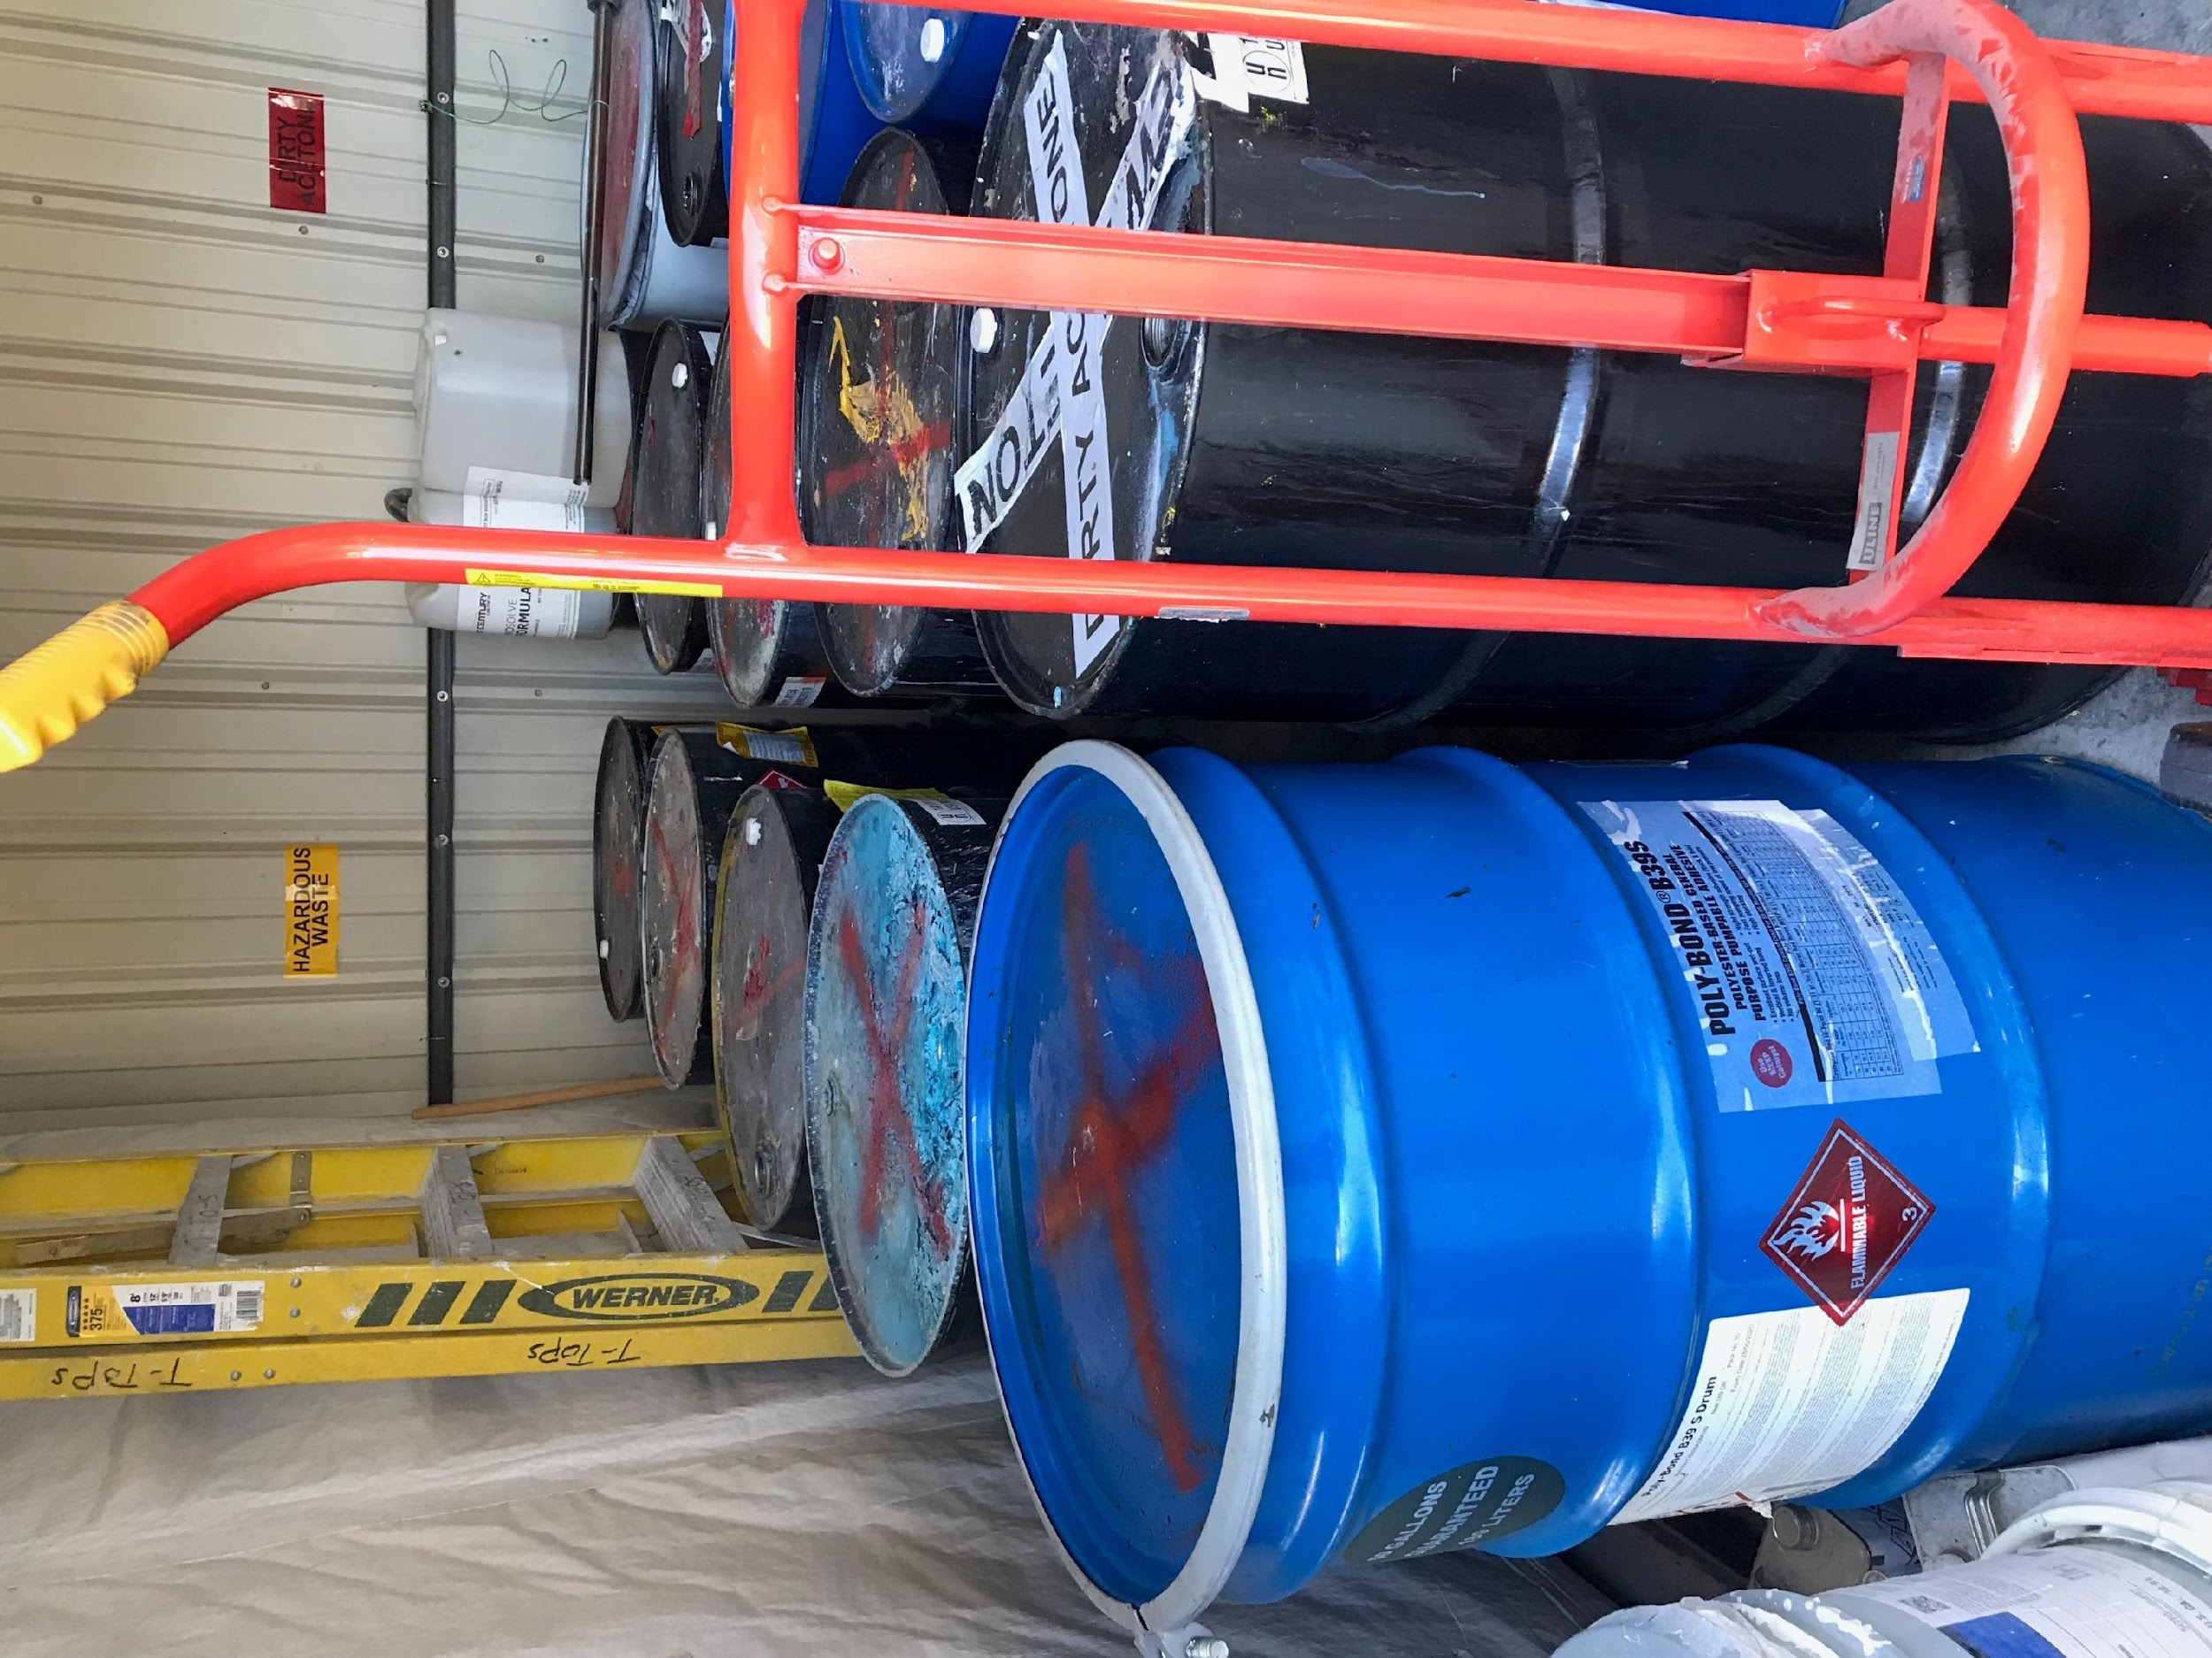
Central Accumulation Areas
(40 CFR 262.16)
Any on-site hazardous waste accumulation area with units [containers] subject to 262.16
A generator can have more than one CAA.
“Central” does not denote a physical location, nor does it have to be “centrally” located.
CAA(s) can be in any location of the facility.
CAA containers can be moved from one CAA to another CAA (but cannot redate)
Notes:
This is the “official definition” but in general it’s the main area where waste is accumulating, typically in larger quantities.

Slide 35
Central Accumulation Areas (continued)
CAAs with multiple locations still cannot exceed SQG standards of no more that 13,200 pounds per location at any time, no more than 180/270 days, container compatibility.
Inspections must be completed weekly or more frequently to check containers for any leaks or deterioration.
Notes:
Central Accumulation Areas with multiple locations still cannot exceed SQG standards of no more that 13,200 pounds per location at any time, no more than 180 days or 270 days in some instances, and container compatibility, meaning the right type of container for the waste stored inside. Any hazardous waste container that is not compatible with other containers of hazardous waste must be separated by using a dike, berm, wall, or other device.
Inspections must be completed weekly or more frequently to check containers for any leaks or deterioration.

Slide 36
Container Management
Satellite Accumulation Area vs. Central Accumulation Areas
40 CFR 262.15 (SAA)/40 CFR 262.16 (CAA)
Requirement | Satellite Accumulation Units | 180/270-day containers (CAA)
Must be in good condition | Yes | Yes
Must be compatible with HW in container | Yes | Yes
Must be closed at all times except when adding/removing waste | Yes (can also open to consolidate waste or venting) | Yes
Weekly Inspections | None | Weekly
Hazard marking | “Hazardous Waste” and indication of hazards | “Hazardous Waste” and indication of hazards
Date marking | On the date 55 gallons of non-acute HW is exceeded | On the date waste first goes in the container

Slide 37
Container Management (continued)
Satellite Accumulation Area vs. Central Accumulation
Requirement | Satellite Accumulation Units | 180-day containers (CAA)
Maximum length of accumulation | Unlimited | 180/270 days
Maximum waste volume in storage | 55 gallons (or 1 quart of acute wastes) | 13,200 pounds
Personnel training required | No (but maybe yes) | Yes
Can treat hazardous waste in unit | No | Yes
Must comply with Subpart CC air emission standards | No | Yes
Comply with preparedness, prevention, and emergency procedures | Yes | Yes
Notes:
40 CFR 262.15(a)(7) requires SQGs to comply with emergency procedures for their SAAs, will trigger personnel training requirements for SAA at SQGs. Although the preamble language states otherwise. “However, EPA would encourage all generators to take appropriate steps to ensure that all employees who work at areas where HW is accumulated, including SAAs, receive sufficient training to ensure that they are familiar with proper handling and emergency procedures [81 FR 85797]
Federal Register is a daily journal of the US government. It is the official daily publication for rules, proposed rules, and notices.

Slide 38
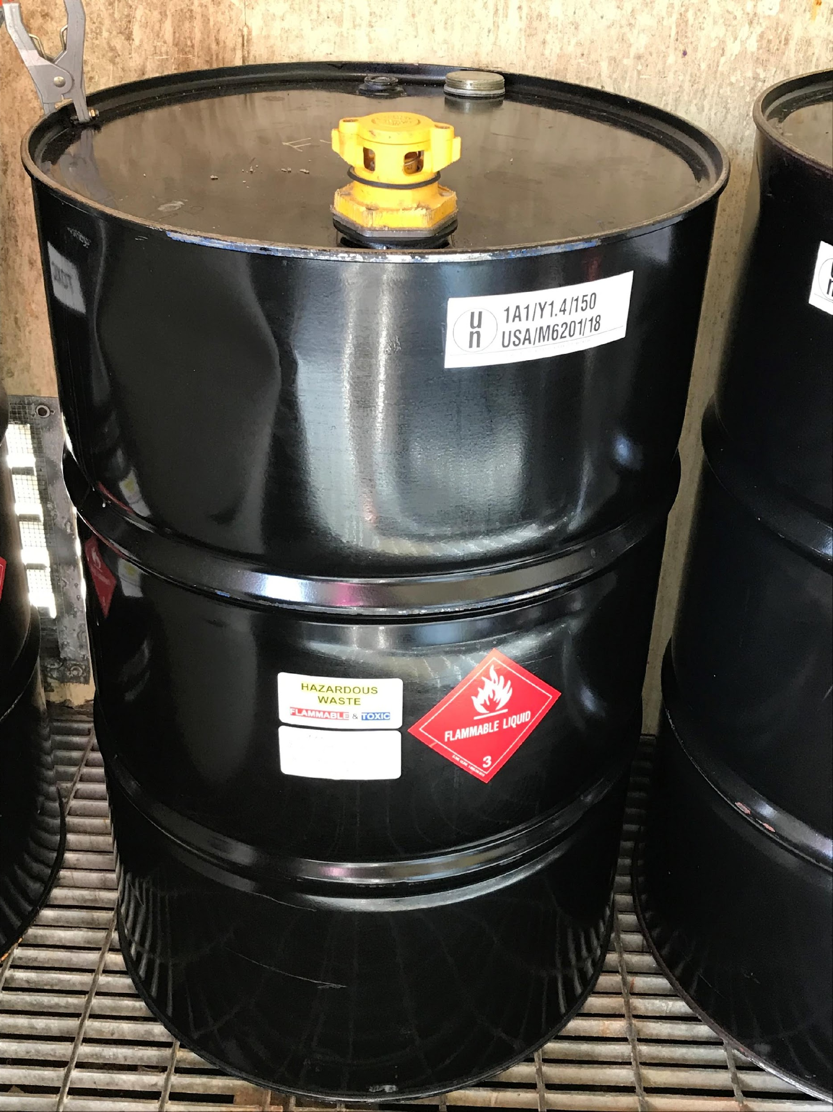
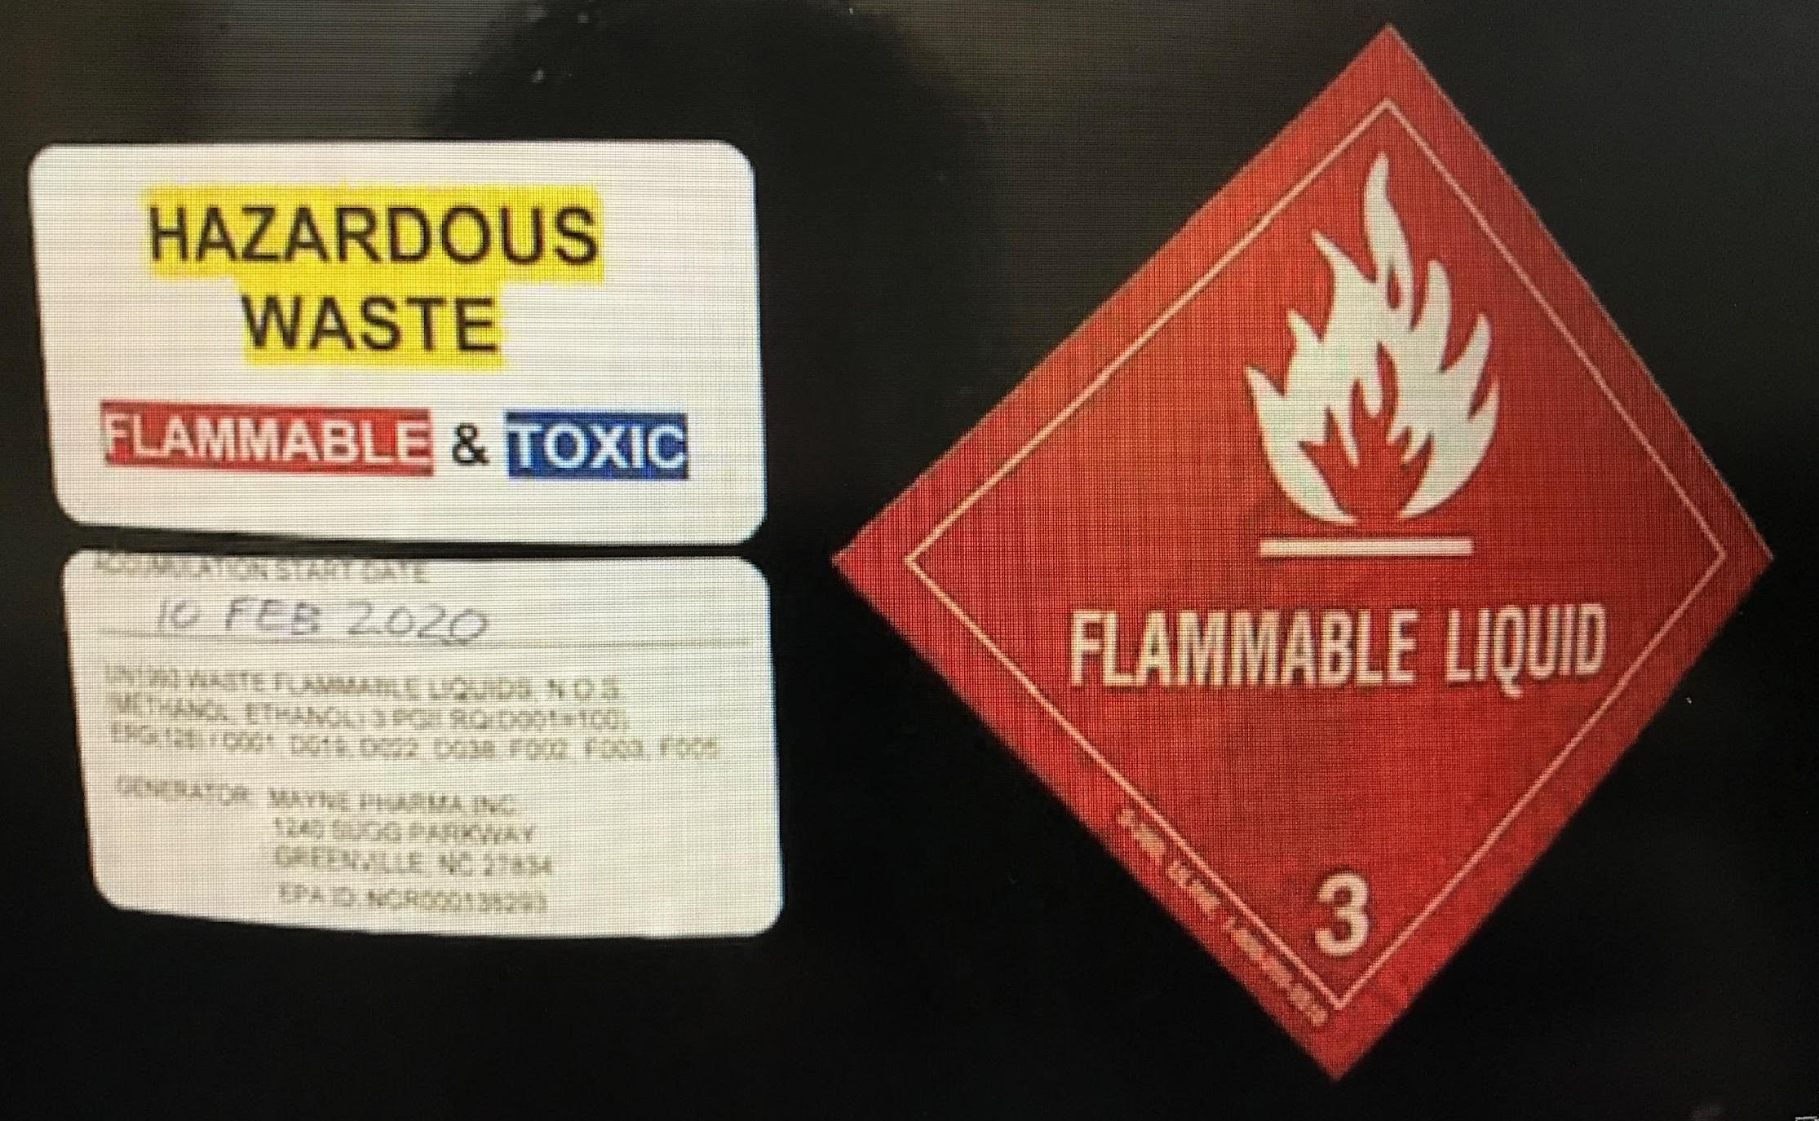
Container Management
40 CFR 262.15 (SAA) and 262.16(b)(2) and (6) (CAA)
Must be clearly marked “Hazardous Waste” (SAA/CAA); and
Indicate the hazards of the contents (SAA/CAA); and
“accumulation start date” - the date upon which each 180-day/270-day accumulation period begins (CAA)
Notes:
In both the Satellite and Central Accumulation Areas the containers must be clearly marked “Hazardous Waste” and state what the contents of the container are, along with the “accumulation start date” - the date upon which each 180-day/270-day accumulation period begins (CAA).

Slide 39
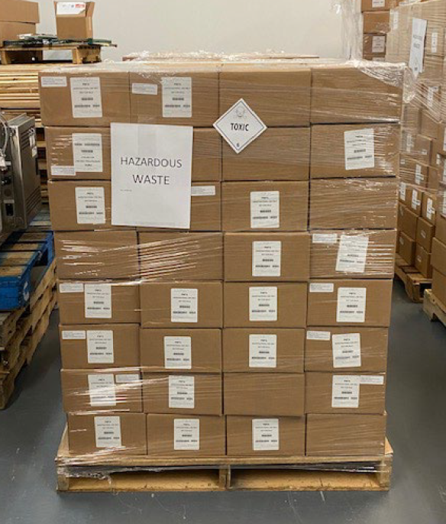
Container Management
40 CFR 262.15 (SAA) and 262.16(b)(2) and (6) (CAA)
A Note About Palletized Waste for
both Satellite and Central Accumulation Area containers:
Each container must be clearly marked (can’t have one label on a shrink-wrapped pallet of HW)
Would also have an issue with aisle space on inner containers
Notes:
Palletized Waste for both Satellite and Central Accumulation Area containers must have each container, or in this instance, box marked with the contents. You can’t have one label on the outside of a shrink-wrapped pallet of hazardous waste. In this picture there would also be an issue with aisle space on the boxes in the center of the pallet since you cannot see them or ready reach them.

Slide 40
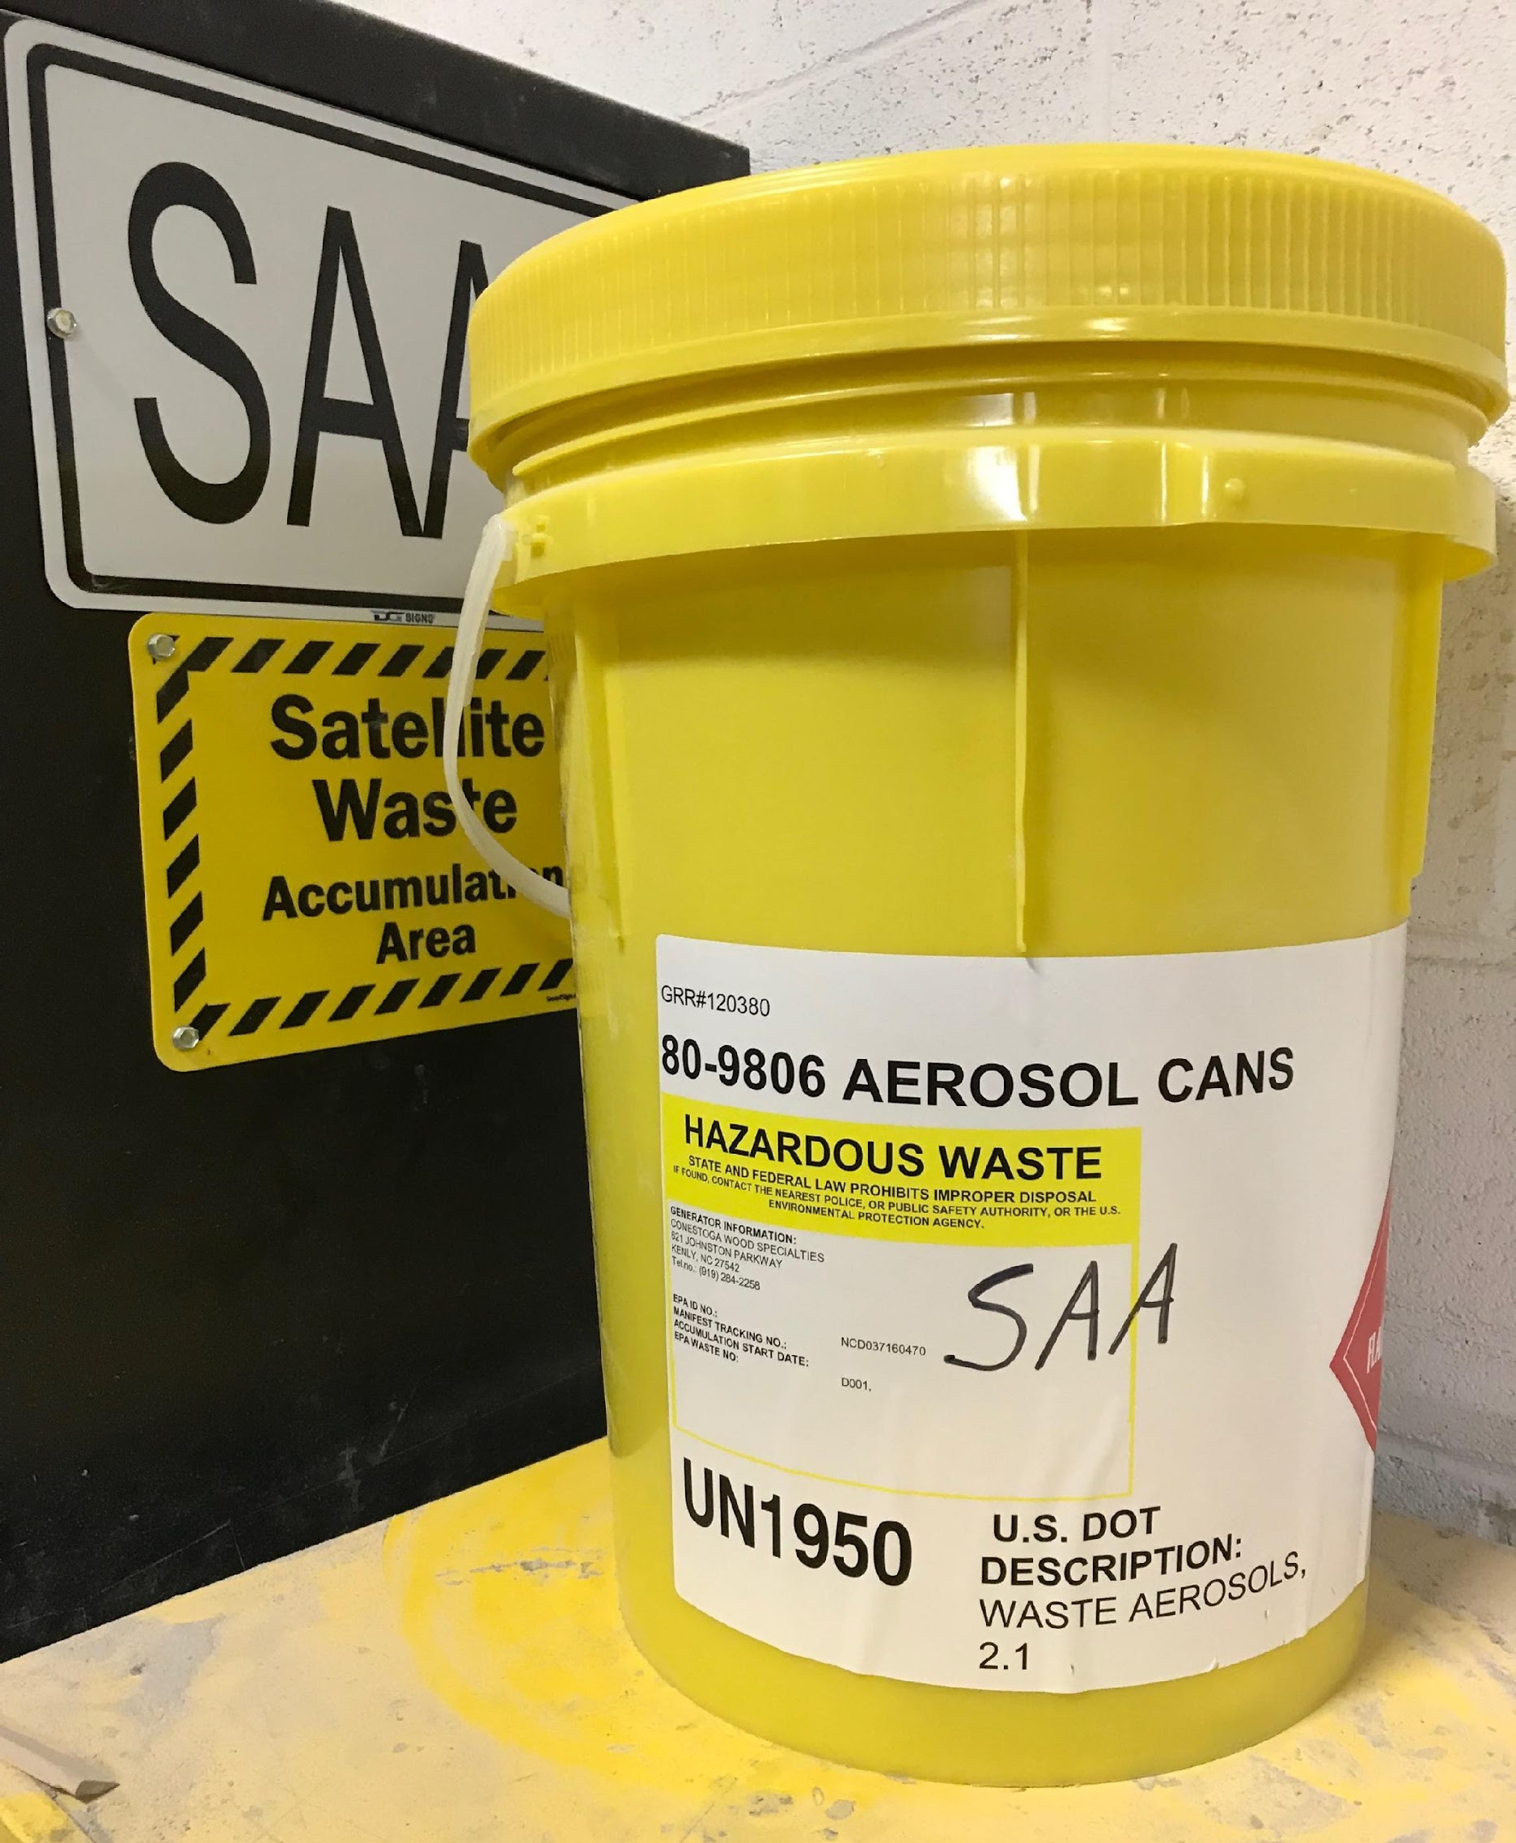
Container Management
40 CFR 262.15 (SAA) and 262.16(b)(2) and (6) (CAA)
Both Satellite and Central Accumulation Area containers:
Must be in good condition
Must be compatible with contents
Must be closed (unless actively adding or removing waste)
  “to minimize emissions of volatile wastes, to help protect ignitable or reactive wastes from sources of ignition or reaction, to help prevent spillage
  RCRA Online document RO 14826 has excellent guidance from EPA on closed containers for SAA, CAA, liquid, solid waste, etc.: https://rcrapublic.epa.gov/files/14826.pdf
Notes:
In both Satellite and Central Accumulation Area containers they must be in good condition, compatible with the hazardous waste stored in them, and be closed unless actively adding or removing waste. This is to minimize emissions of volatile wastes, to help protect ignitable or reactive wastes from sources of ignition or reaction, and to help prevent spillage.
There is a RCRA Online document RO 14826 that has excellent guidance from EPA on closed containers for SAA, CAA, liquid, solid waste,

Slide 41
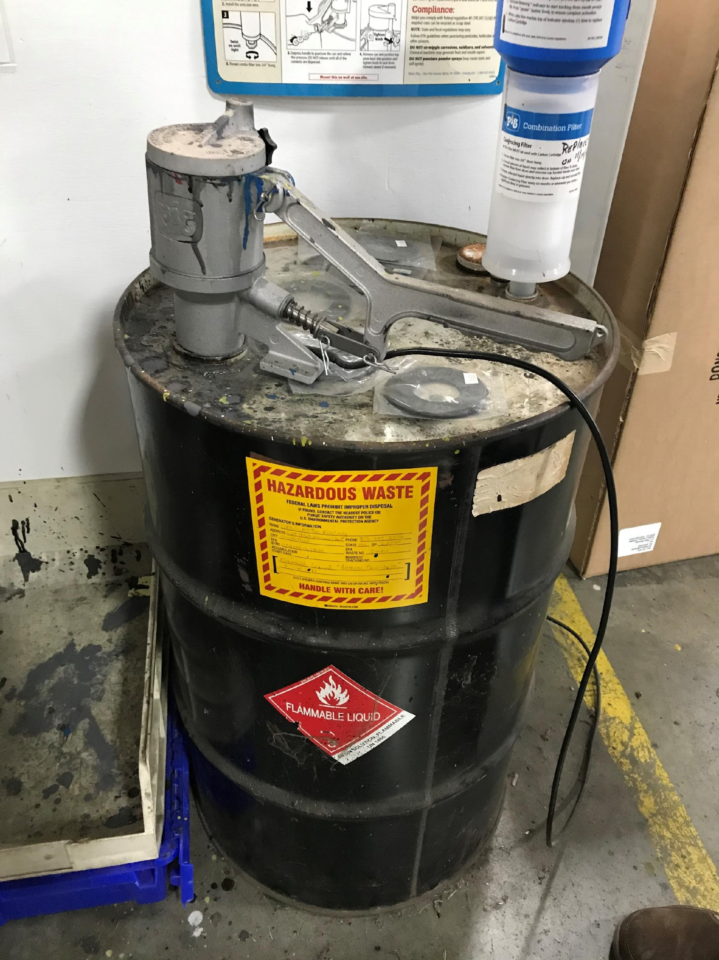
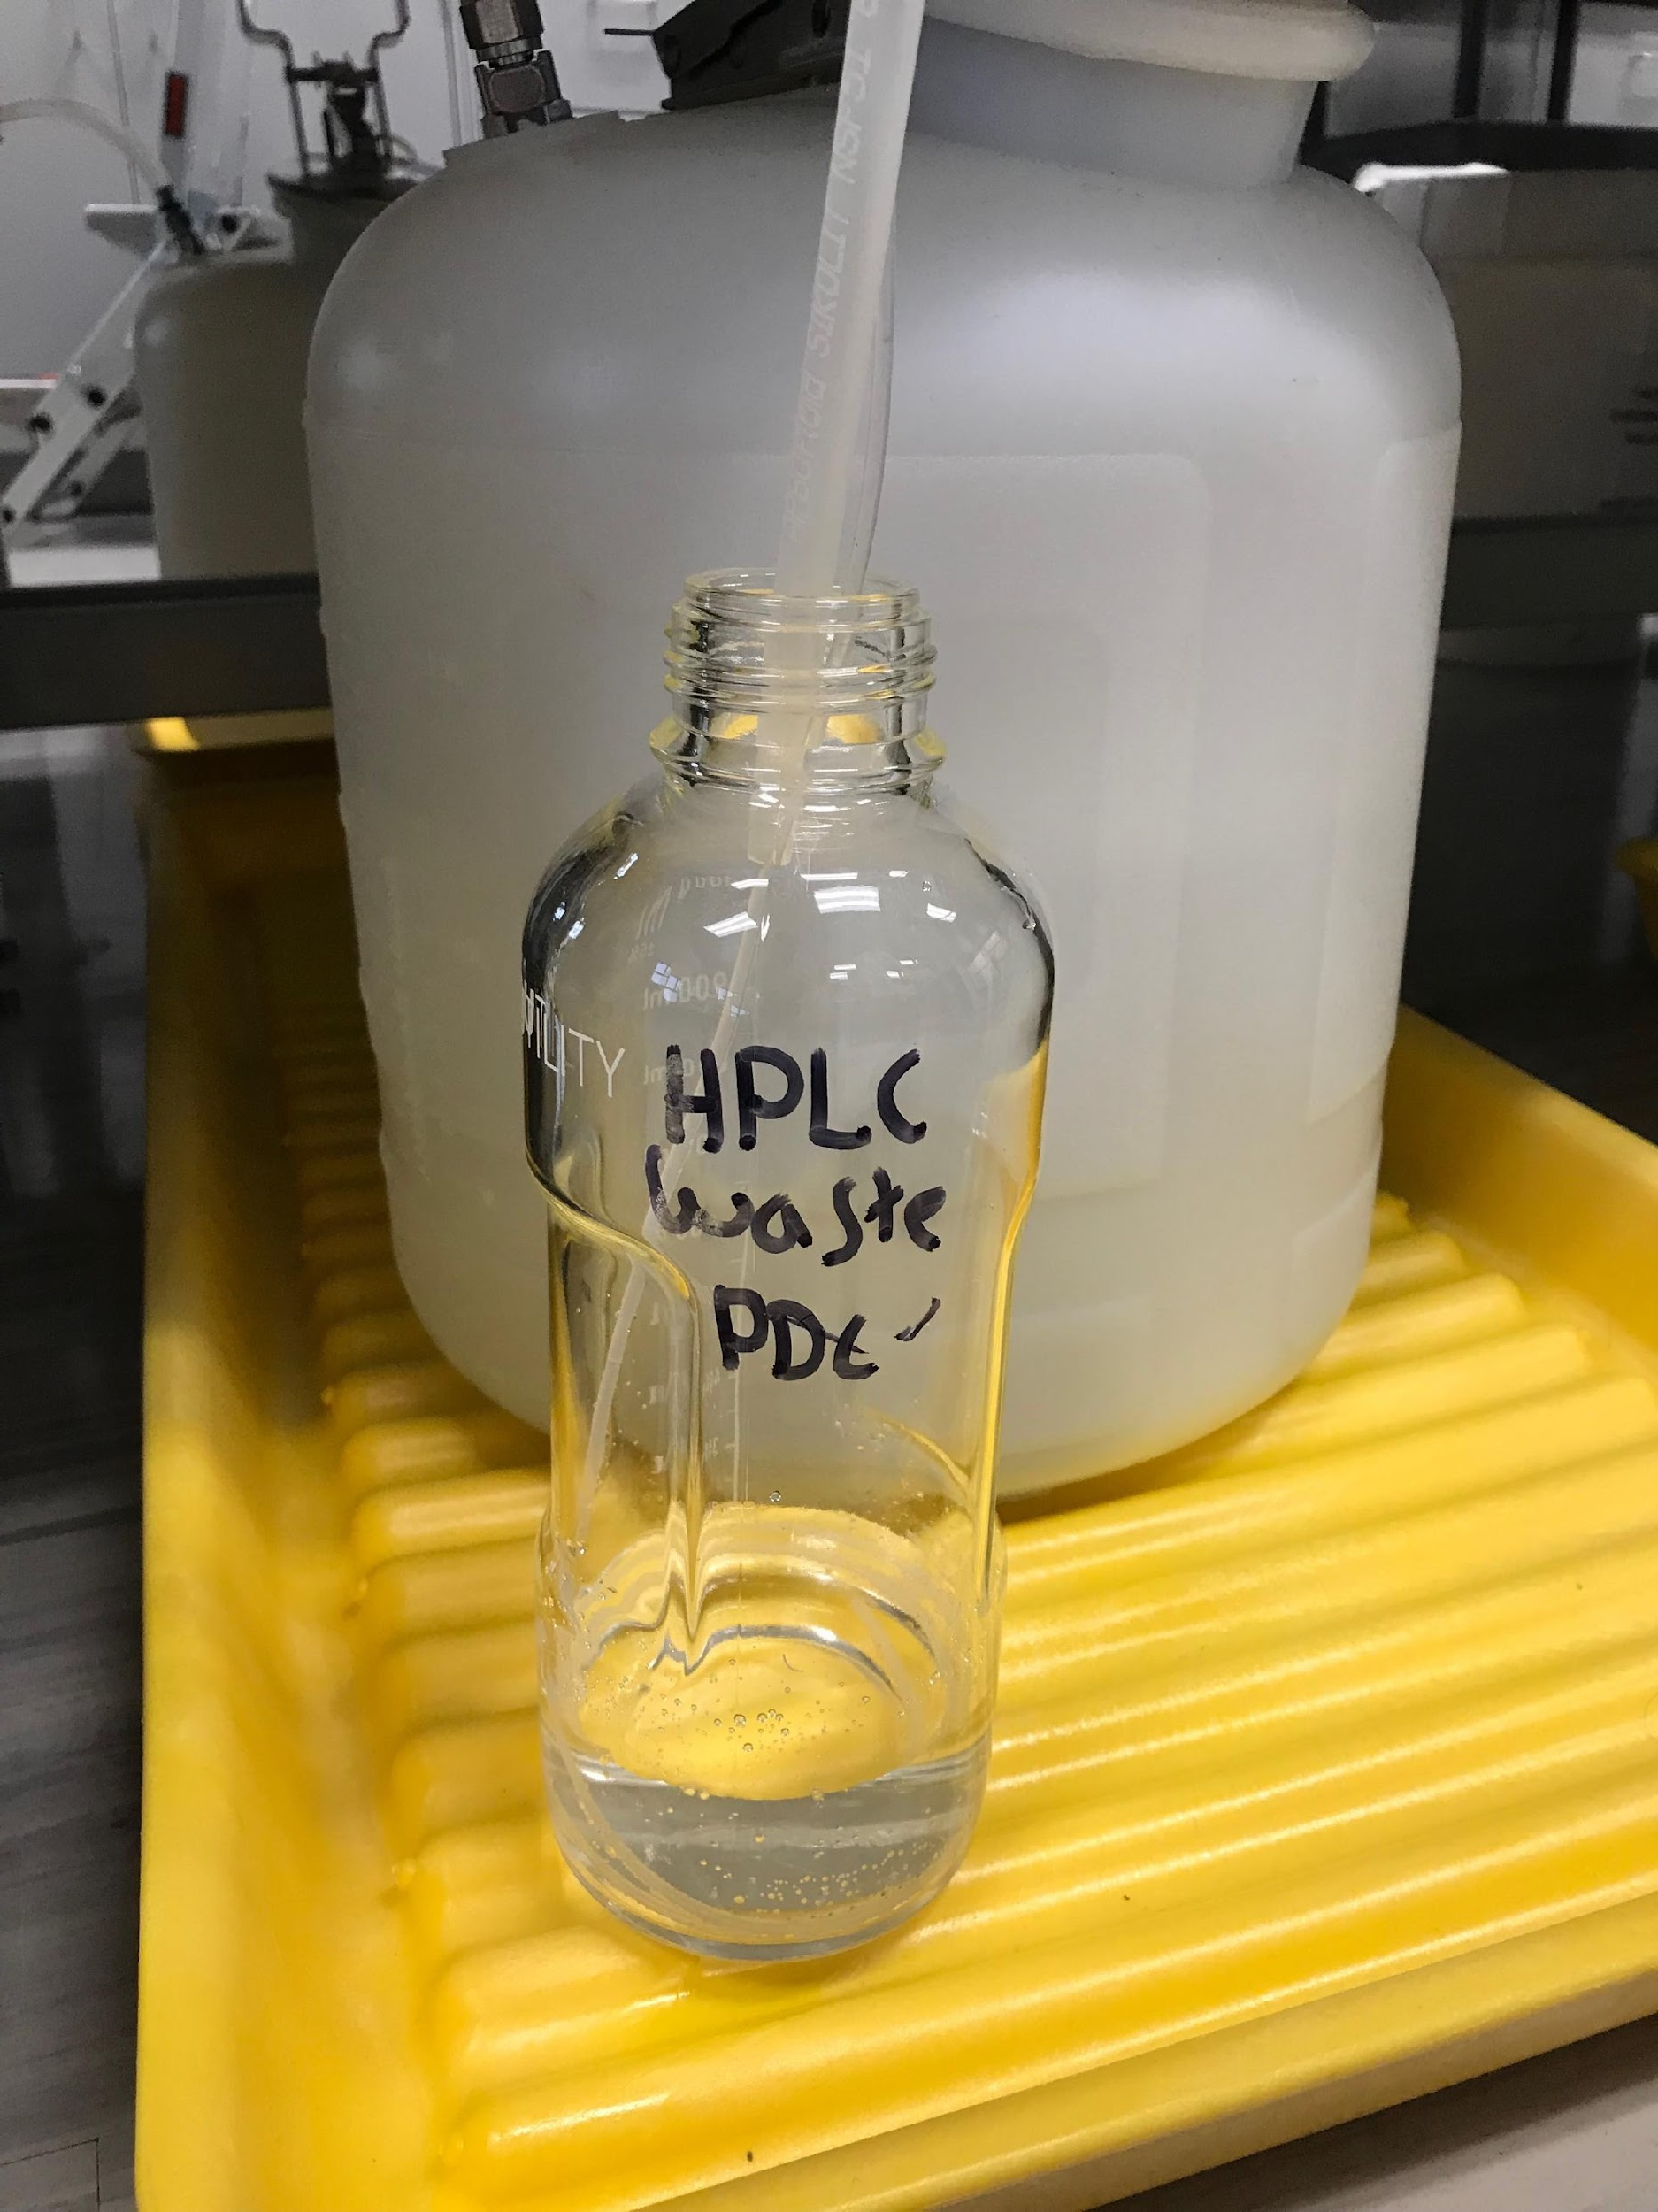
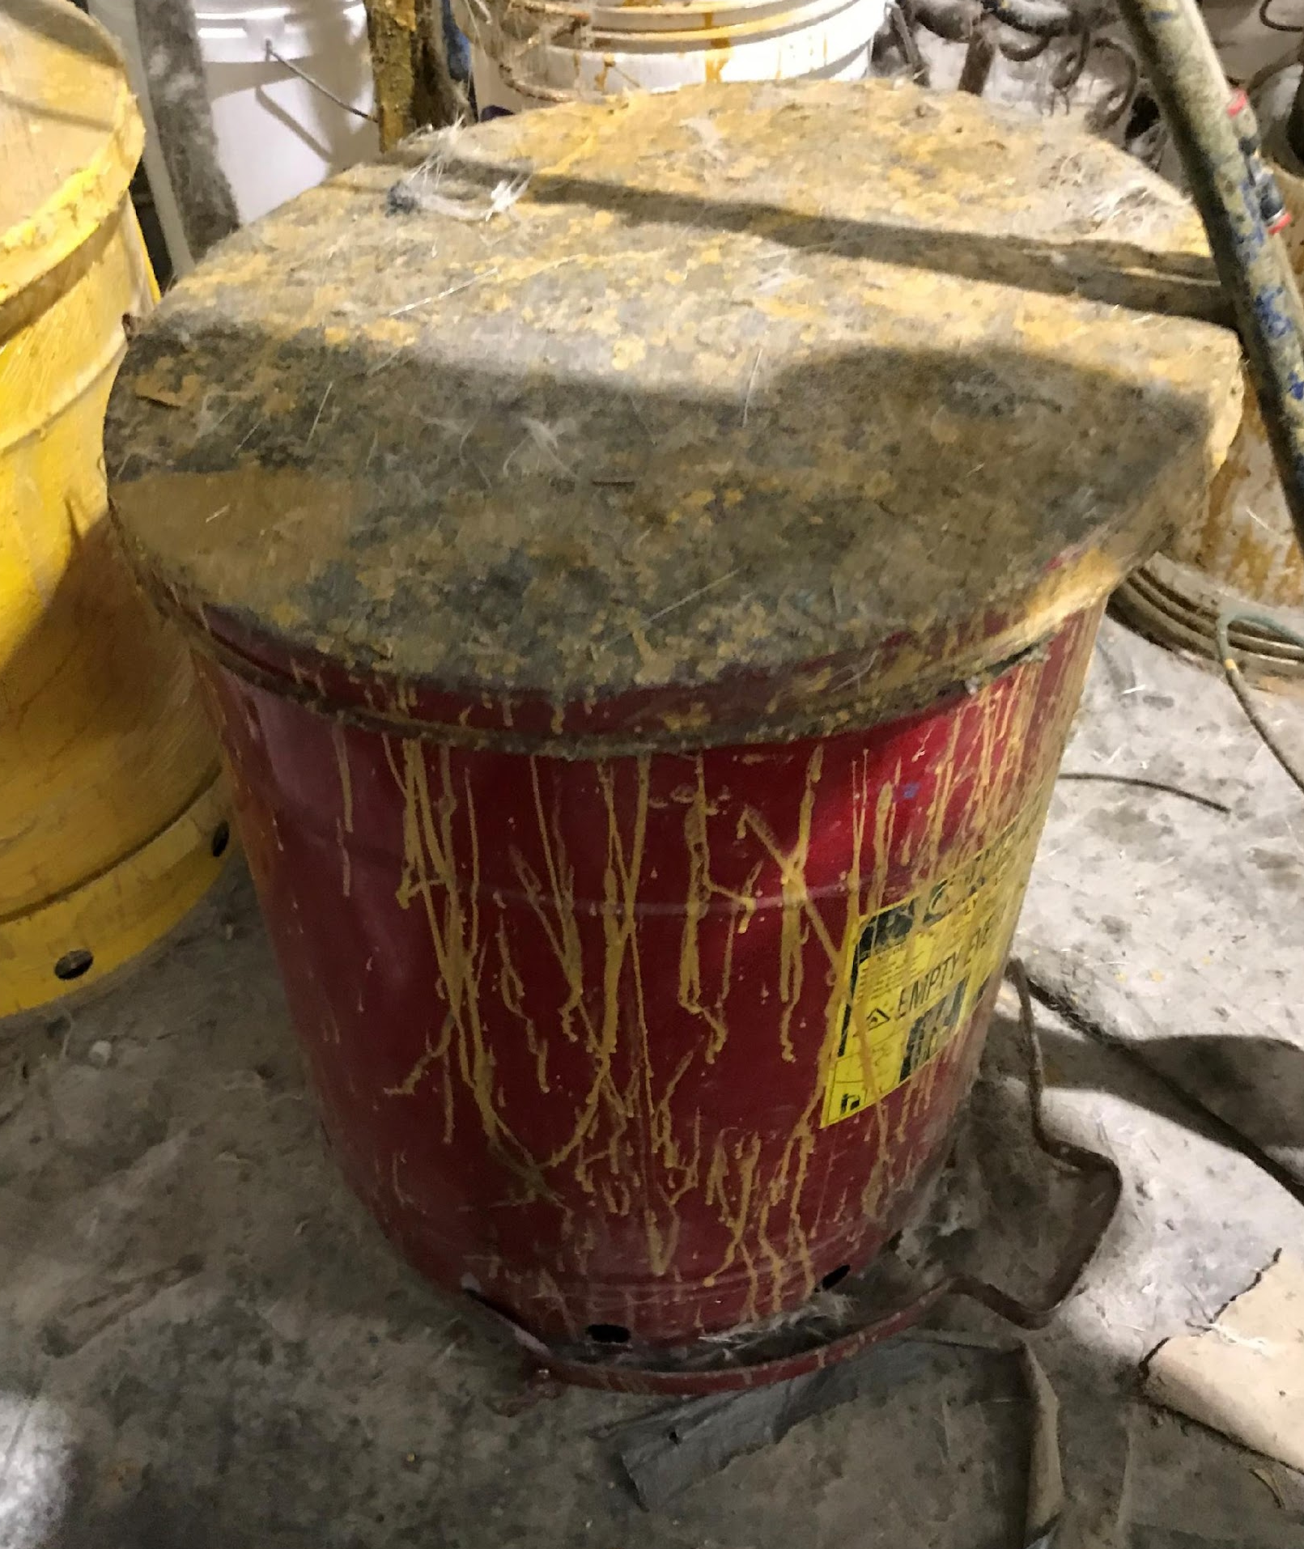
Container Management
40 CFR 262.15 (SAA) and 262.16(b)(2) and (6) (CAA)
Both SAA and CAA containers:
Waste must be kept inside the container
Clean up spills immediately
Notes:
In both Satellite and Central Accumulation Area containers waste must be kept inside the container. If a spill occurs, clean it up immediately.
Who can tell me what is wrong with picture one? Two? Three?
Photos left and right have spills; center one is “open”.

Slide 42
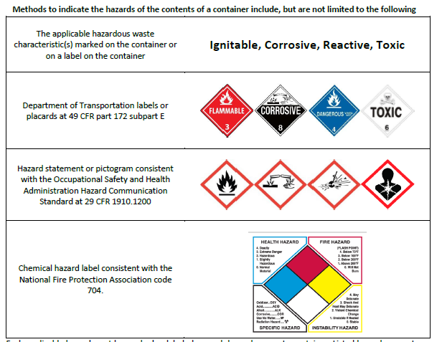
Hazard Indication Guide for Marking HW Containers
“Newer” requirement from the Hazardous Waste Generator Improvements Rule
All HW containers (SAA and CAA) must be marked with an indication of the hazards of the contents of the container.
Notes:
All HW containers (Satellite and Central Accumulation Areas) must be marked with an indication of the hazards of the contents of the container. These are some of the symbols that may be utilized.

Slide 43
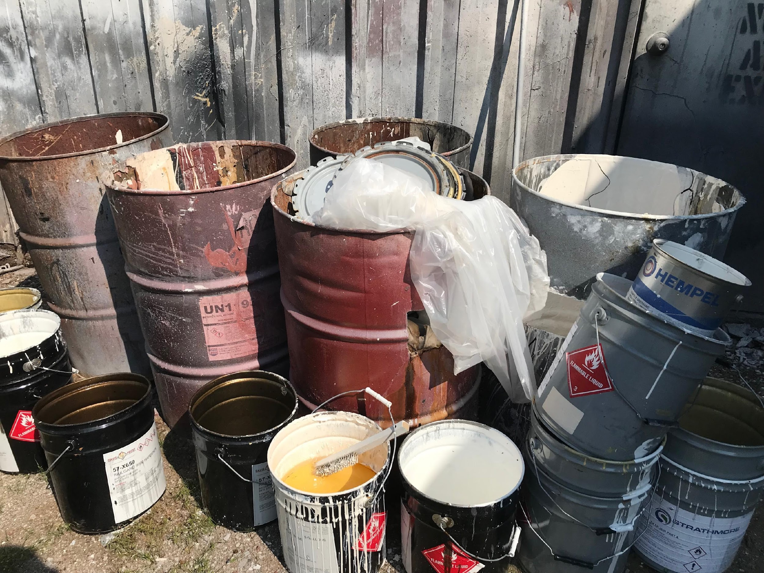
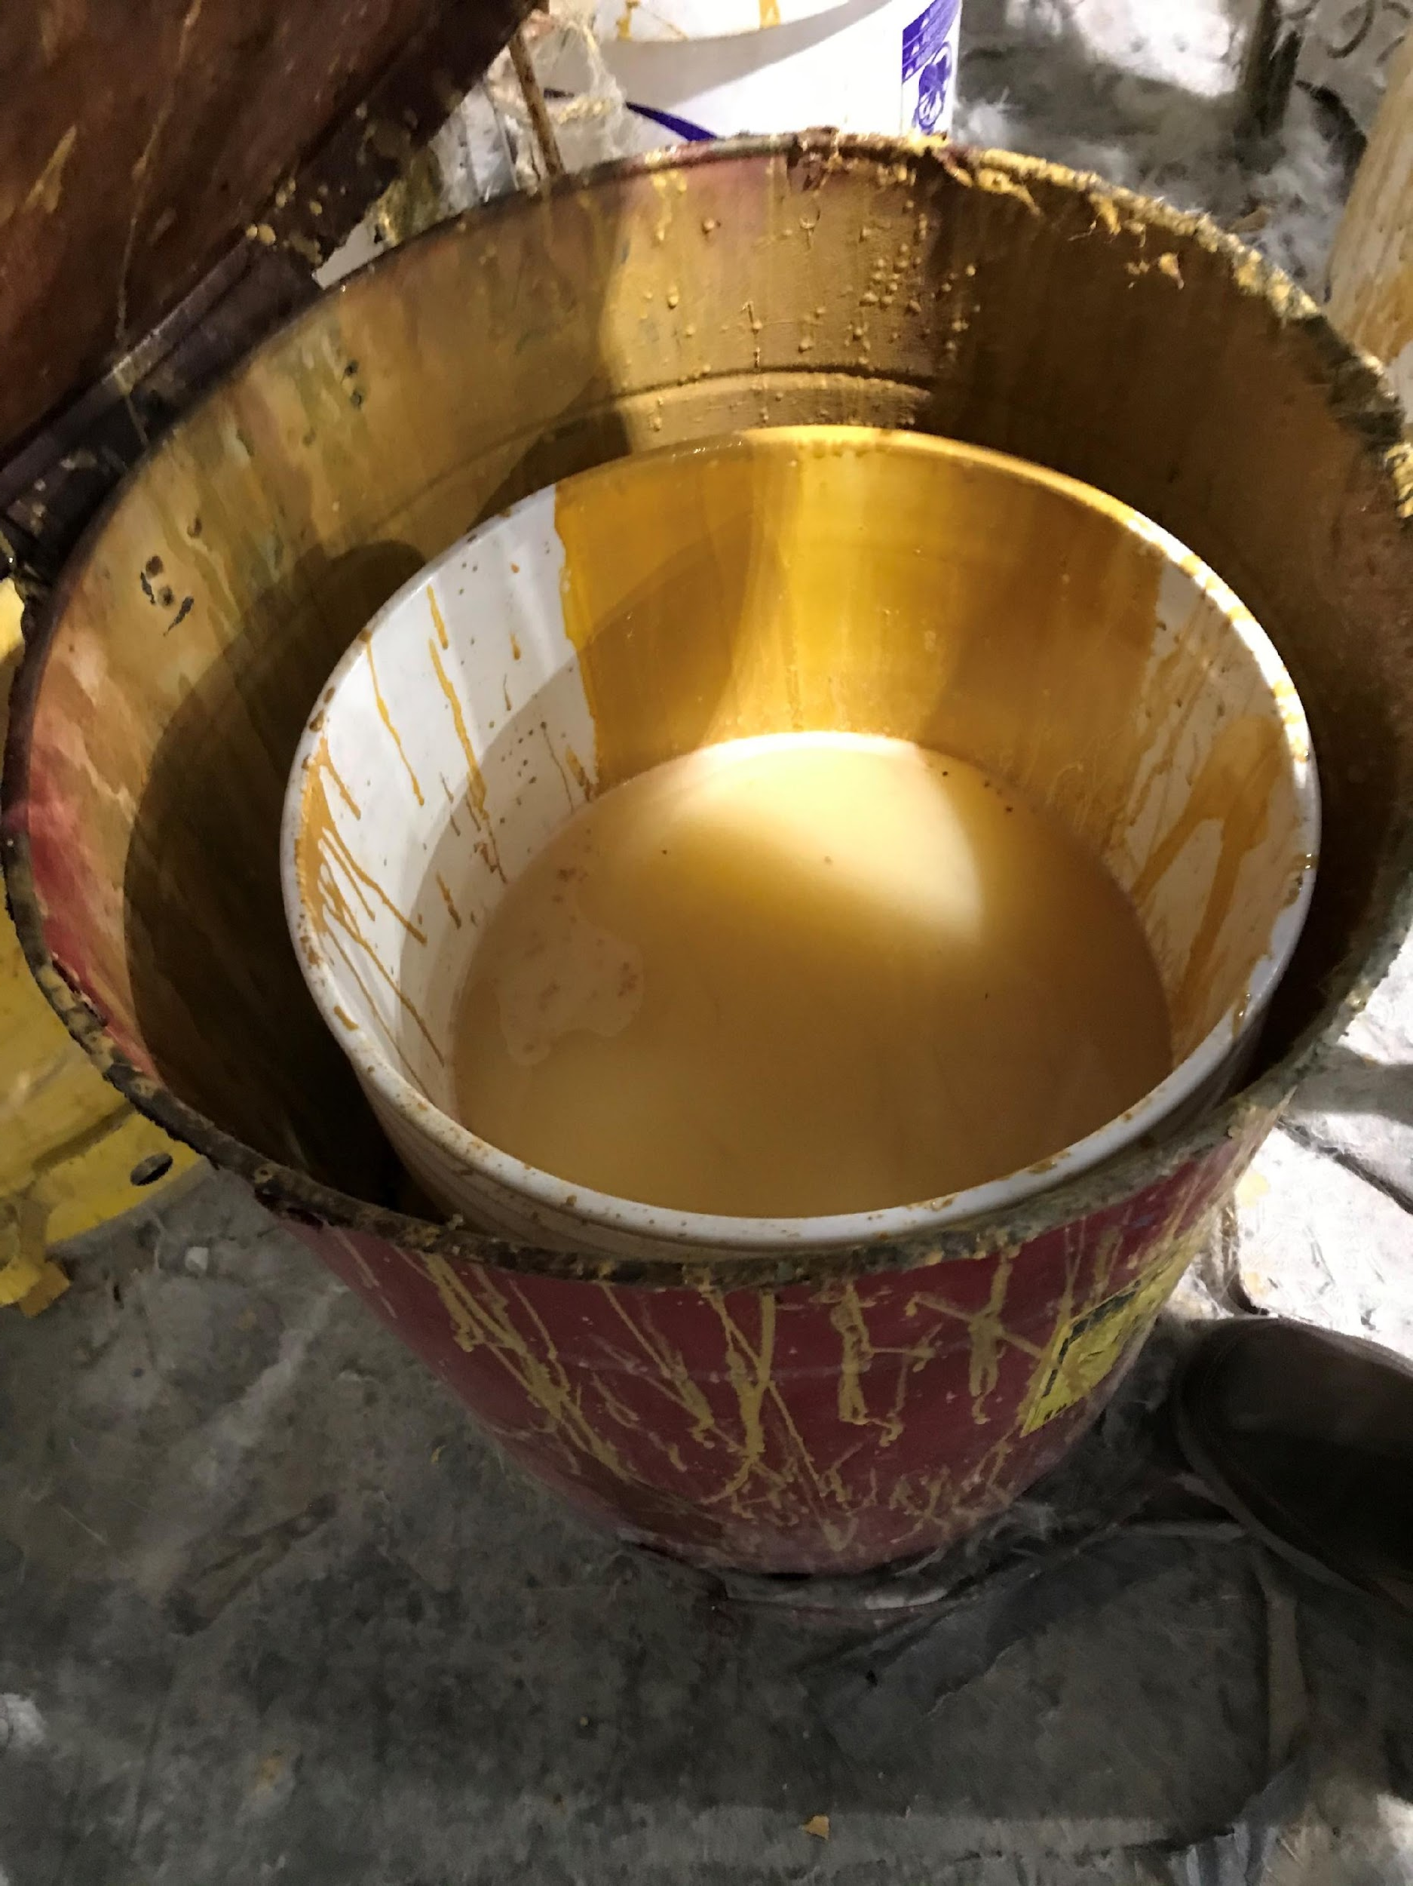
Improper Container Management
Notes:
Who can describe something wrong in picture one on the left? The one on the right?
Open containers (including step can with liquids on the right).

Slide 44
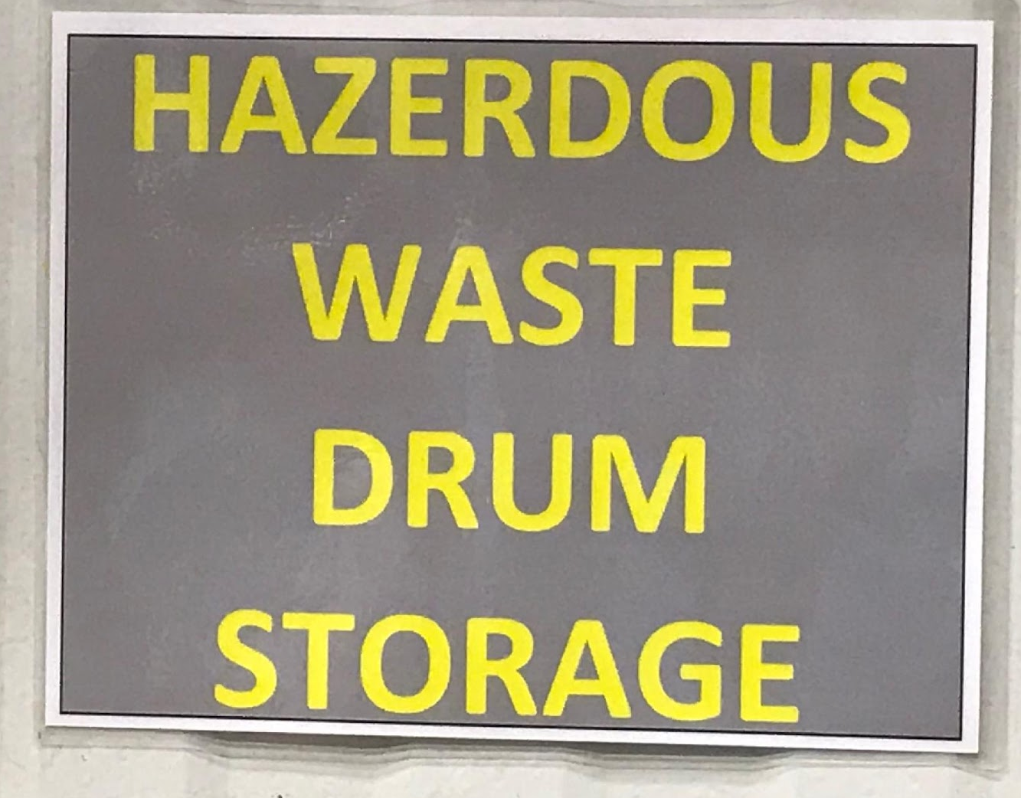
CAA Inspection Records – Containers
40 CFR 262.16(b)(2)(iv)
At least weekly, the generator must inspect Central Accumulation Areas (CAAs) looking for leaking containers and deterioration of containers caused by corrosion.
Documentation of weekly inspections in Florida must include:
Include the date and time of the inspection,
the legibly printed name of the inspector,
the number of containers,
the condition of the containers,
a notation of the observations made, and
the date and nature of any repairs or other remedial actions
Notes:
Central Accumulation Areas must be inspected at a minimum of once a week. The containers must be checked for leaking and any signs of deterioration or bleve. The generator must keep documentation of the inspections including the date and time of the inspection, the printed name of the inspector, the number of containers present, the condition of the containers, any notes on observations made, and if there are any repairs or remediation performed it must be noted.

Slide 45
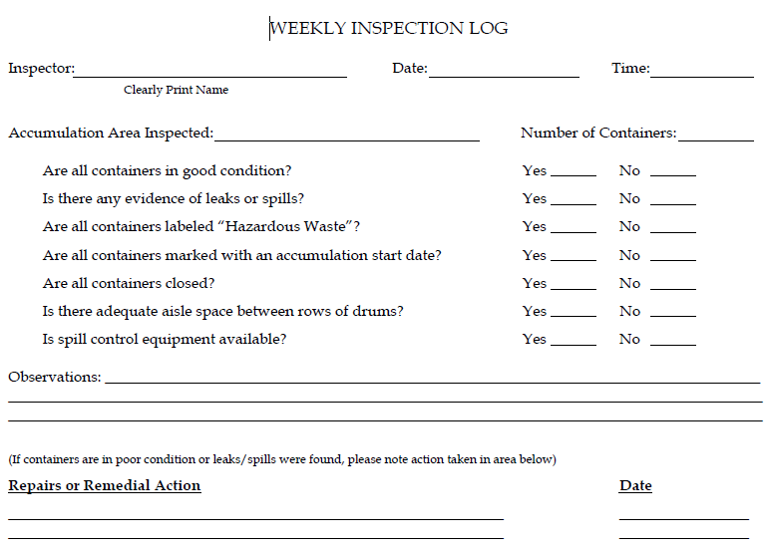
Weekly Inspection Form Example
Meets Florida Requirements
Weekly inspections conducted and documented (in Central Accumulation Areas)
https://floridadep.gov/waste/permitting-compliance-assistance/content/hazardous-waste-publications
Notes:
This is an example of a weekly inspection log. This may be found on the FDEP website.

Slide 46
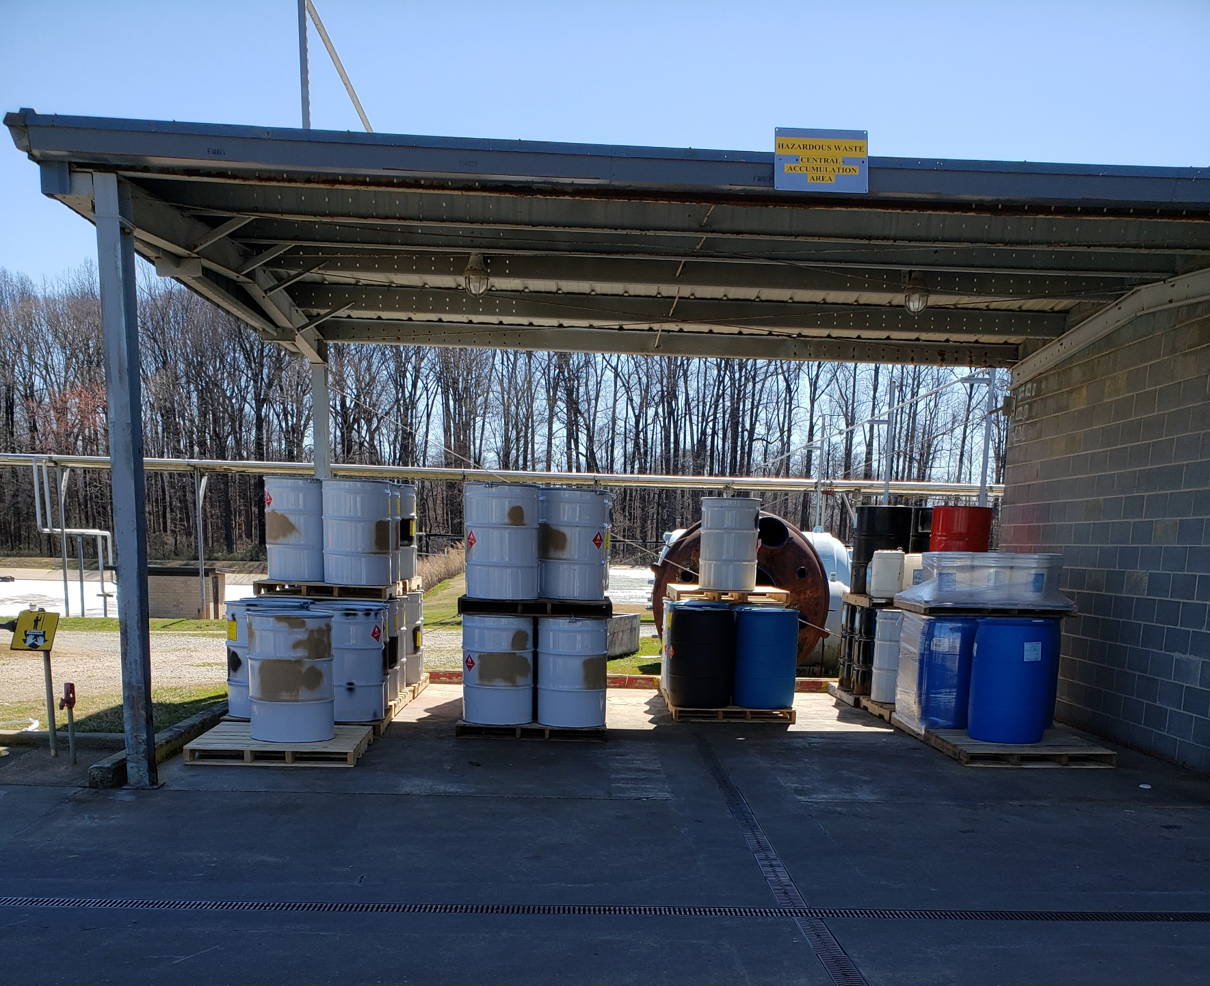
Aisle Space
40 CFR 262.16(b)(8)(v)
Must be maintained to allow unobstructed movement of personnel, fire protection equipment, spill equipment, etc.
Also required in SAAs
Good aisle space!
Notes:
40 CFR 262.16(b)(8) discusses the Preparedness and prevention requirements, so it pertains to all areas where hazardous waste is either generated or accumulated. There must be enough aisle space between rows to allow personnel, fire protection equipment, spill cleanup equipment, and other necessary movement to occur between the rows. This is an example of good aisle space.

Slide 47
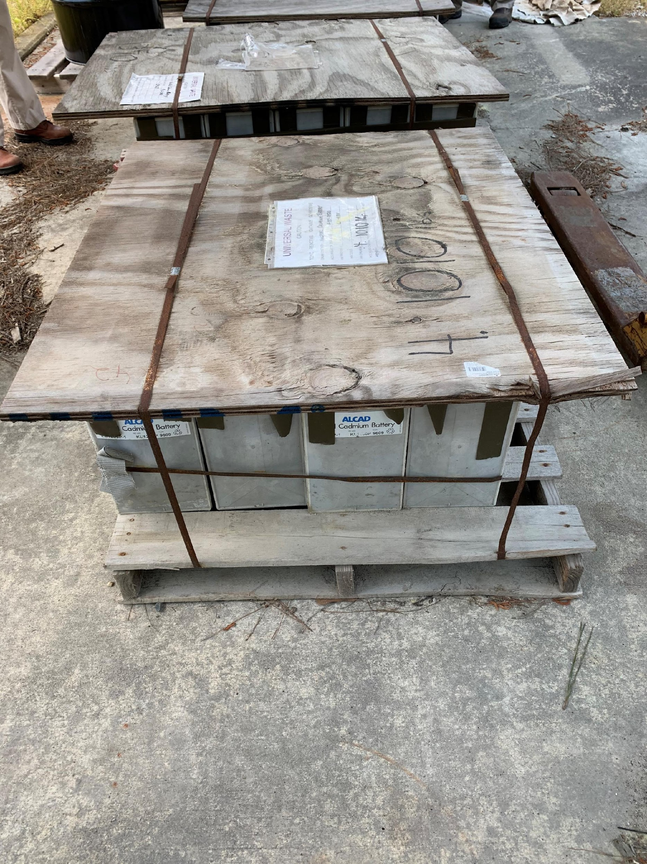
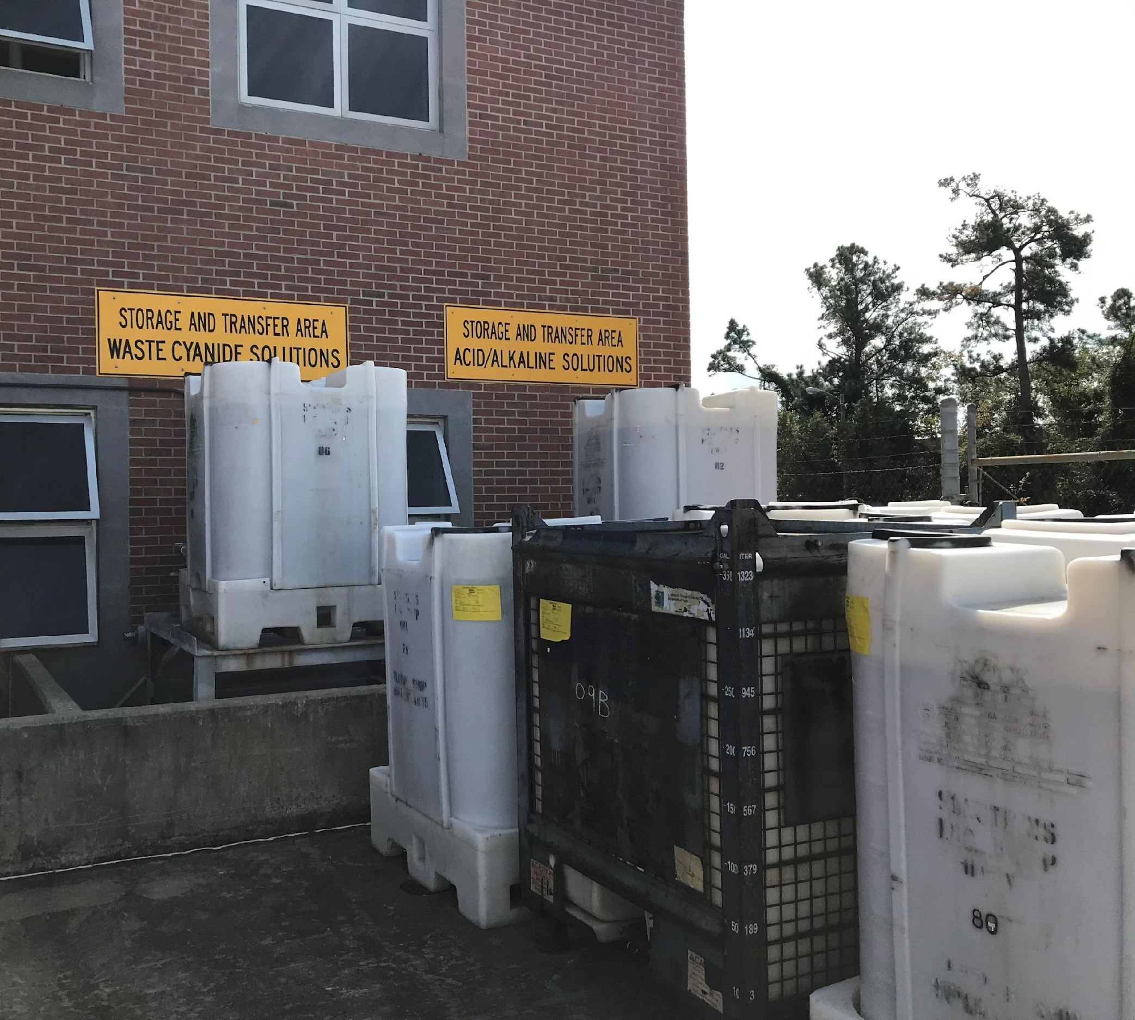
Improper Aisle Space
If this was HW it would be bad aisle space!
Notes:
If this was hazardous waste, there would not be adequate aisle space in the center of the pallet. This was Universal Waste, so that wasn’t a problem, but it doesn’t meet requirement for Universal Waste labeling either (and nor for marking HW).
Military base IWTP with improper aisle space – you cannot reach the row of containers in the back/right side.

Slide 48

Questions?
Sondra McCulloch
Environmental Specialist II
Volusia County
Environmental Management
Pollution Control
386-736-5927
Notes:
Thank you for your time today. I hope you found this presentation useful and perhaps learned something new today.

