Slide 1

AEROSOL CANS 101 &
Waste Management Options
Presented by: Vanessa Cruz

Slide 2
Federal Intent – March 16, 2018
Include this common waste stream as universal waste to better ensure that aerosol cans are managed appropriately at the end of their lives, remove these wastes from the municipal waste stream, potentially encourage recycling, and reduce unnecessary burden for generators.
84 FR 67202

Slide 3
Federal Register Volume 84 No. 236
Increasing Recycling: Adding Aerosol Cans to the Universal Waste Regulations
12/09/19: Formal announcement in Federal Register.
02/07/20: Final rule effective date.
10/30/20: Florida adoption outlined in Chapter 62-730.185, FAC.

Slide 4
Aerosols 101

Slide 5

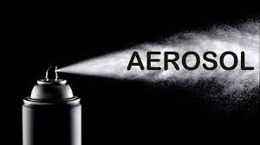
What is Aerosol?
wikipedia.com
A system of colloidal particles dispersed in a gas and commonly formed as smoke, fog, mist, haze, or smog.
Source: dictionary.com/browse/aerosol
In other words it’s what comes out of the can not the can itself.
Youtube.com

Slide 6
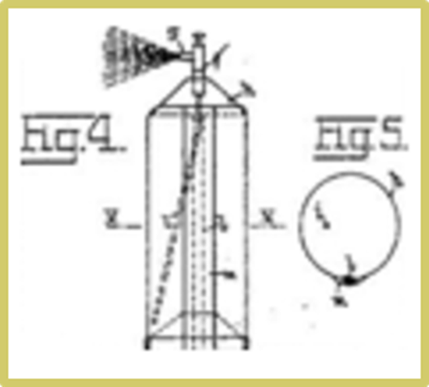
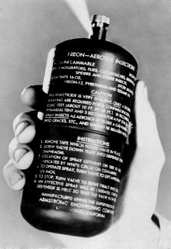
History of the Aerosol Can
1926 - Norwegian engineer, Erik Rotheim wanted a better way to wax his skis.
1941 – two USDA scientists credited with the invention of the modern day spray can.
    Bug bomb used by the US military to protect soldiers from malaria
1949 – Patent filed by Robert Abplanalp (a machine shop proprietor) for first mass-produced aerosol valve known as the “crimp-on-valve.”
    It was this invention that revolutionized the aerosol can industry
1974 – two U.S. scientists propose research that chlorofluorocarbons (CFCs) contribute to ozone depletion, which were phased out by 1995.
Notes:
You’ve probably never heard of Eric Rotheim, but there’s no doubt you are familiar with his work. So it wasn’t until WWII that this invention became popular to keep soldiers safe. However, it was around the 1950’s when the can as we know it today was revolutionized…that little mechanism we all take for granted - for when we press it something comes out…and uniform…the valve. It was that part that made the can so diverse and widely able to be used.

Slide 7
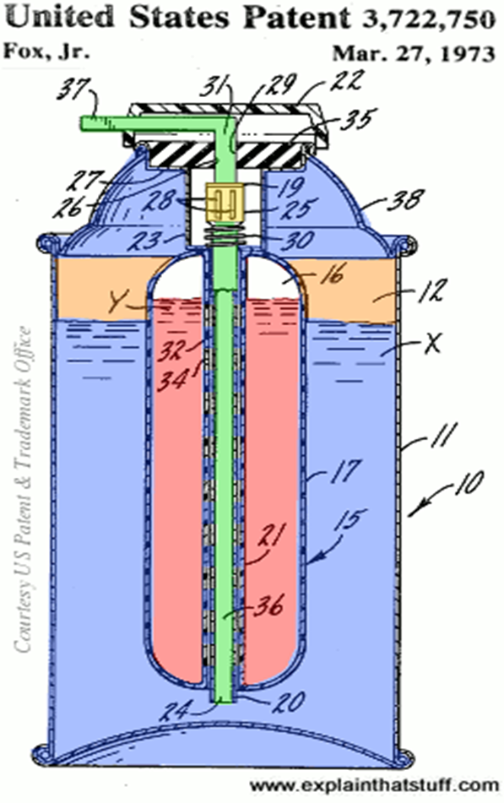
Aerosol Convenience
Suitable for a wide range of products
      Powders
      Gels
      Foams
      Pastes
      Liquids
Easy & ready to use – no mixing or measuring
Long shelf life
Spill-proof (generally)
Product stability - low risk for contamination or evaporation
Safe (generally)
Notes:
We use over 3.75 billion aerosol cans in the US each year and the EPA estimates that they are 40% of the hazardous waste stream in the retail industry.

Slide 8
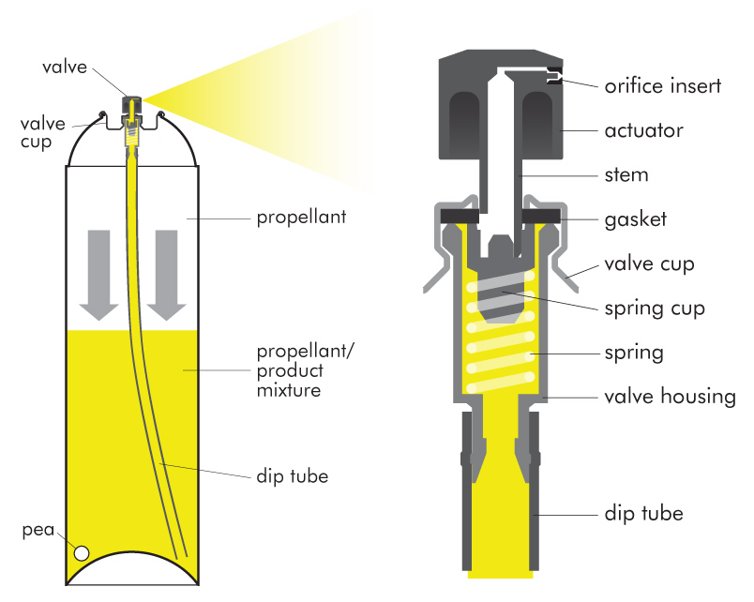
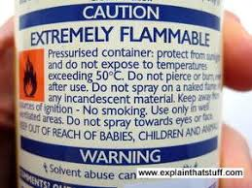
How Aerosol Cans Work
To pressurize container – must use propellant (pressurized gas such as propane & butane these days), which turns into a liquid in container.
When valve engaged – propellant turns back into gas, pushes down on the product (liquid) your interested in, forcing it up through the dip tube.
Container is useless without functioning valve.
When released, the liquid propellant becomes a gas and helps break up the product into a fine mist. In foams the liquid gas forms bubbles, making the product expand as it is released from the aerosol.
The gas is released and evaporates from the liquid causing constant performance and pressure from the container.
en.wikipedia.org
Notes:
A typical aerosol can consists of several components, including (but not limited to) the following: (1) The can or container storing both propellant and the product; (2) an actuator or button at the top of the can that is pressed to deliver the product; (3) a valve, which controls delivery or flow of the product; (4) the propellant (a compressed gas or liquefied gas), which provides the pressure in the container to expel or release the product when the actuator is pressed to open the valve; (5) the product itself; and (6) a dip tube, which is connected to the valve to bring the product up through the can to be released when the actuator is pressed.

Slide 9
Two waste Concerns
Desired Product
Propellant (Pressurized Gas)
During the manufacturing process:
the cans are first filled with product
then gas propellant is injected
the valve is then crimped trapping the highly compressed compound within the confines of the can
Chlorofluorocarbons – until 1978 when it was banned after learning that it contributed to the depletion of the ozone layer.
Hydrocarbons – organic compounds made up of hydrogen and carbon – were the alternative until the 1980s when it was determined they may cause smog (i.e., butane, propane, and methane).
Hydrofluorocarbons –common today, which consist of hydrogen and carbon, and present a much smaller risk.

Slide 10
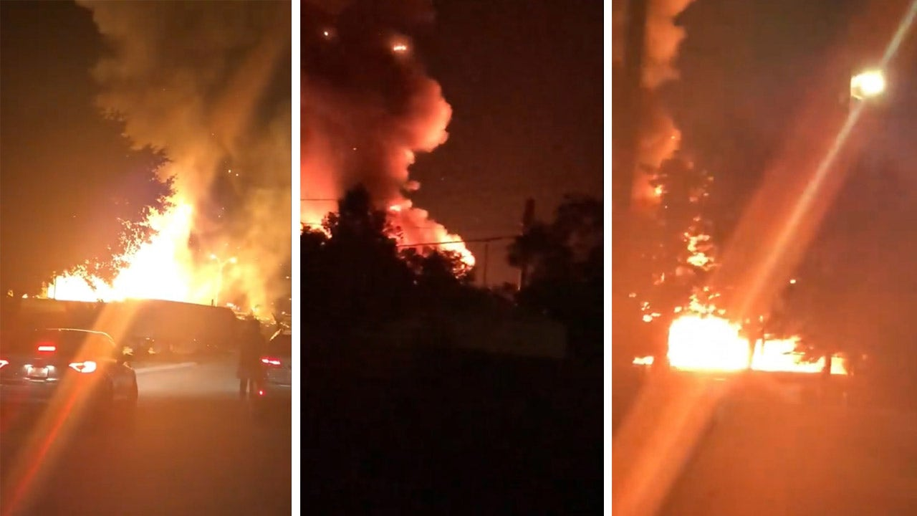
Caution
Many propellants are flammable, so it's dangerous to use aerosol cans around an open flame.
Another possible danger is inhalation: Some aerosol cans, such as whipped-cream containers, use nitrous oxide, which can be harmful if inhaled in mass quantities.
courtesy of: fox13news

Slide 11
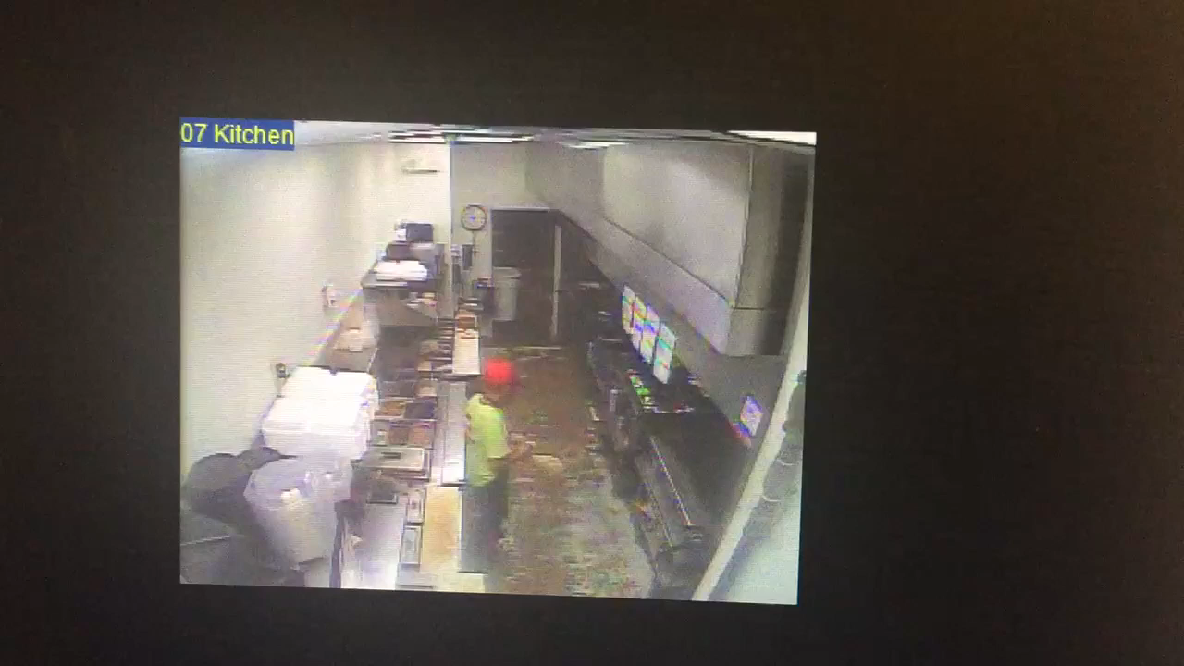
Don’t worry – you’re not having trouble hearing – there is no sound.
Employer surveillance camera caught this kitchen worker as he sprays cooking spray into oven.

Slide 12
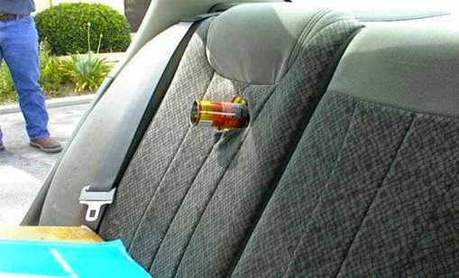
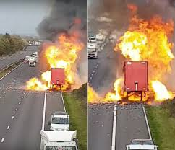
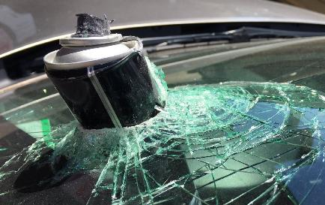
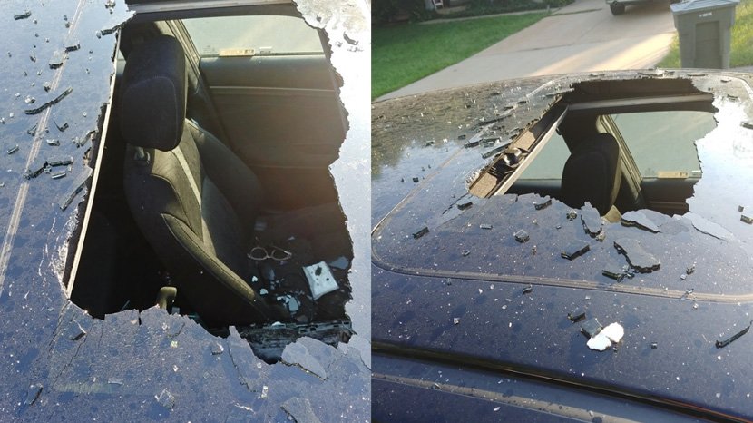
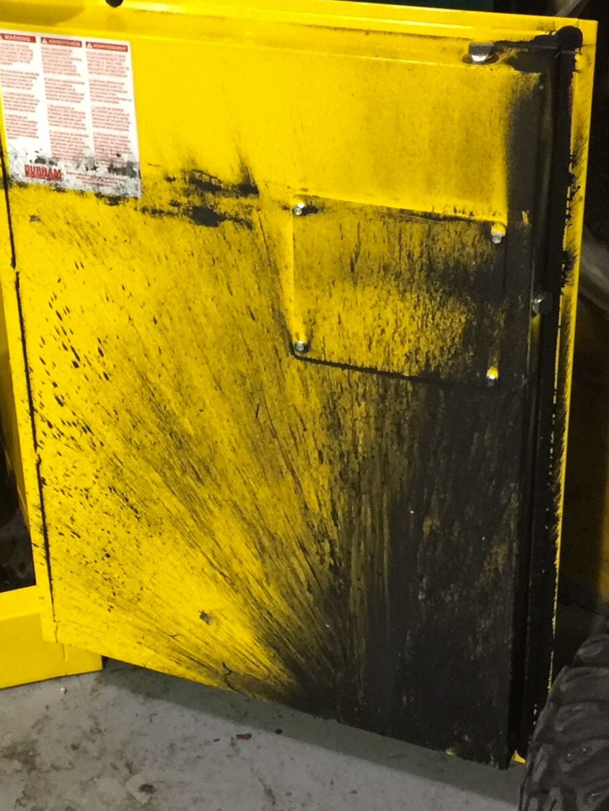
Metropolitan consulting engineering & forensics
Geekologie.com
Weather.com
Various explosions of aerosol can products. Most were common household items such as pam cooking spray, dry shampoo, hairspray, and wasp spray.
Nationalenvironmentalpro.com
CBS 17 News

Slide 13

Driver sprayed aerosol air freshener, then proceeded to light a cigarette. Even damaged nearby buildings.
Courtesy of: dailymail.co.uk

Slide 14
Aerosol Can Waste Management
Notes:
The current day rule went into effect nationally on February 7, 2020 and effective within the state on October 30, 2020.

Slide 15
40 CFR 273.9 Definition.
Aerosol can means a non-refillable receptacle containing a gas compressed, liquefied, or dissolved under pressure, the sole purpose of which is to expel a liquid, paste, or powder and fitted with a self-closing release device allowing the contents to be ejected by the gas.

Slide 16
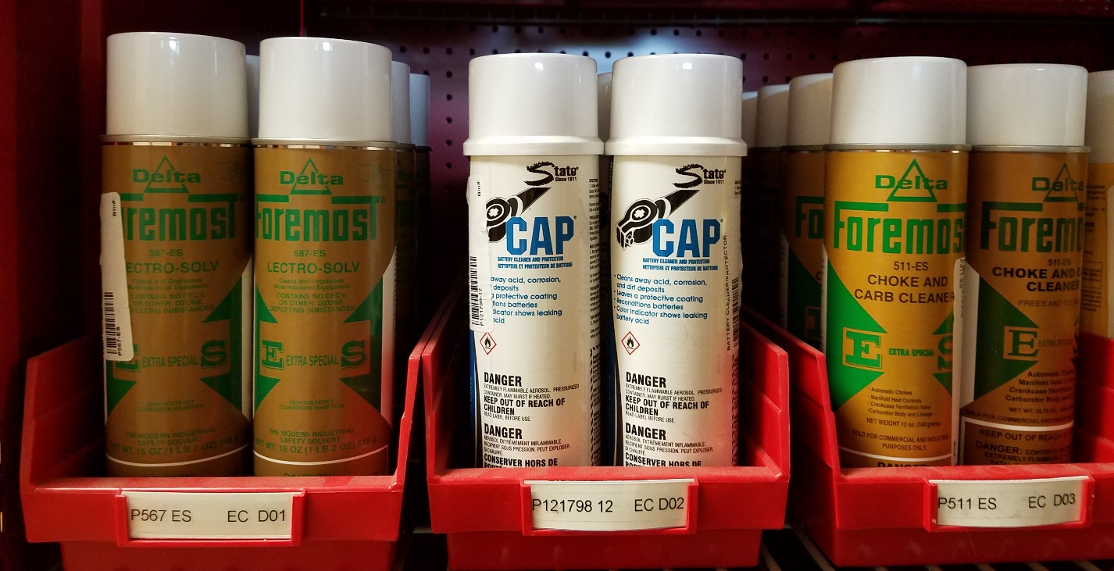
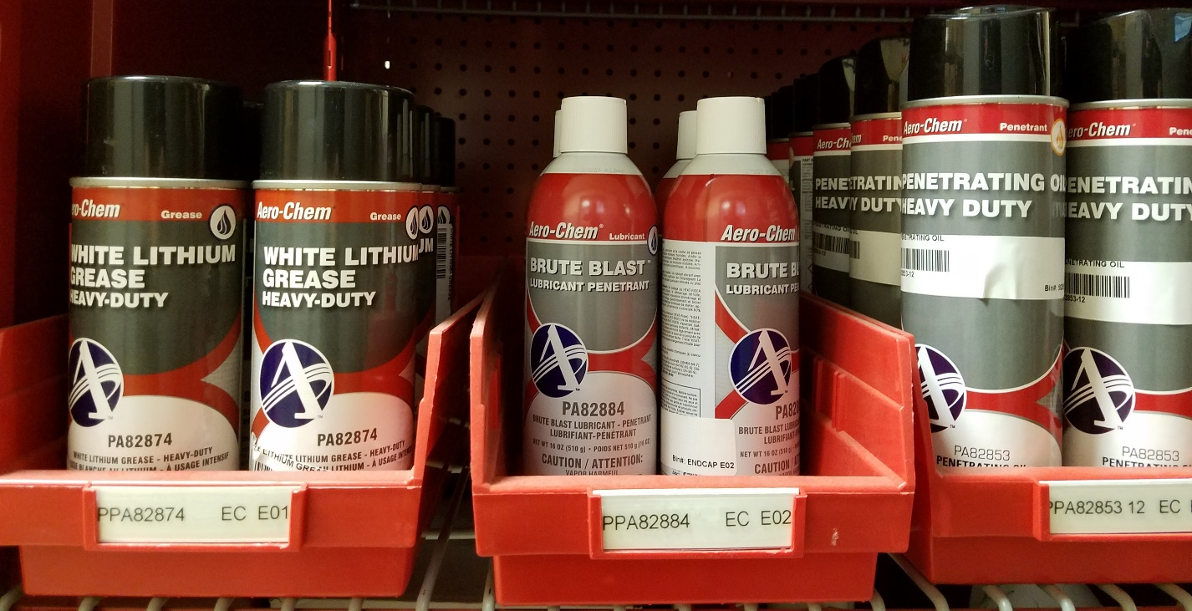
When Does an Aerosol Can Become A waste?
40 CFR 273.6 Applicability – Aerosol cans.
(c) Generation of waste aerosol cans.
(1) the date the aerosol can is discarded.
(2) the date the handler decides to discard the aerosol can.

Slide 17
What’s not Aerosol can Waste?
40 CFR 273.6 Applicability – Aerosol cans.
(b) Aerosol cans not covered under this part.
(1) Aerosol cans that are not yet waste under 40 CFR 261.
(2) Aerosol cans that are not hazardous waste.
      An aerosol can is a hazardous waste if the aerosol can exhibits one or more of the characteristics identified in part 40 CFR 261, subpart C, or the aerosol can contains a substance that is listed in part 261, subpart D; and
(3) Aerosol cans that meet the standard for empty containers under 40 CFR 261.7.

Slide 18
What Does Empty Really Mean?
40 CFR 261.7 Residues of hazardous waste in empty containers
(b)(1) A container or an inner liner removed from a container that has held any hazardous waste, is empty if:
(i) All wastes have been removed that can be removed using the practices commonly employed to remove materials from that type of container, e.g., pouring, pumping, and aspirating, and
(ii) No more than 2.5 centimeters (one inch) of residue remain on the bottom of the container or inner liner, or
(iii) (A) No more than 3 percent by weight of the total capacity of the container remains in the container or inner liner if the container is less than or equal to 119 gallons in size; or
(b)(2) A container that has held a hazardous waste that is a compressed gas is empty when the pressure in the container approaches atmospheric.
Note: Uncommon, but if a generator is using an aerosol can with acute hazardous waste refer to 261.7(b)(3)
Notes:
Basically when you press the valve and nothing at all comes out. This does not mean if the valve is broken and nothing can come out. It literally means there is nothing left to be used in the can. It also does not mean you depress the valve until nothing comes out (product or propellant).

Slide 19
Who Does the UW Rule Affect?
This final rule will affect persons who generate, transport, treat, recycle, or dispose of hazardous waste aerosol cans, herein referred to as aerosol cans, unless those persons are households or very small quantity generators (VSQGs).

Slide 20
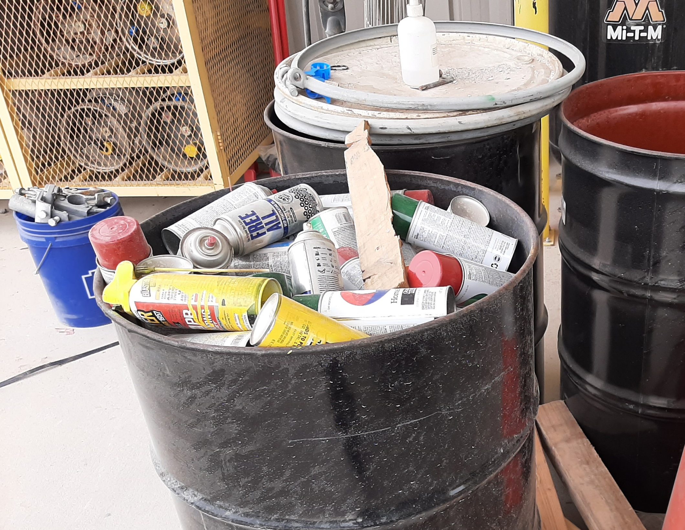
VSQGs
Extra burden to VSQGs if aerosol cans are managed as Universal Waste
- Training
- Labeling
- Dating
- Accumulation time limits
- Cannot puncture without a commercial designed puncturing device and procedures*
*VSQGs must meet 40 CFR 262.14(a)(5) if treating without a permit.

Slide 21
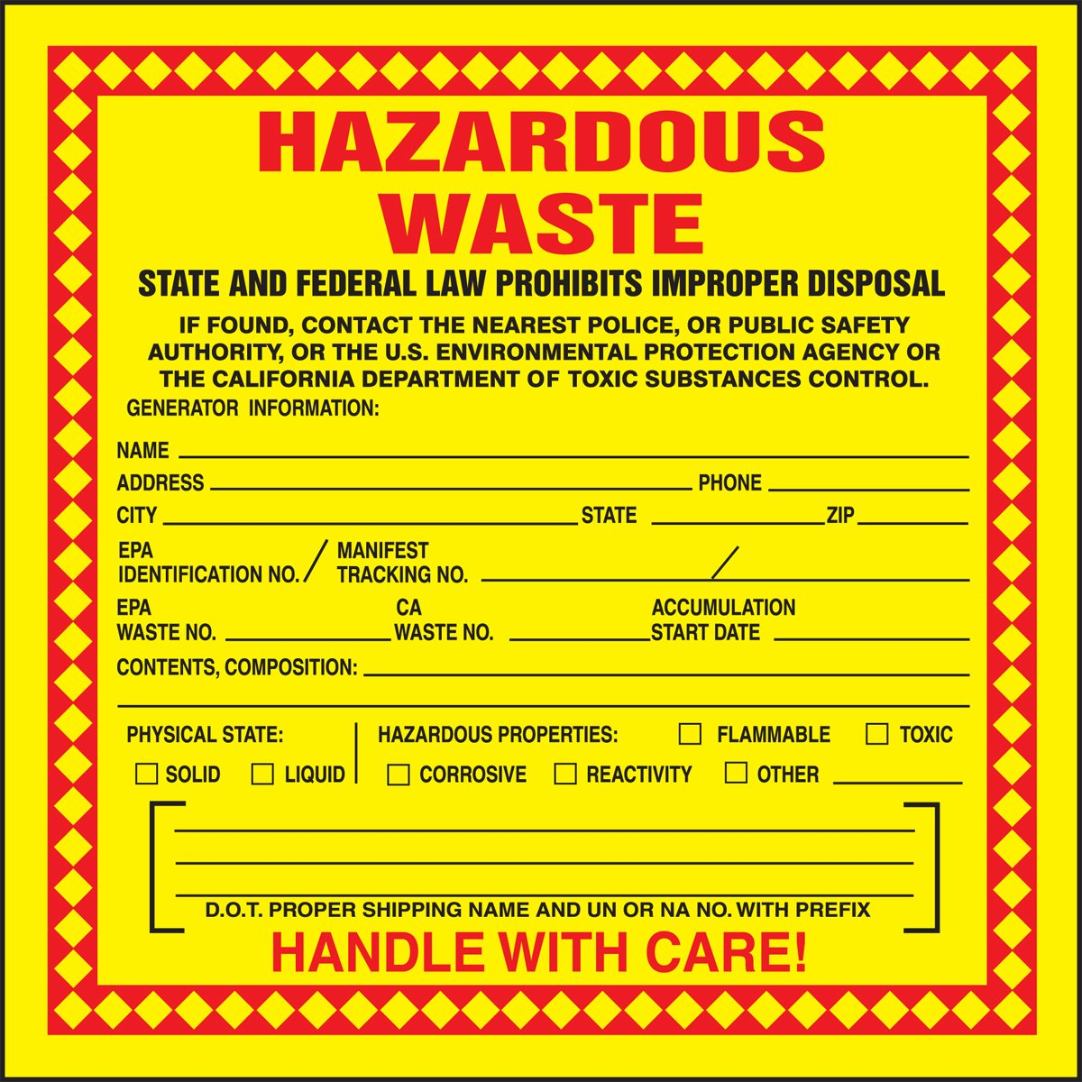
Generators Get to Choose!
Notes:
Lucky You! But first you must follow some steps to ensure you choose wisely.

Slide 22
Step 1
A person who generates a solid waste must make an ACCURATE determination as to whether that waste is hazardous at the point of generation.
Follow steps provided in 262.11(a) through (e).
We recommend also:
  Make an inventory of aerosol cans used in facility operations.
  Determine which aerosol cans would be hazardous.
  Are their viable alternatives to the hazardous ones currently in use?
  Use them up and switch to non-hazardous products, if possible.
40 CFR 262.11
Waste Determination

Slide 23
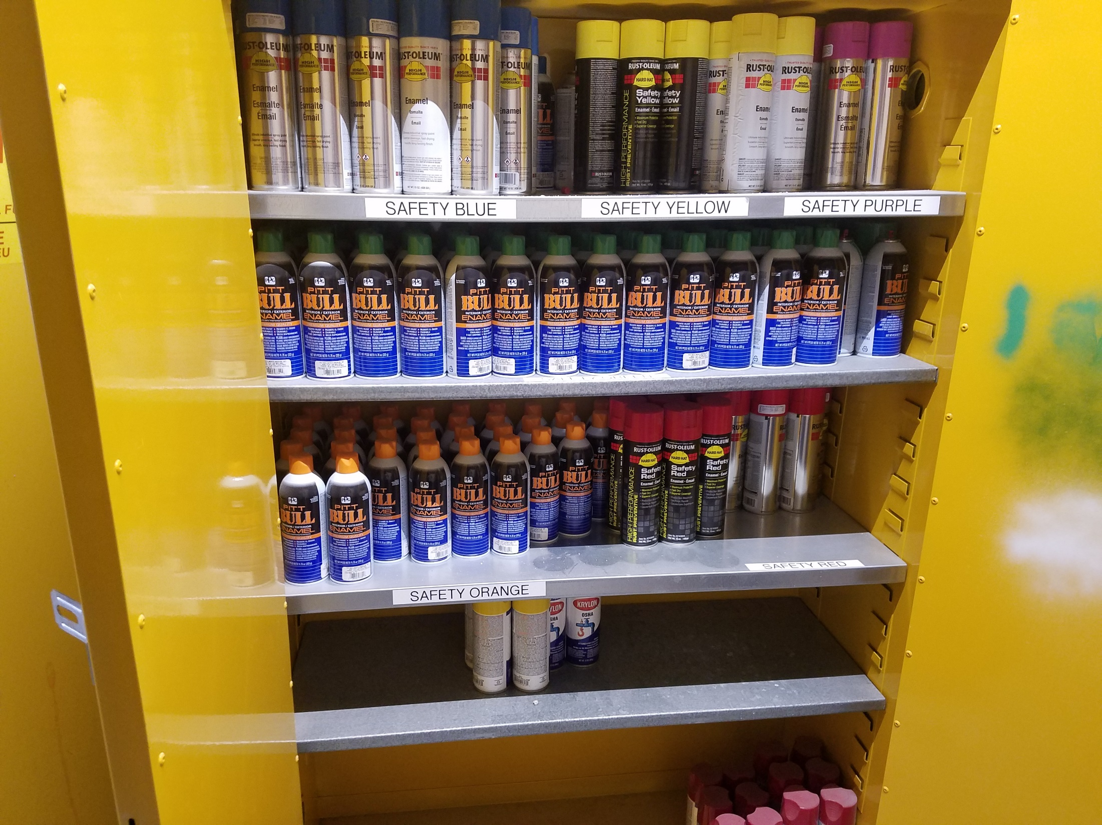

Slide 24
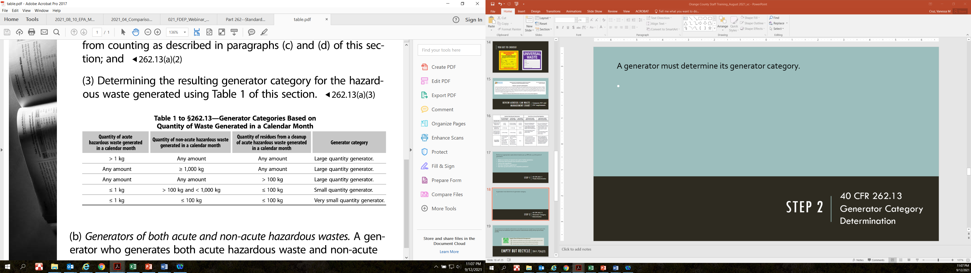
Step 2
40 CFR 262.13
Generator Category Determination
Notes:
A generator must determine its generator category based on the amount of hazardous waste generated each calendar month.

Slide 25
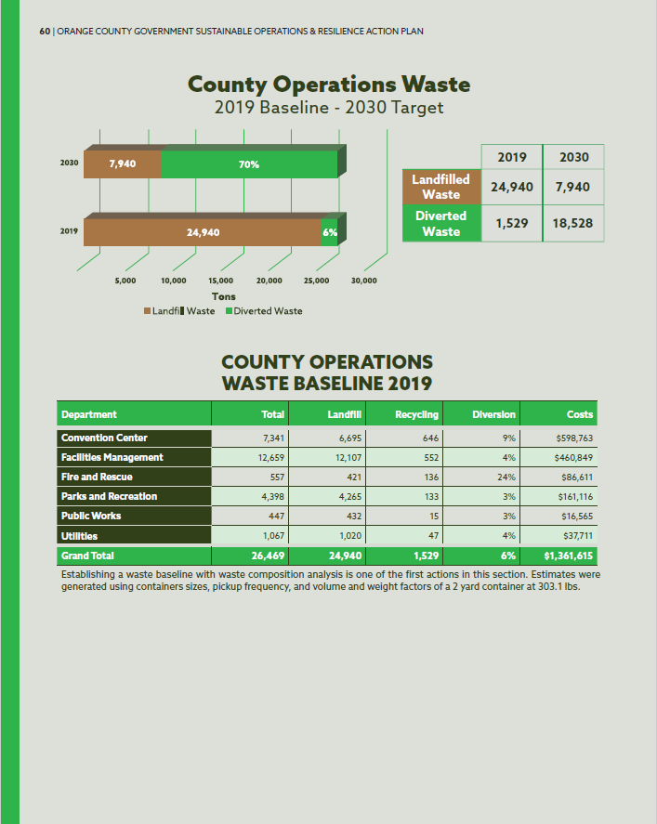
Step 3
Sustainable Operations & Resilience Action Plan
Supply Chain Management & Materials Management
Goal 14: Increase Waste Diversion Rates to 70% by 2030 at county facilities.
Determine how this waste stream fits into your division's goals and actions
Waste Minimization Requirements?

Slide 26
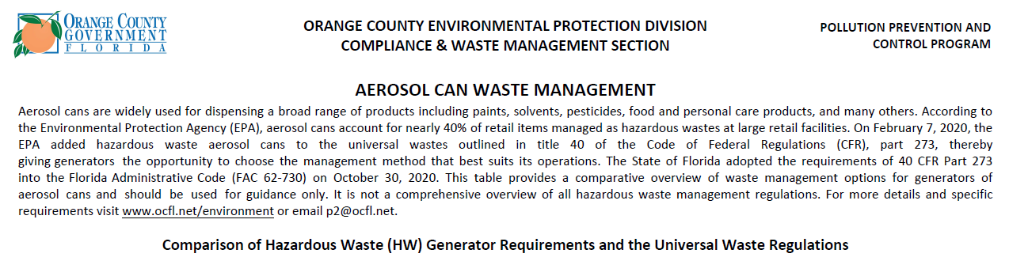
Step 4
Review and Compare Regulations

Slide 27
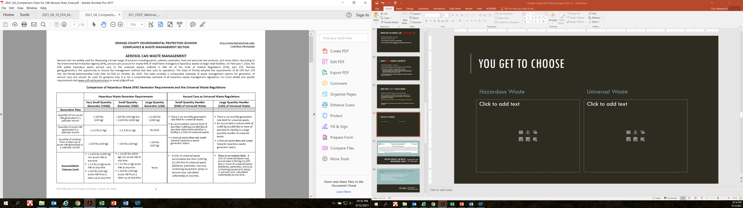
Notes:
We’ve made a 6 page chart that outlines the majority of the requirements in one place to make it easier for your facility to determine what’s right for your operations.

Slide 28
Step 5
Depending on your generator category keep in mind some of the following:
Benefits of the UW rule will apply to a generator that has potential for episodic generation. Waste managed as UW does not count towards monthly generation rates.
In order to recycle – cans must be drained and punctured. There are requirements to properly perform this activity to ensure compliance. Refer to Step 6.
The UW rule does allow waste to be accumulated for up to one year.
If consistently VSQG, recommend following hazardous waste regulations.
Considerations

Slide 29
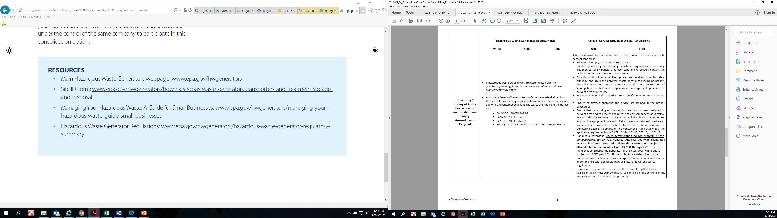
Step 6
Gold star worthy!
The next slide details 7 key steps before puncturing.
Refer to page 5 of the Aerosol Can Waste Management Chart
So, You’ve Decided to Recycle

Slide 30
Key Steps Before Puncturing
1. Puncturing and draining must be conducted in a device specifically designed to safely puncture aerosol cans. Keep manufacturer's instructions accessible.
2. Create and follow a written procedure that details how to safely puncture and drain cans. Ensure procedure is designed to prevent fires and releases.
3. Ensure employees are properly trained to operate.
4. Immediately after puncturing, transfer the contents to a container or tank that meets the requirements of 262.14, 262.15, 262.16, or 262.17.
5. Conduct a hazardous waste determination on the drained contents of the cans.
6. Establish a written procedure to respond to spills or leaks and keep spill kit near.
7. Ensure empty punctured aerosol cans are RECYCLED.

Slide 31
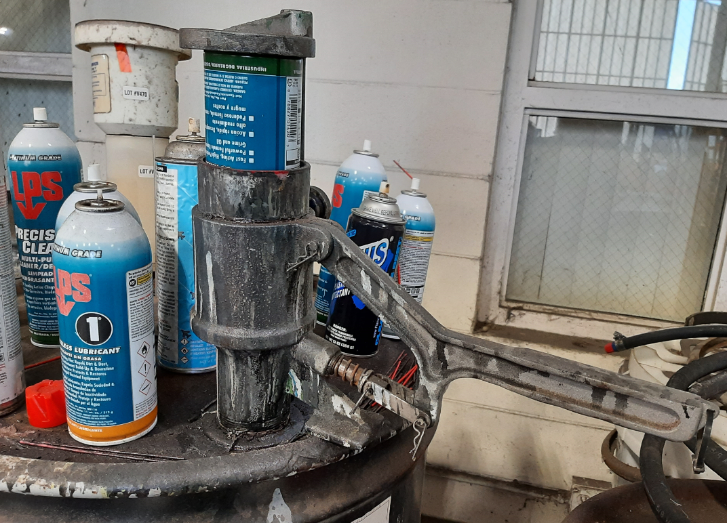

Slide 32
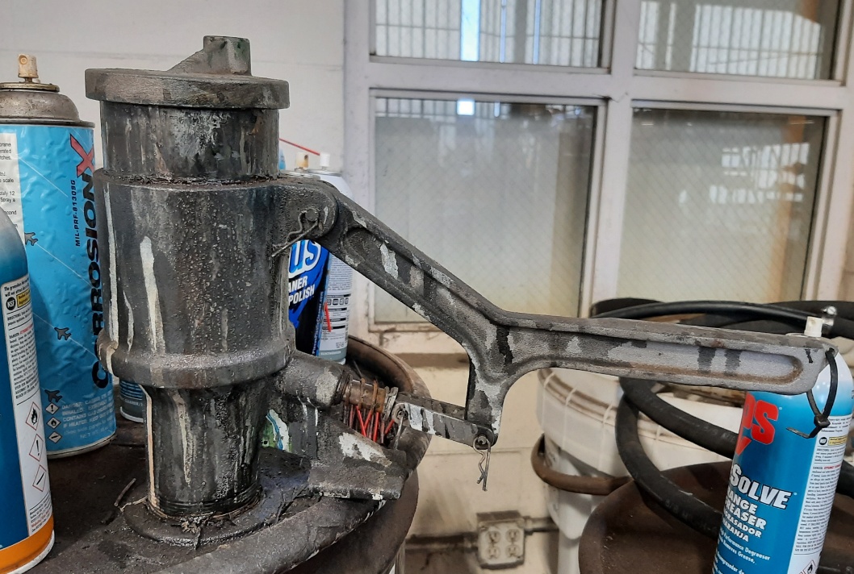

Slide 33
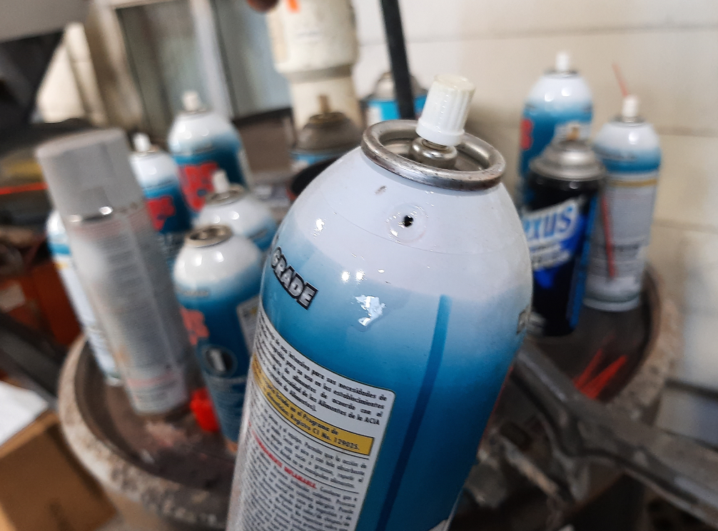
Puncture

Slide 34
Wrap it up

Slide 35
The bottom line
Generators have a choice on how to manage this waste stream.
Generators can manage different aerosols under either standard.
All aerosols must be managed in a manner that prevents releases to the environment.
Empty aerosol cans are recyclable, and facilities should be encouraged to keep this waste out of the MSW.
Easy waste stream to recycle and help reach sustainability goals.
The State of Florida transporter requirements are more stringent than the Federal requirements.

Slide 36
Resources
Aerosol Can Waste Management Comparison Chart: http://orangecountyfl.net/Portals/0/Library/Environment/docs/2021_04_ComparisonChartforUWAerosolRule_Final-CERT.pdf
Code of Federal Regulation (40 CFR Part 260 – 268 & 273): https://www.ecfr.gov/current/title-40/chapter-I/subchapter-I/
Federal Register (84 FR 67202): https://www.federalregister.gov/documents/2019/12/09/2019-25674/increasing-recycling-adding-aerosol-cans-to-the-universal-waste-regulations
Florida Administrative Code (62-730): https://www.flrules.org/gateway/ChapterHome.asp?Chapter=62-730
Florida DEP Registered Transporter Search: https://fldeploc.dep.state.fl.us/www_rcra/reports/handler_sel.asp

Slide 37
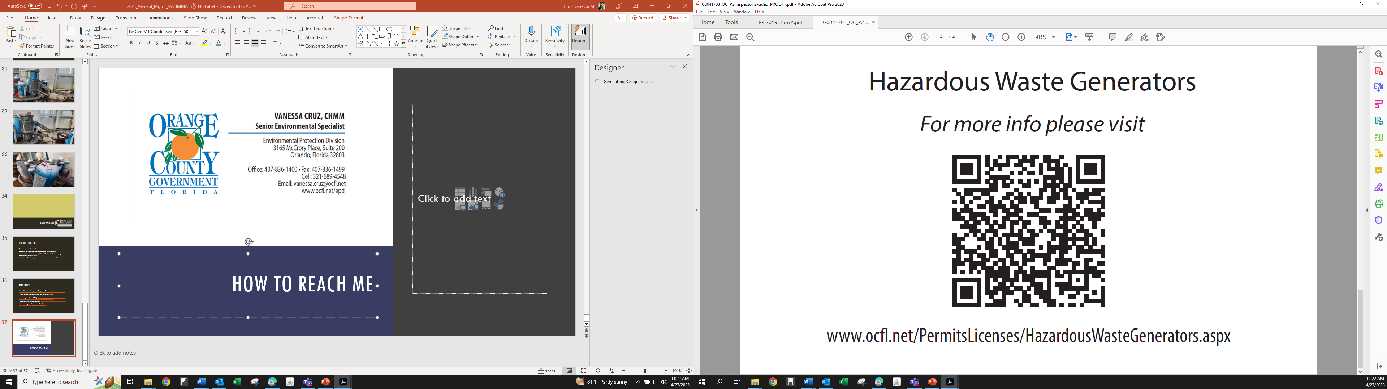

Slide 38
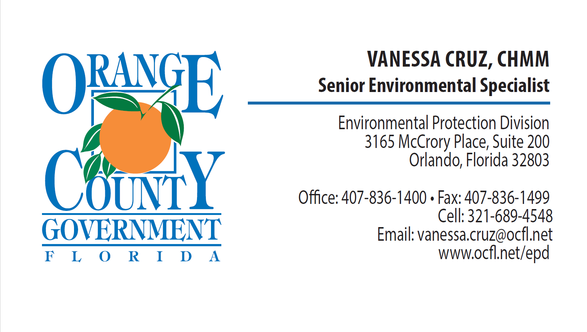
How to Reach me

