Slide 1


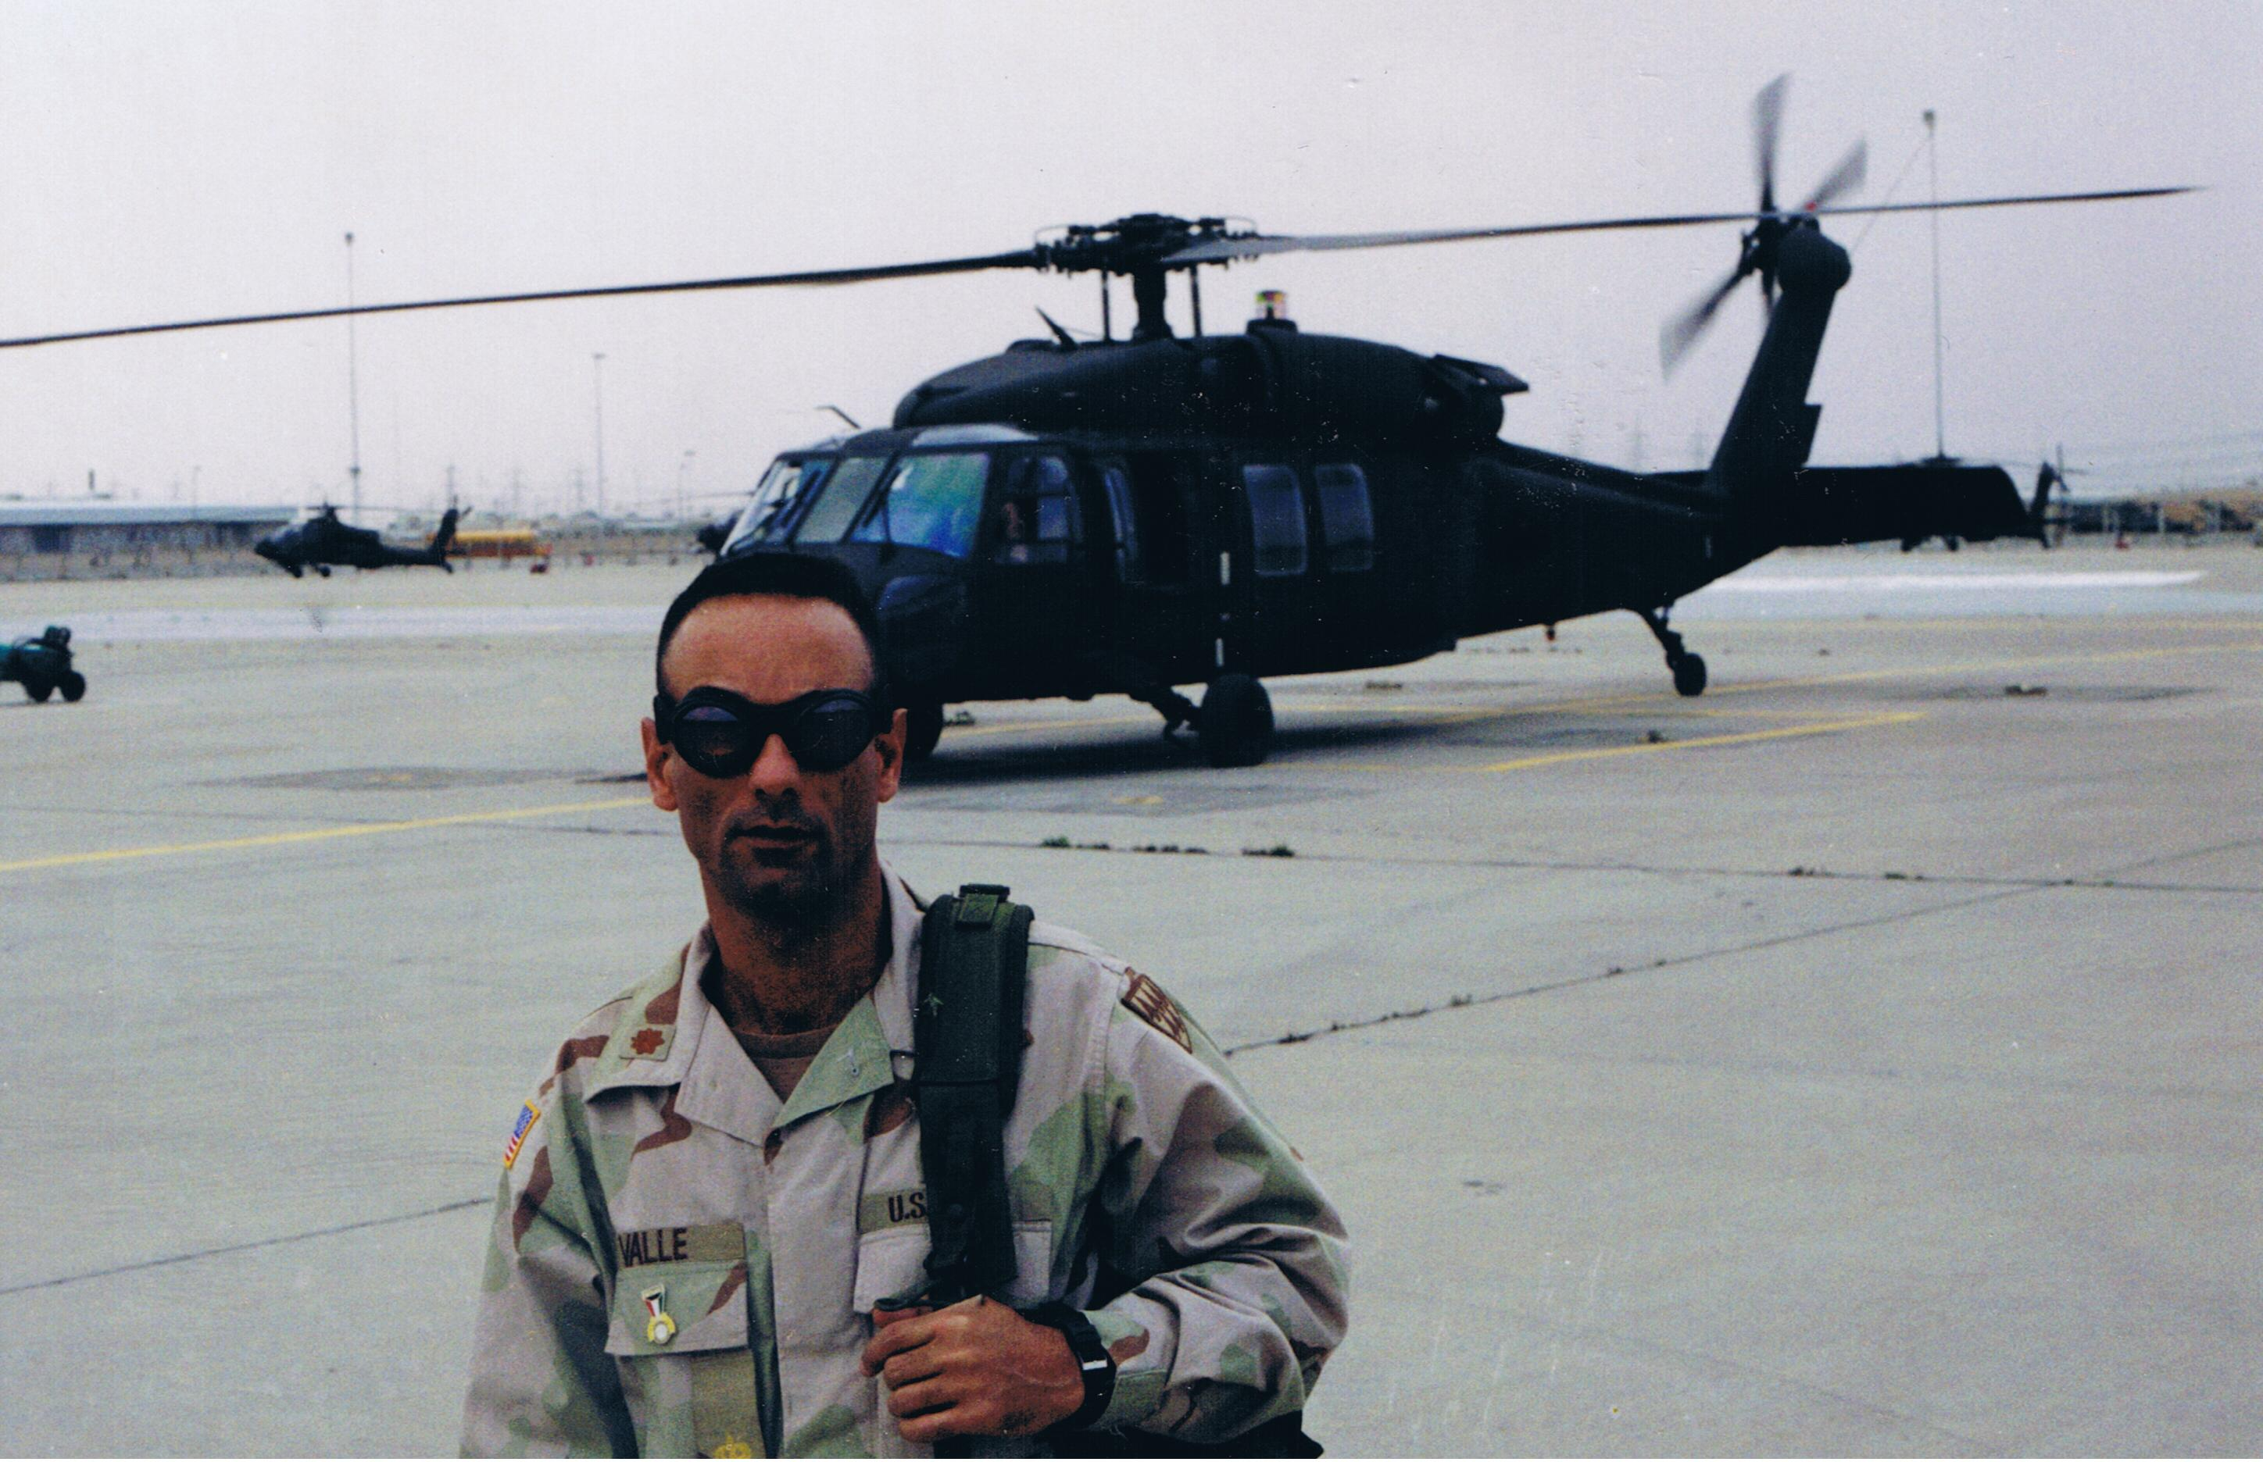
HHW Reuse Shop Fundamentals
NAHMMA Workshop
2023
Presented by: Hector R Valle Sr.
Retired - Seminole County

Slide 2
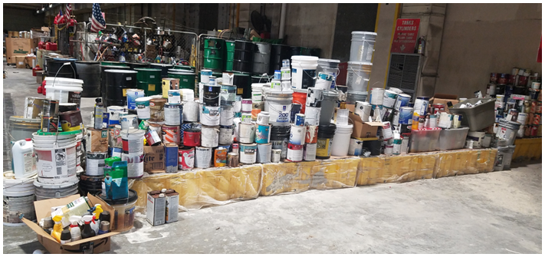
Seminole County HHW Program
2023
Population of 500-K
HHW for 7 Cities, + County Unincorp.
Included as County-Wide Service
County Operated 60 hours a week, 2 techs
60 to 100+ users daily

Slide 3
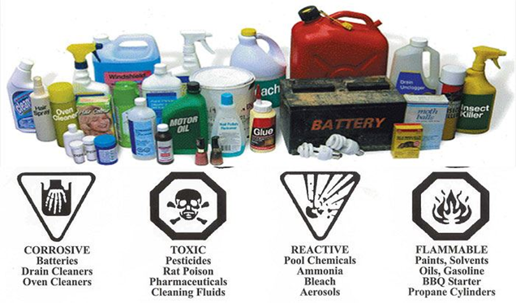
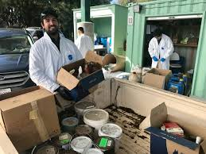
Why have a “reuse shop”?
2023
10-30% of HHW materials are “reusable”
Reduces cost of HHW hauling
Promotes good community relations
Reduces scavenging at the HHW facility
Saves on HHW locker space

Slide 4
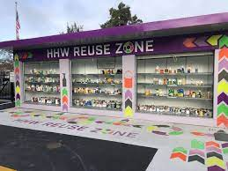
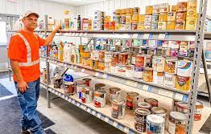
Reuse Shop “must haves”
2023
Trained/Experienced Techs
Enclosed area/space
Shelves (corrosion resistant)
Signage
Liability Release Form
A good SOP

Slide 5
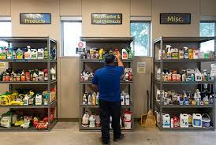
Reuse Shop “watch-out fors”
2023
Skavengers
Unmanned Times
Items sold at Yard/Garage Sales
Disorganization

Slide 6
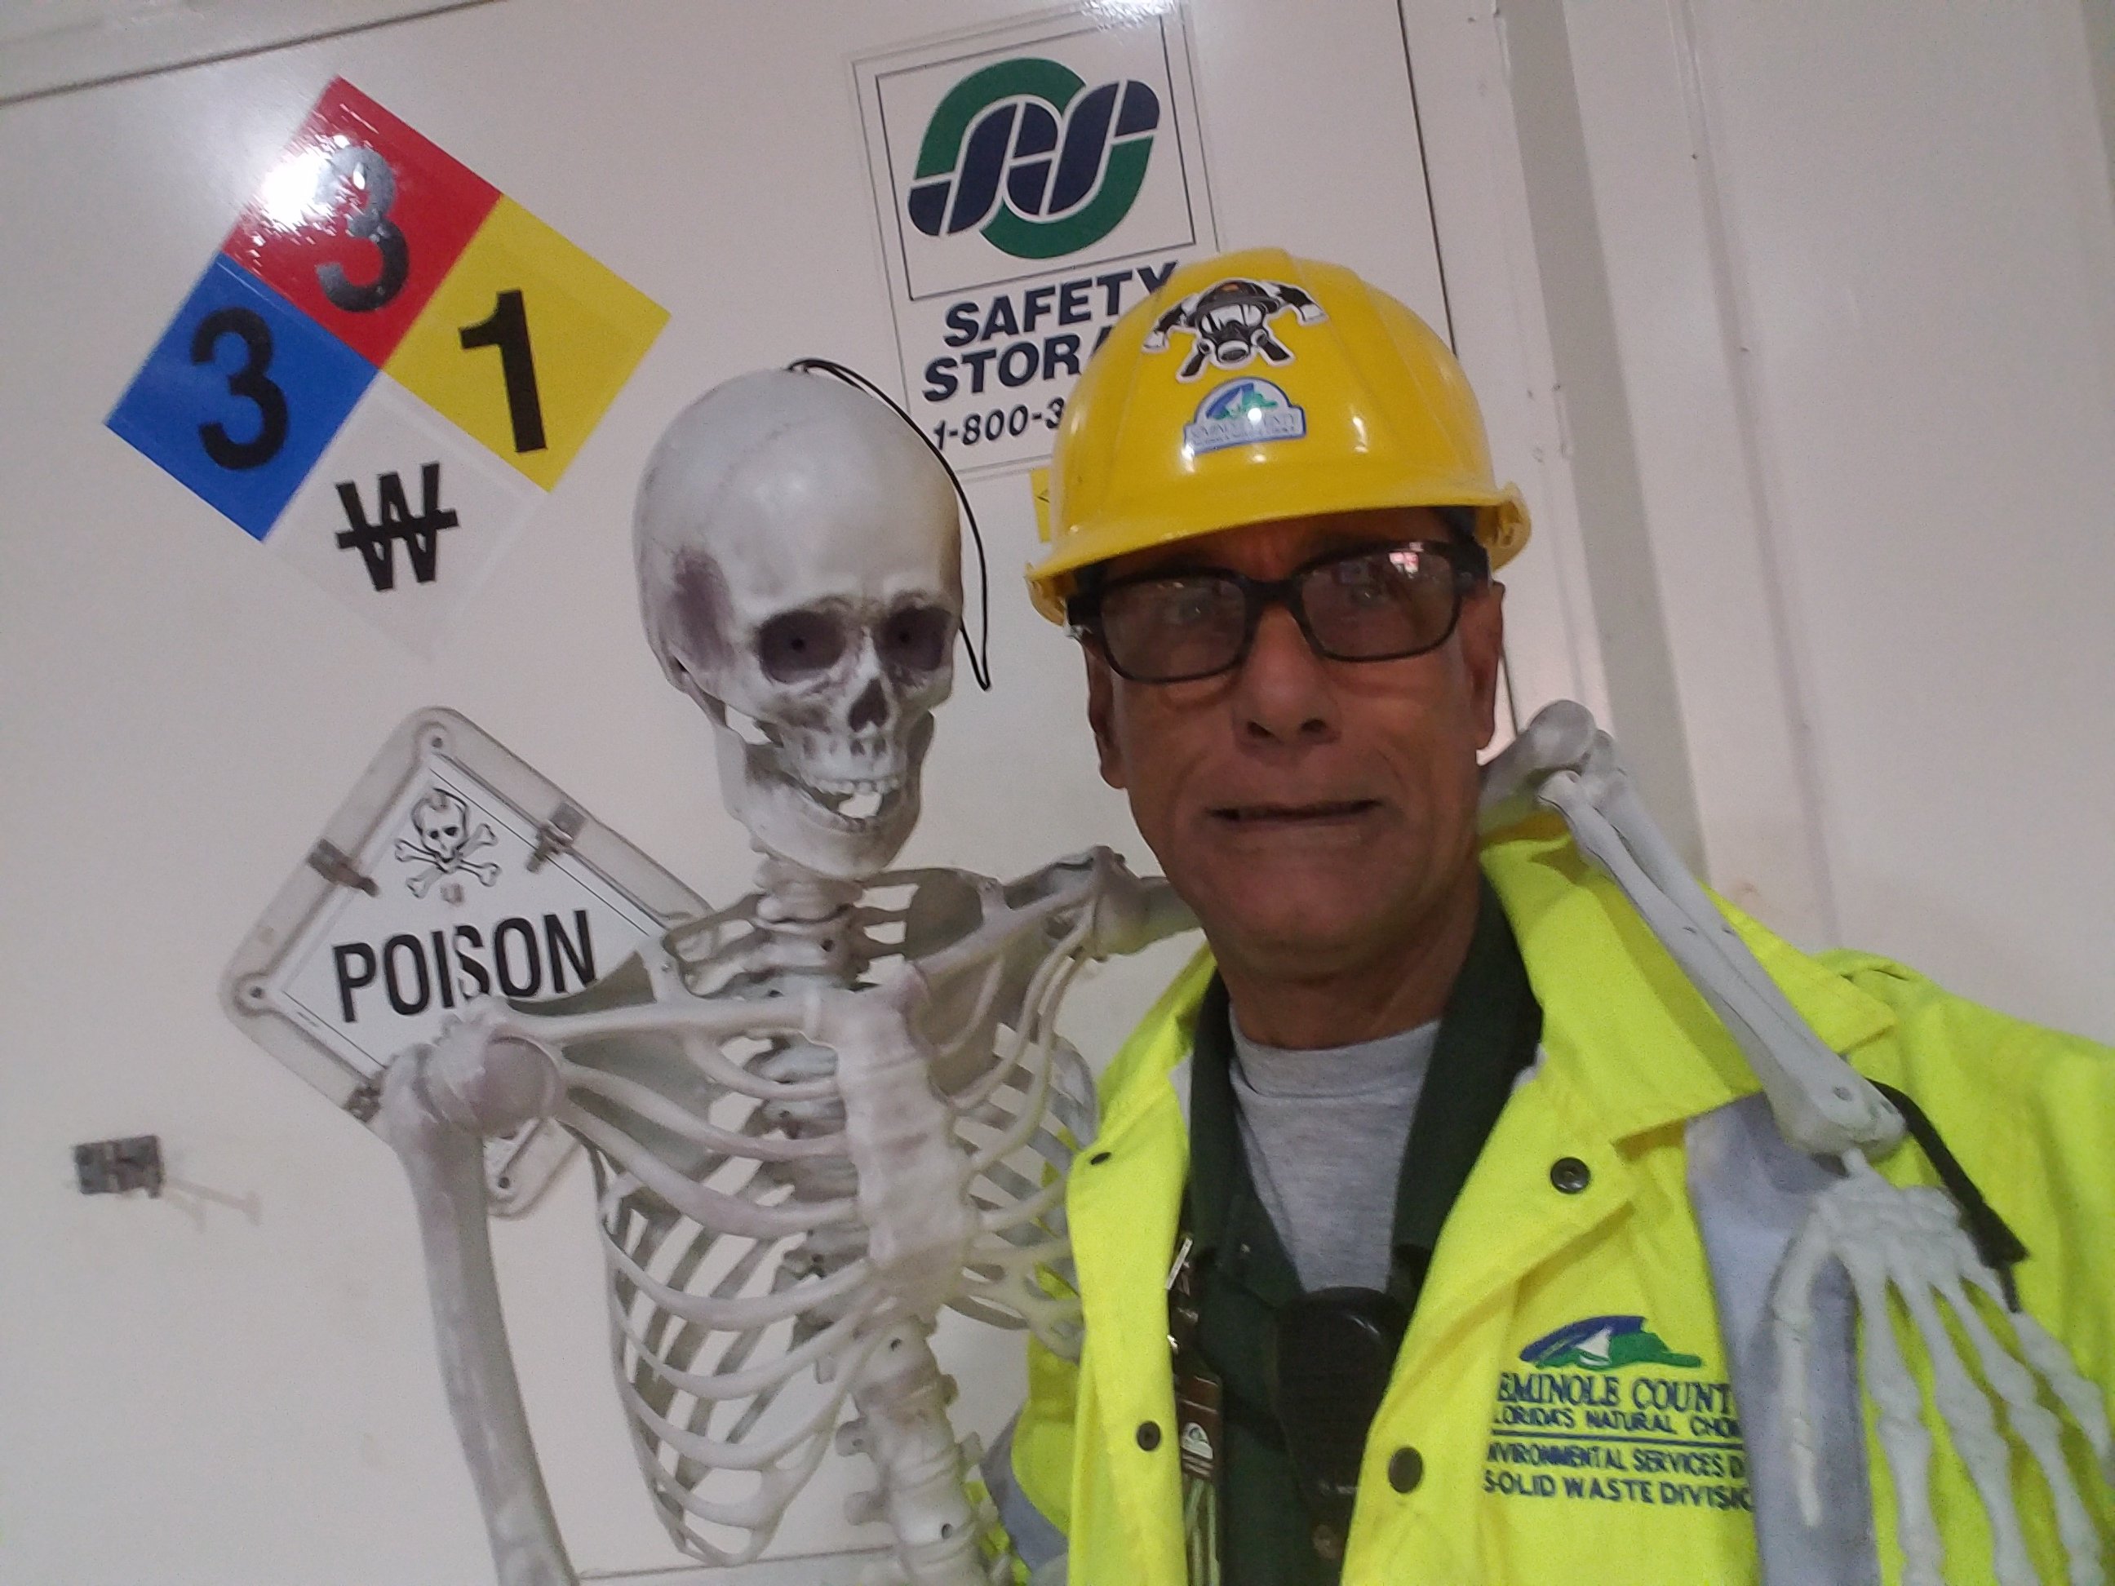
Questions/Comments?
Thank you for coming to NAHMMA!
2023

