Slide 1


Pollution Prevention (P2)
Strategies
Orange County Environmental Protection Division’s (OCEPD) Approach Over the Years
Helena Dacenay, Program Supervisor, OCEPD
Aimee Krivan, P2 Coordinator, OCEPD
Notes:
intro

Slide 2
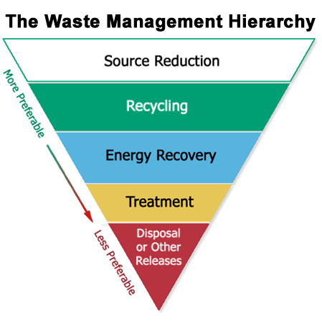
What is pollution prevention?
RCRA (1976)
CERCLA (1980)
Pollution Prevention Act (1990)
Orange County P2 Program (2009)
Notes:
HD
The federal Pollution Prevention Act of 1990 (PPA) established a national policy that states that pollution should be prevented or reduced at the source whenever feasible; pollution that cannot be prevented should be recycled in an environmentally safe manner whenever feasible; pollution that cannot be prevented or recycled should be treated in an environmentally safe manner whenever feasible; and disposal or other release into the environment should be employed only as a last resort and should be conducted in an environmentally safe manner.

Slide 3
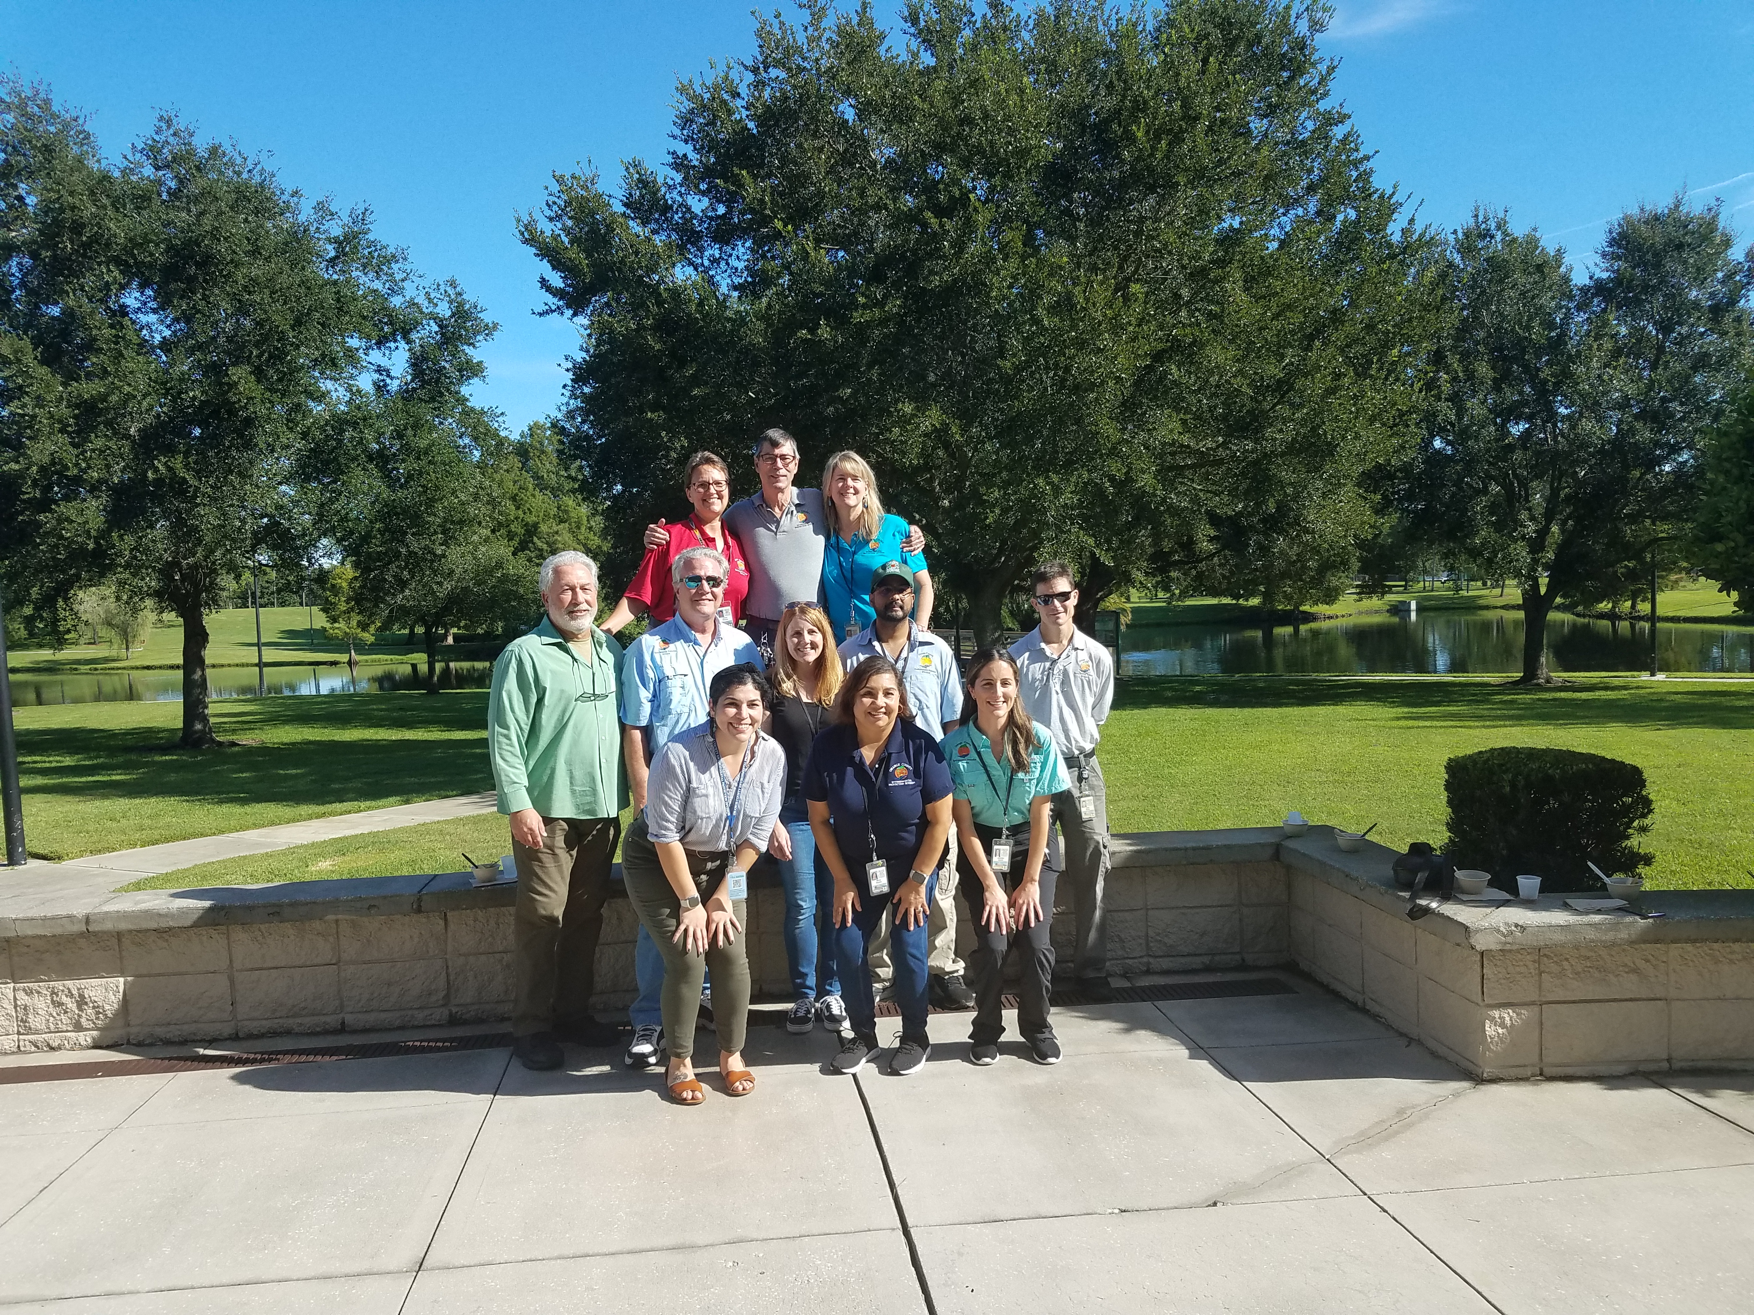
Pollution Prevention and Control (P2C) at Orange County EPD
Our Team:
  P2 Coordinator
  + P2 assistant
  + P2 Intern
  Citizen Services Coordinator
  7 inspectors
Responsible for:
  SQG Program
  Complaint Response
  P2 Outreach
Notes:
HD
The broad mission of Orange County’s Pollution (P2) Prevention Program is to prevent pollution at the source, conserve natural resources, and promote the use of greener, earth-friendly products.
Dissemination of waste reduction technologies and information to help SQGs further reduce their generation of hazardous waste.

Slide 4
P2C Metrics
Year | Complaints | SQG Inspections
2020 | 1,293 | 2,196
2021 | 1,115 | 1,494
2022 | 990 | 1,679
2023 YTD | 288 | 1,005
Orange County Current Assessment Roll: 6,153
Notes:
HD
During inspections, SQG inspectors have the opportunity to encourage organizations, facilities and individuals to fully utilize source reduction techniques in order to reduce risk to public health, safety, welfare and the environment. This is a key educational moment having a generators face-to-face attention and a critical component to the success of the P2 Program.

Slide 5
P2C Goals
Elimination or reduction of waste at its source
Increase energy and water efficiency and minimize waste
Sustainable acquisition and procurement
Engage, educate, and train on P2 practices
Collaborate with community stakeholders
Establish a technical internship program
Establish an alternative resolution to environmental violations by performing P2 projects
Notes:
HD
Elimination or reduction
Energy and water efficiency
Environmentally Preferable Purchasing (EPP) is defined as the procurement of items that have minimized or reduced environmental effects. The purpose of EPP is to give preference to environmentally preferred products whenever possible
Bulk of program is engagement and collaboration
Make internship projects more technical with research
P2 penalty offsetting with other programs, eventually re-do our own ordinance for HW

Slide 6
Targeted Outreach
Through education, engagement, and training

Slide 7
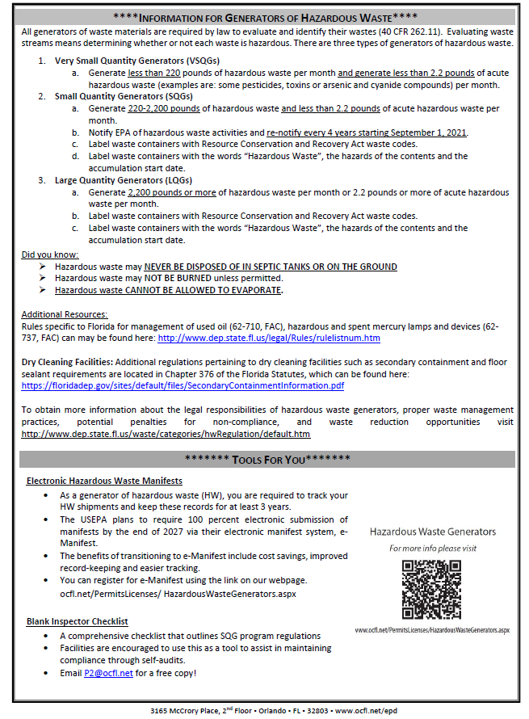
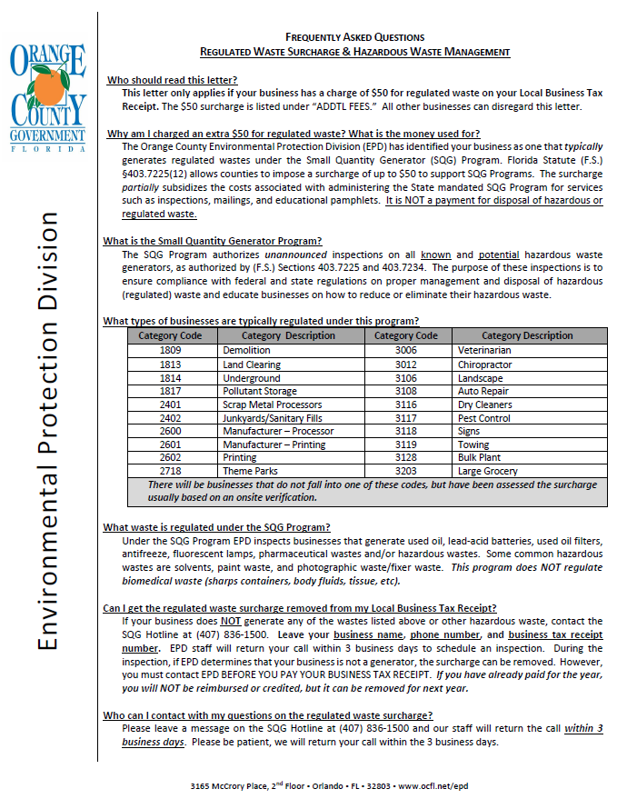
Notification
Notes:
- BTR notices every year
Update bottom section annually
Notify all businesses on the Assessment Roll and inform them of their legal responsibilities regarding proper waste management practices including pollution prevention options and opportunities.

Slide 8
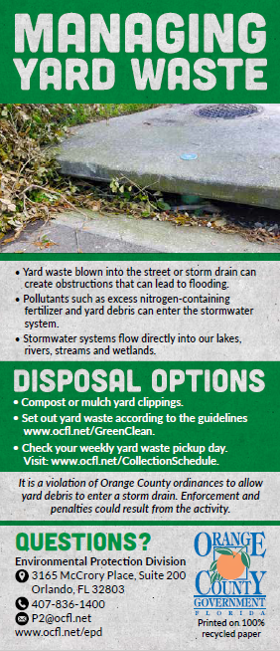
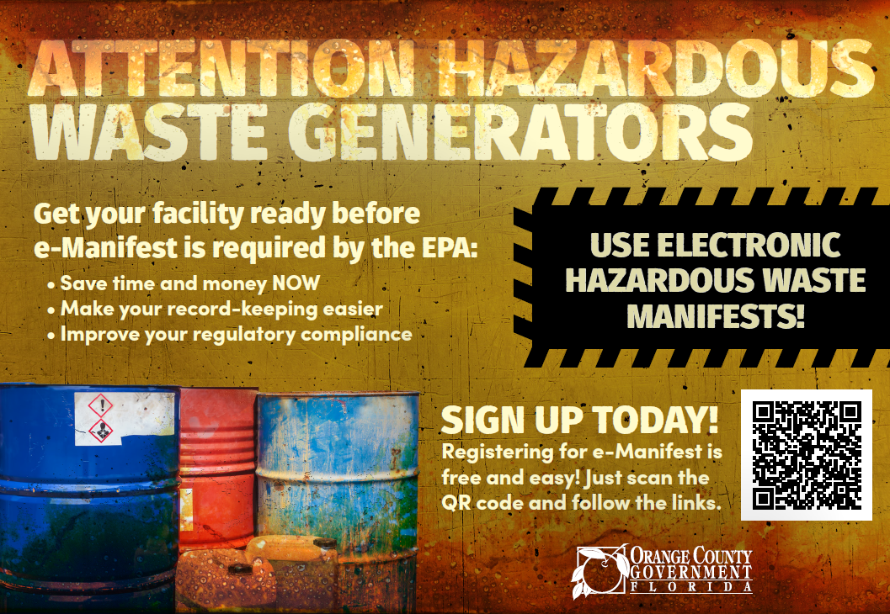

Education
Yard Waste Handbill
E-manifest postcard
“No Medications Down the Drain” post card
VSQG/SQG Inspection checklist
Notes:
AK
- Bring additional material with us

Slide 9






Training
Orange County Lake Advisory Boards
Notes:
AK
- Highlight the importance of networking/training

Slide 10
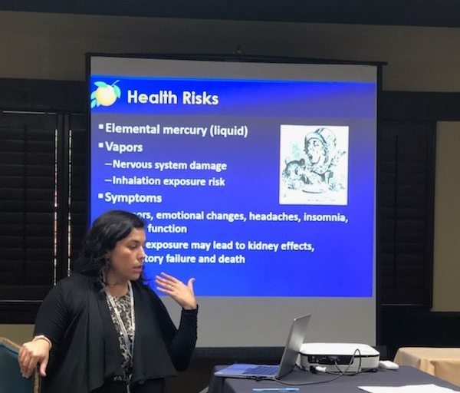
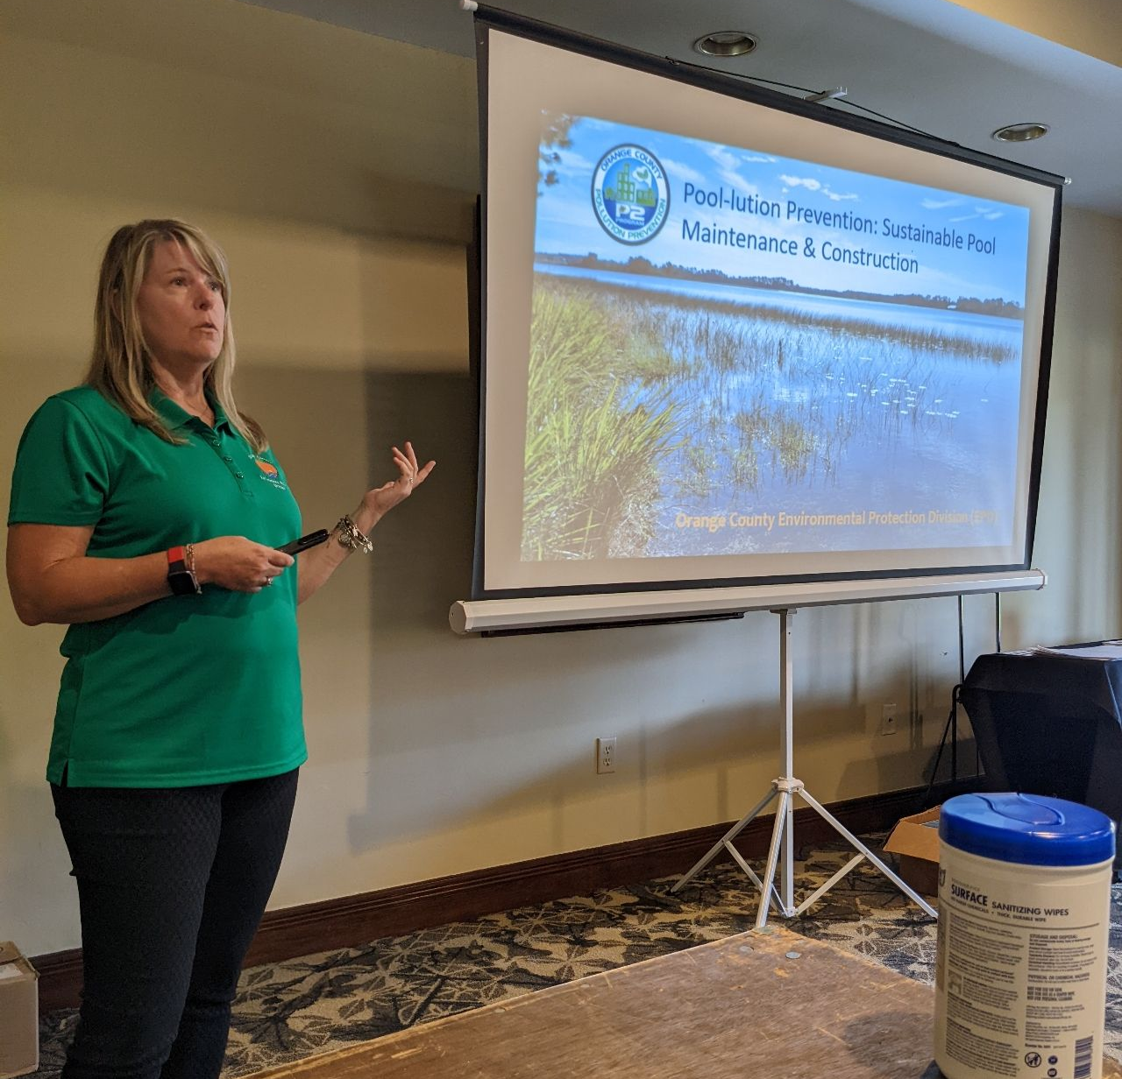
Engagement
UCF School of Environmental Studies
FEHA Annual Education Meeting
Florida Swimming Pool Association (FSPA)- Everything Under the Sun Pool Expo
Hosting virtual and in-person trainings to County Employees
EcoMap
  https://experience.arcgis.com/experience/cf1afc9d2d5a476eb94ffd0f0d93ddbc/page/Home/
Notes:
AK
Great way to recruit interns/new hires
Different uses of EcoMap
Perks of networking and reaching specific audience
Other opportunities at FEHA, medical marijuana, talk about how we learned about swimming pool expo from FEHA
Lots of overlap with FDOH

Slide 11
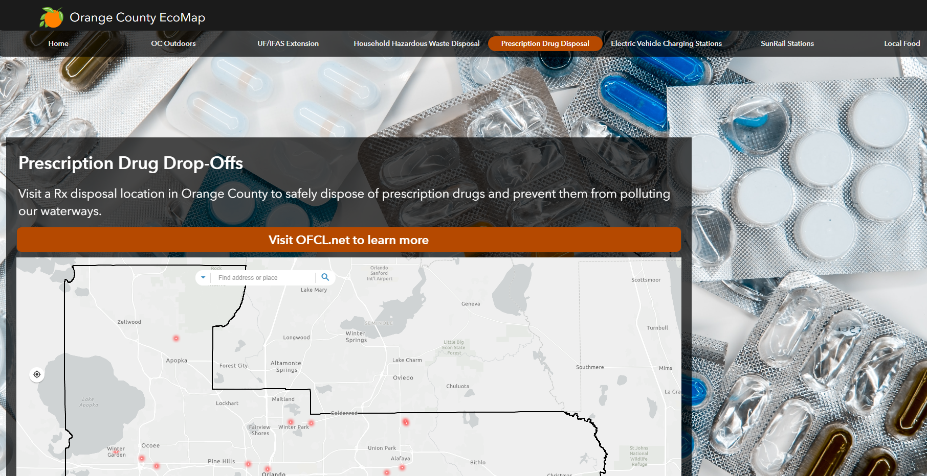
Notes:
AK

Slide 12
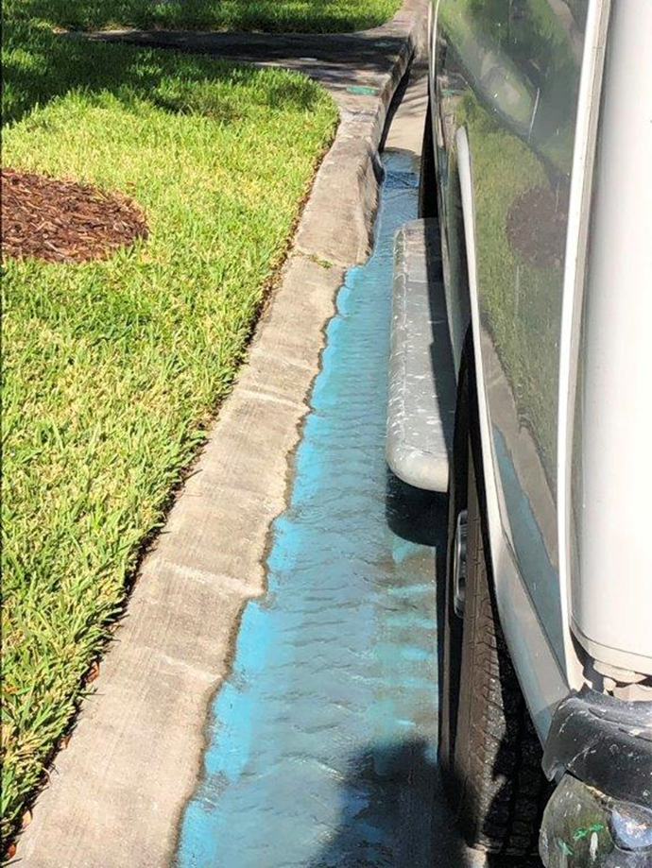

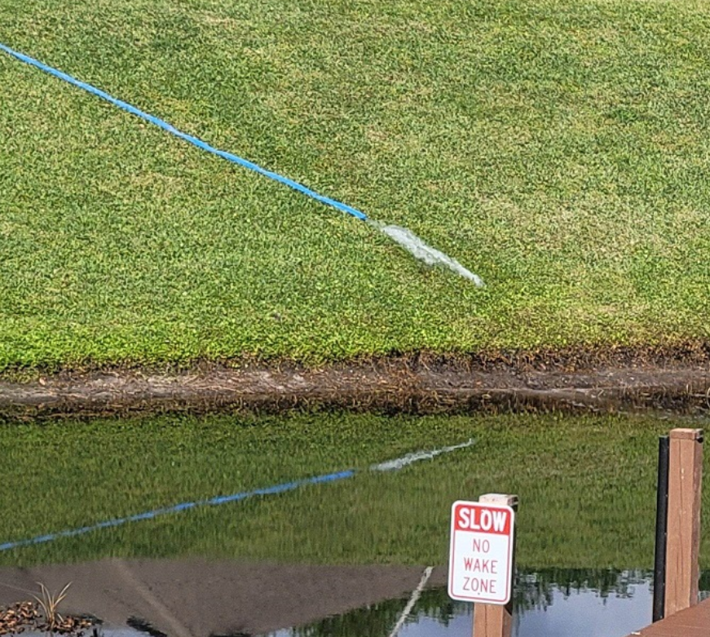
Pool Pollution Prevention Campaign
Driven by high volume of pool draining complaints & illicit discharges to stormwater system
Website and presentation material created with info on BMPs
Notes:
AK
- Highlight the process of the “campaign” aspect

Slide 13
Pool Pollution Prevention Campaign
Notes:
Launch day July 5, 2022
- On going tool and data collection
- 5,877 total views

Slide 14
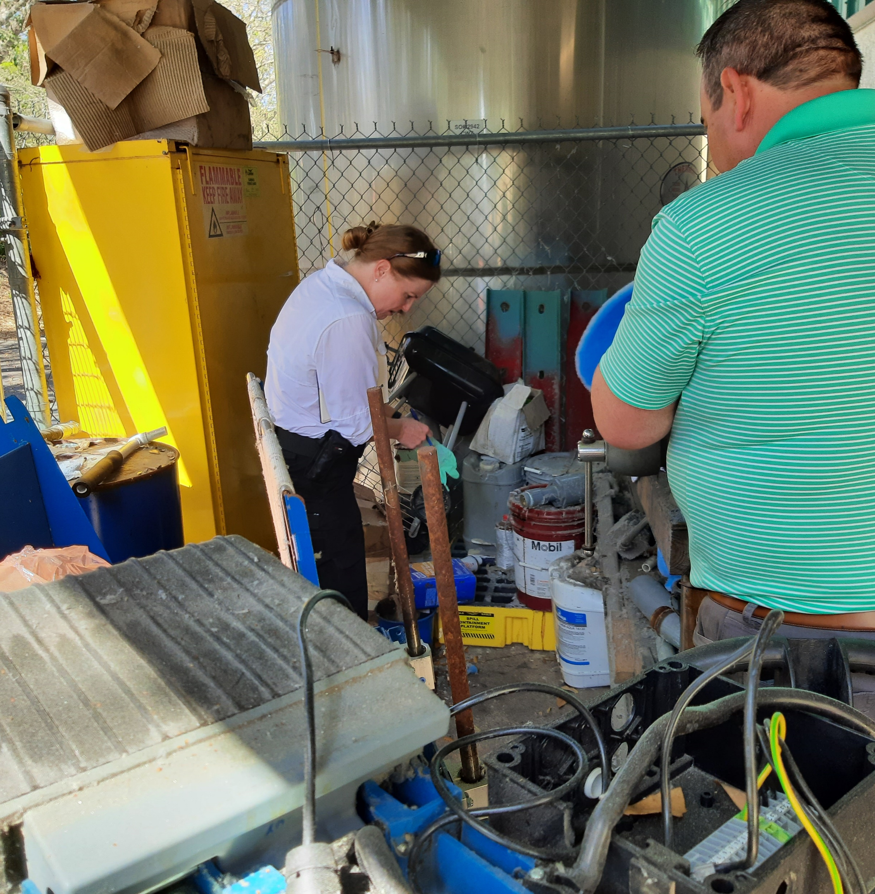
Internal Audits
28 Orange County Operated HW generators
HW Minimization Reports provided
Annual site visits
Common issues
Blast Media Unit disposal at HHW
Used oil logs missing
Parts washer maintenance
BMPs
Recycling empty aerosol cans
Conversion from fluorescent to LED bulbs
Notes:
AK
- We want our facilities to set the standard/be the example
BLAST MEDIA UNIT
XXX has a self-contained Blast Media unit used occasionally to blast rust off of metal. The staff has historically disposed of the blast material at the Orange County Household Hazardous Waste (HHW) facility at the Orange County landfill. As part of the proper disposal process, a hazardous waste determination shall be performed on the spent blast media. Once the hazardous waste determination has been completed and analysis provided to staff, the material should be disposed of by a licensed waste hauler.
EMPTY AEROSOL CANS
Product contained in aerosol cans are safely stored in flammable lockers on site. When these products are used, and the can is empty it becomes a waste. Once OC staff has verified there is no liquid and no propellant in the can, the can is considered empty, and it can be thrown in the trash. If the can still contains product, it may be hazardous waste and should not be thrown in the garbage. EPD encourages the recycling of empty aerosol cans. If interested in implementing a recycling program for empty aerosol cans, please contact Aimée Krivan of EPD for additional guidance.
MAINTENANCE SHOP
Generally, at the PWMU the Highway Utility Repair Person (HURP) conducts general maintenance on equipment and tools used. A parts washer is located inside the maintenance shop which is locked when not in use. Some used oil is generated during routine maintenance of tools and the used oil is delivered to the main Fleet facility located at 4400 Vineland Road, Orlando, FL. No logs to document the disposal of the used oil were available. PWMU is advised to maintain logs, which should include the name and location of the collection or disposal facility. Records should be maintained on site for three years.
USED OIL
Used oil can be transported by the generator if the quantity is less than 55 gallons at a time. In such cases, the generator must maintain logs indicating the name and the location where the used oil is taken.
Used oil logs not available during inspection {40 CFR 262.11}; If the generator self-transports used oil, provide the name and location where self-transported used oil is taken {40 CFR 279.24(a)} Maintain records and retain on site for three years and available for inspection. The MU is advised to maintain a log to track the disposal of used oil.

Slide 15
Events
Starting small and building with community

Slide 16
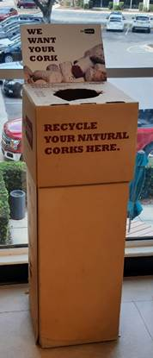
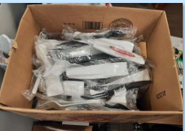
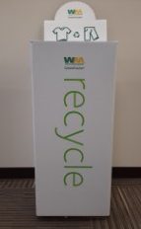
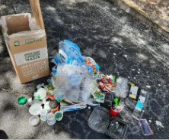
Collection Programs at EPD
Single Use Products Policy (2020)
O-town Compost
Terracycle Bin
Textile Recycling
Christian Service Center
ReCork
Waste Toner Recycling
Notes:
AK
Start small and get colleagues involved

Slide 17
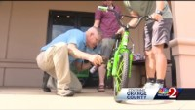

Fix It! Don’t Pitch It!
Notes:
AK
- Things you can do in your community

Slide 18
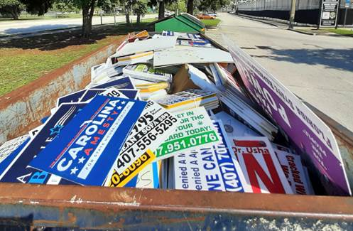
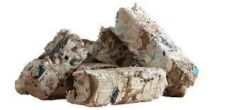
Single-use campaign sign waste diversion
Partnership with City of Orlando, Winter Park, Seminole County and League of Women Voters
6,080 pounds of election signs diverted from landfill
Shredded and transformed into Enviro Fuelcubes
Notes:
AK
- Things you can do with other communities
single-use election sign collection and recycling effort in partnership with the City of Orlando, City of Winter Park, Seminole County, and the League of Women Voters of Orange and Seminole County. During the August 2022 election cycle, 6,080 pounds of election signs were diverted from the landfill. They were shredded and transformed into Enviro Fuelcubes (EFC’s) which were used to generate electricity replacing coal as a cleaner energy source.

Slide 19

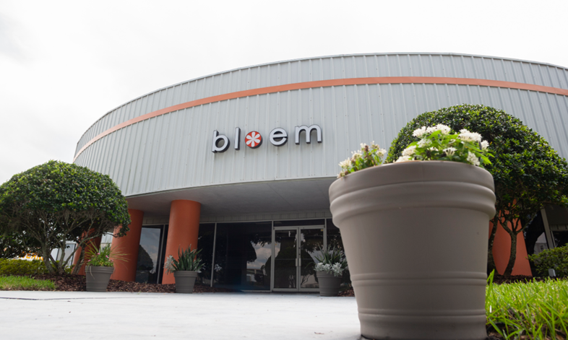

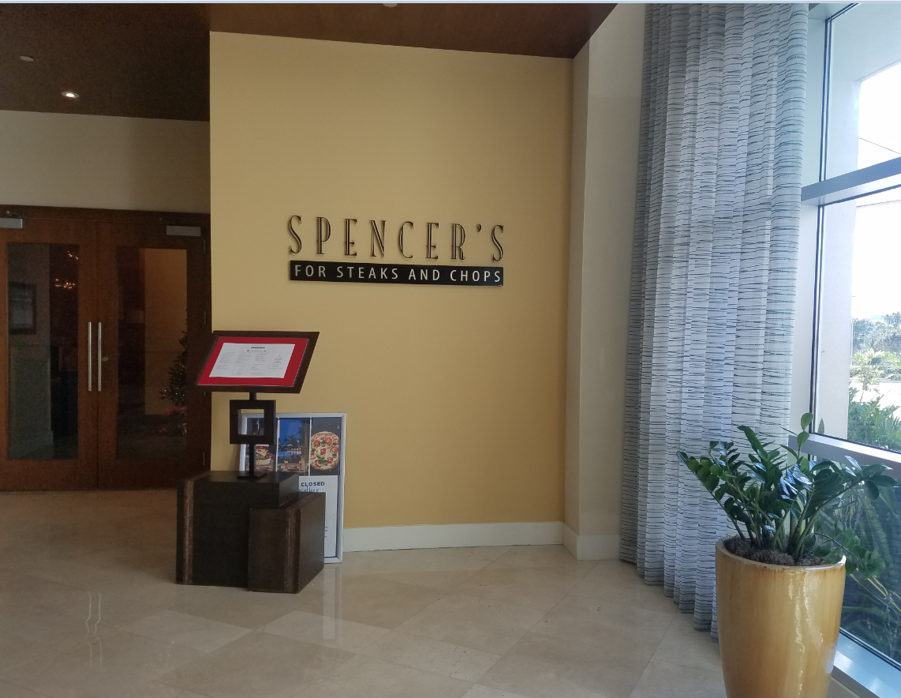
P2 Spotlights
Hilton Ocean Friendly Restaurant
Avalon Eatery
Bloem
Notes:
AK
- Elaborate on Bloem

Slide 20
Looking Ahead
5-year plan
Notes:
HD

Slide 21
Future Goals
Expand team
Continue training
Increase partnerships
Increase frequency of inspections
Florida Green Local Government Recertification
Maintain an accurate database with transition to Survey123 tracking system
Targeted outreach to smoke shops and ALFs
Notes:
HD
Limited capabilities with one person focus
Exchange of info so important
Inspect facilities every 2 years
Get recertified for our 28 facilities
Streamline data entry and reports

Slide 22
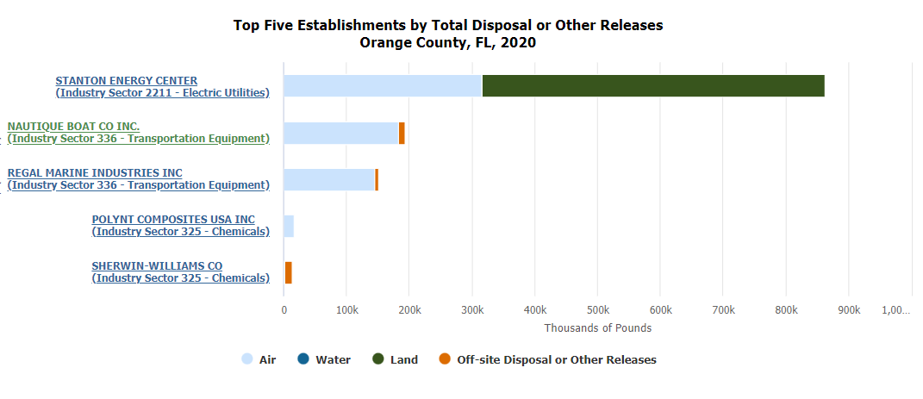
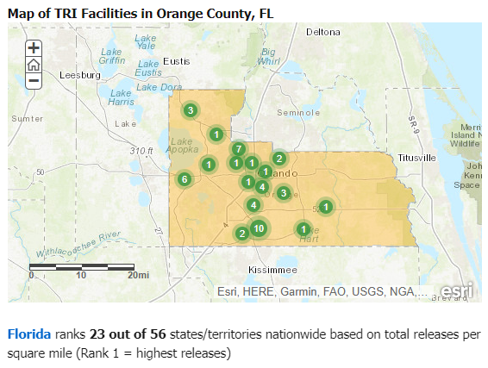
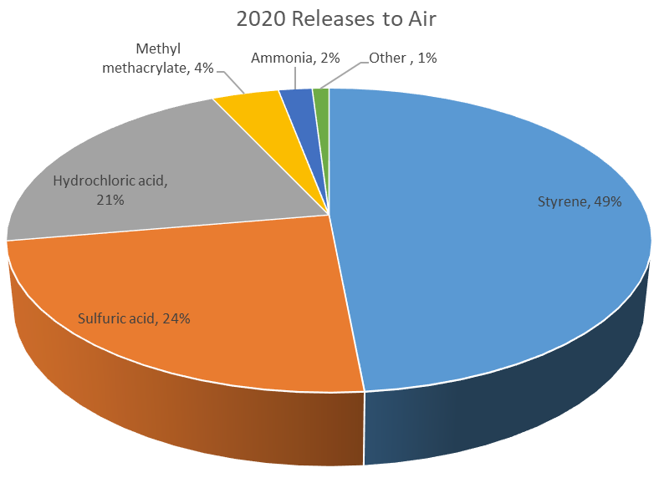
TRI Data Analysis
Notes:
HD
EPA data we haven’t touched yet
Intern to organize and help us identify our focus

Slide 23
BMP Research
Review Tier II reports
Better understand industrial processes
Build relationships with facilities
New technology
Cost-saving$
Notes:
HD

Slide 24
P2 Incentives
Penalty offsets
Incorporate P2 Projects in County enforcement with NPDES/Air/Solid Waste
Business recognition
Social media
Certificate
P2 Spotlights
Notes:
HD
- Get generators interested

Slide 25

Thank you
Questions?

