Slide 1
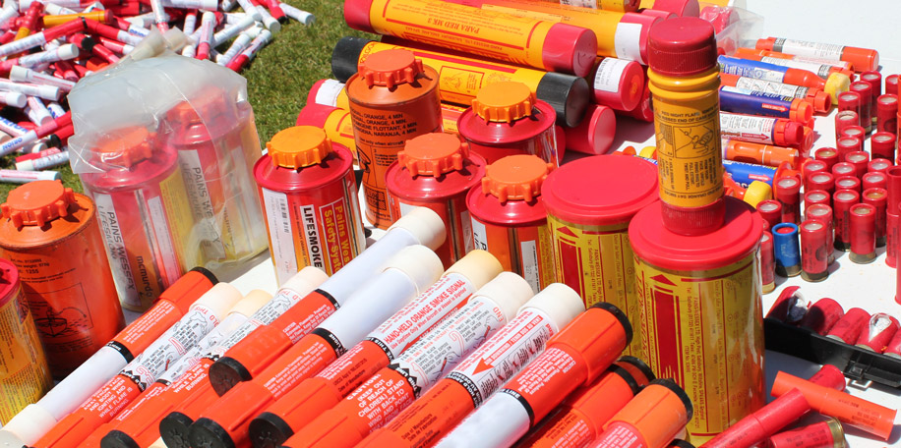
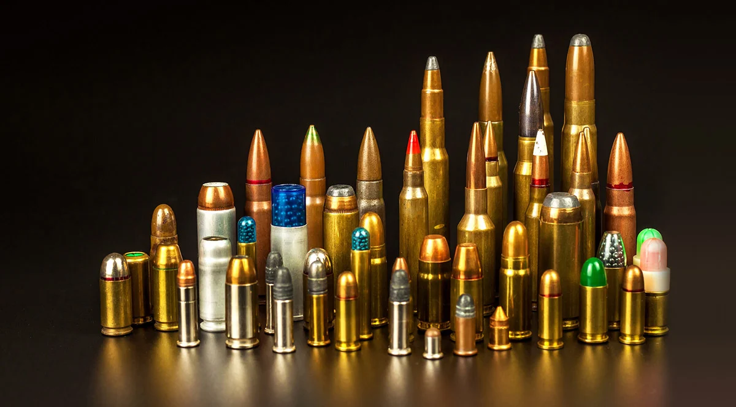


Problematic Waste:
Flares & Ammunition

Slide 2
Flares

Slide 3
Types of Flares

Slide 4



Slide 5
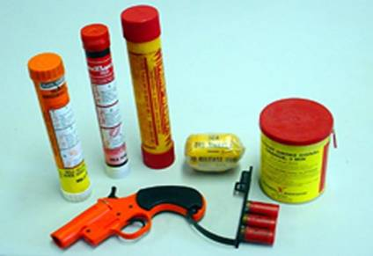
Types of Flares
Red Hand-held Flare (day and night)
Parachute Flare (day and night)
Red Meteor (day and night)
Orange Smoke Signal (hand-held/day only)
Floating Orange Smoke Signal (day only)

Slide 6
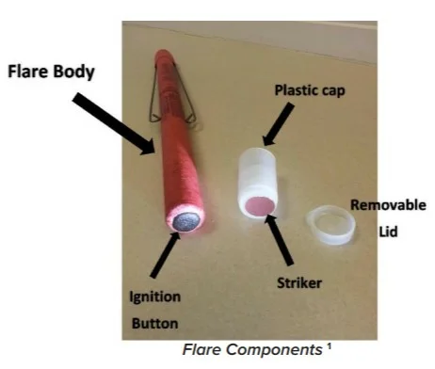
Pyrotechnic Flare
Notes:
Composition of flares. And proper storage

Slide 7

What makes flares hazardous?
The ingredients vary, but often based on strontium nitrate, potassium nitrate, or potassium perchlorate, mixed with a fuel such as charcoal, sulfur, sawdust, aluminum, magnesium, or a suitable polymeric resin.
Contain many ingredients that can pose risks to human health/environment with potassium perchlorate being of most concern.
Frequent exposure to potassium perchlorate can cause problems with breathing and can start to affect your thyroid, white blood cells and kidneys
A single improperly disposed of flare can contaminate up to 240,000 gallons in a drinking water source with perchlorates.
Notes:
Marine handheld flares in particular

Slide 8


Why are flares problematic waste?
Outlets for disposal are very limited
Flares are considered class 1 explosives and there are only 4 permitted explosive incinerators in the US
Only a few transporters in the SE US are licensed and permitted to haul explosives.
*Explosives can not be transported with other hazardous waste
Notes:
General Dynamics Ordnance and Tactical Services. They are a licensed munitions incinerator in Joplin, MO. Decommission and try to recycle all materials that can be
Clean Harbors Colfax, Louisiana permitted incinerator as well

Slide 9

Cost of disposal
Prices vary but the average price of flare disposal can cost between $8-$10 per pound with a $3,000 minimum pick up
There is also a transport fee of $2500 - $3500 in addition to the disposal fee

Slide 10
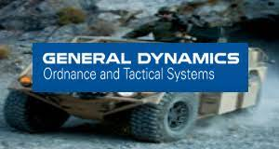
Munitions Incinerators
General Dynamics Ordinance and Tactical Systems
Pyrotechnics - Recovery and reuse of magnesium and
resale of recovered metals and packaging materials
Main Office & Disposal Facility
4174 County Rd 180 - Carthage, MO 64836
ph. (417) 624-0212 - fax (417) 782-6366
Notes:
Dave Zogby 610-298-3085

Slide 11

Munitions Incinerators
Clean Harbors
7001 Kilo Avenue Bartow, FL 33830
Phone Number:
863-533-6111
Notes:
Dave Zogby 610-298-3085

Slide 12

Improper disposal
Throwing flares into the trash
Tossing flares into the ocean or any body of water
Soaking flares in water
*Certain flares can have a reaction if soaked in water
Notes:
Add more, remove throwing flares

Slide 13
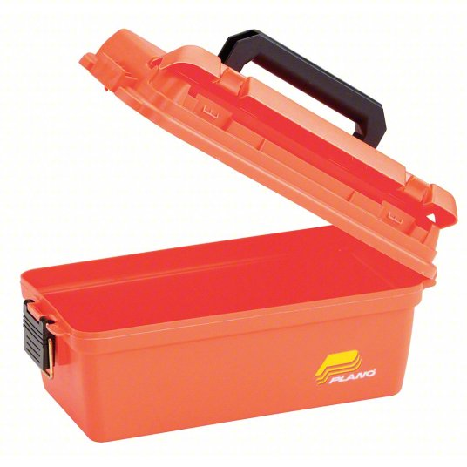
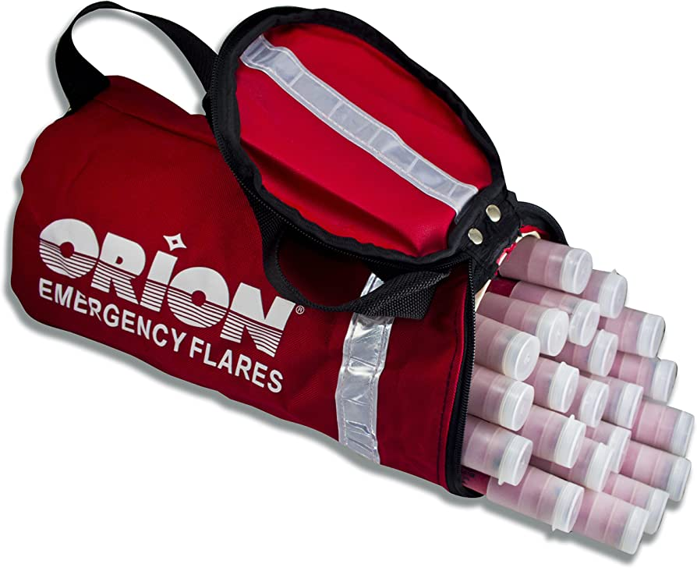
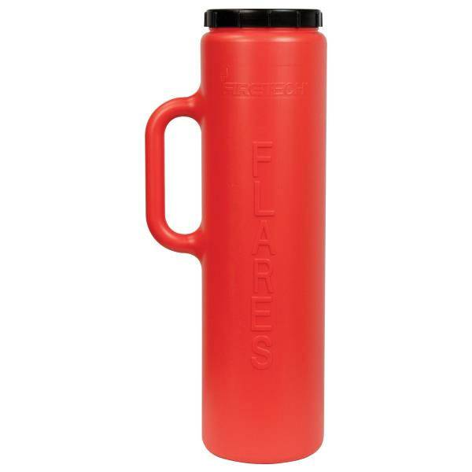
Proper storage of flares
While flares are classified as flammable, they are generally safe and stable if stored correctly. There is no threat of mass explosion, nor is there any threat of an individual flare exploding.
They should be stored in a cool, dry place away from excessive heat (above 167 degrees F), and away from sparks or flames. The normal recommended storage temperatures are 40 degrees to 90 degrees F. Do not expose flares to water for periods of longer than 10 minutes

Slide 14
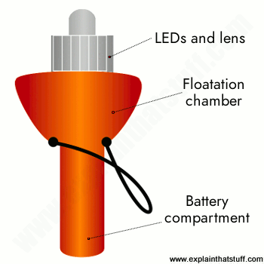
Alternatives to pyrotechnic flares
Electronic Flares (E-Flares)
Pros
Reusable and operate with batteries
Last longer than pyrotechnic flares
No risk of getting injured while using one
Float in water
Cons
Only can be used at night

Slide 15
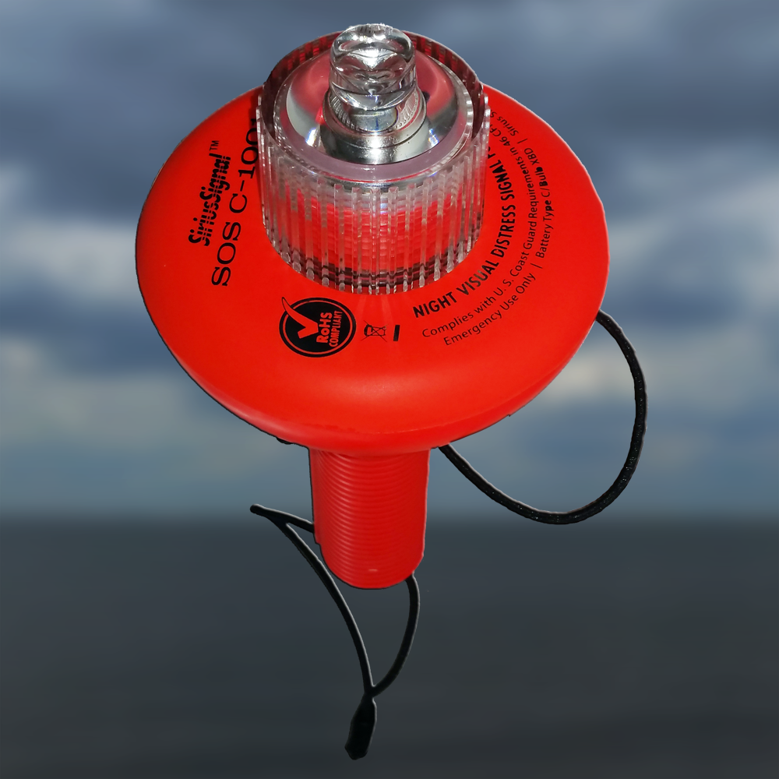
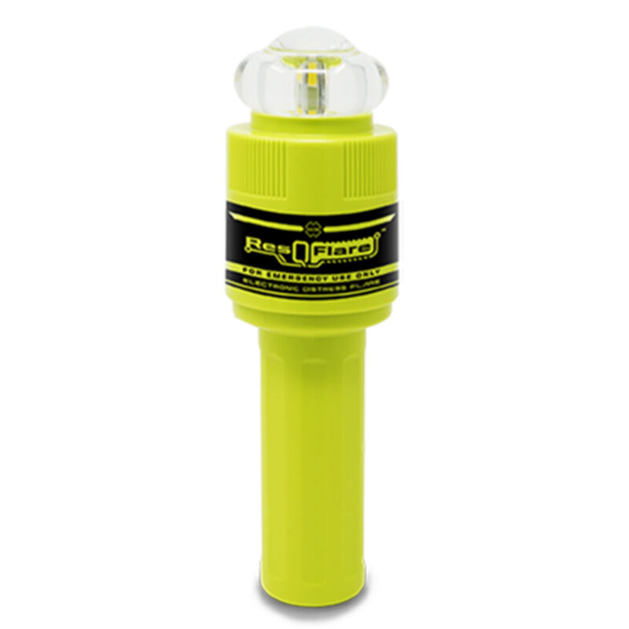
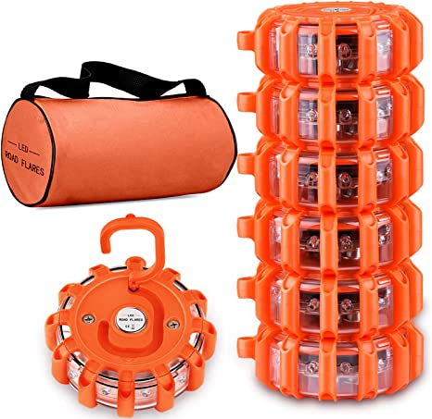
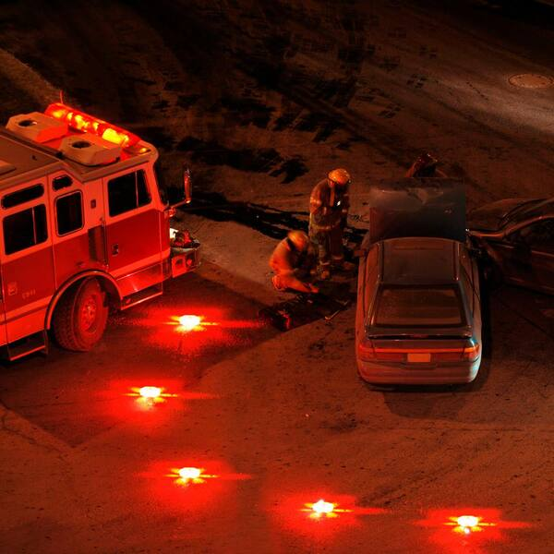
E-Flares

Slide 16

What does Pasco County HHW do with flares?

Slide 17
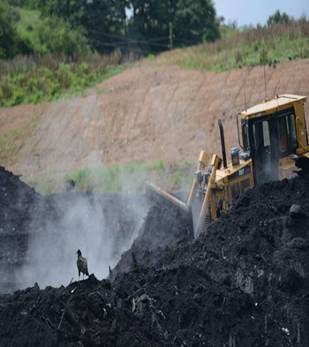
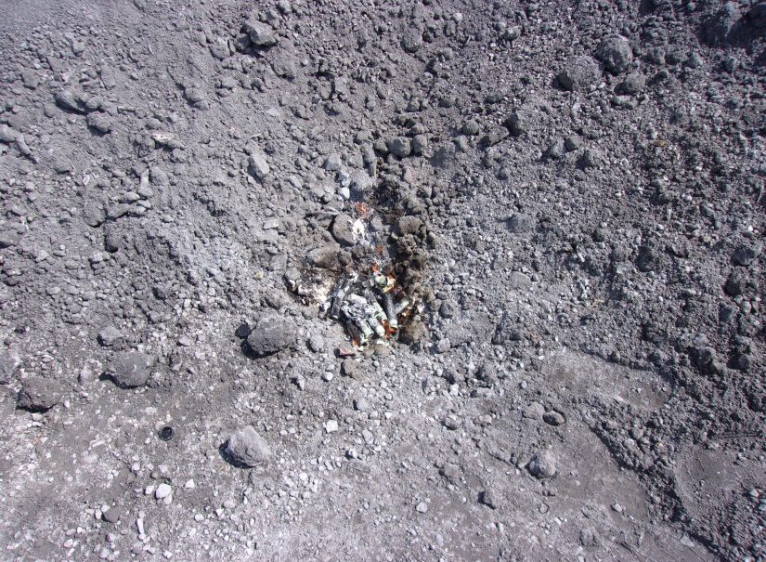
Flares are buried in the ash of the lined ash cell
PPE is worn (eye protection, gloves and safety vest)
Excavator operator digs a hole in the ash, flares are put into the hole and then ash is put back on top burying the flares
The ash is caustic so it erodes the flares
Notes:
-Burn down to ash
-Proper safety equipment required, glasses gloves fire extinguisher shovel
This is what Pasco does.

Slide 18
How can we guide people with flare disposal?
Contact your local sheriffs office or fire department
Contact the local Coast Guard
Contact your local HHW facility

Slide 19
Ammunition

Slide 20
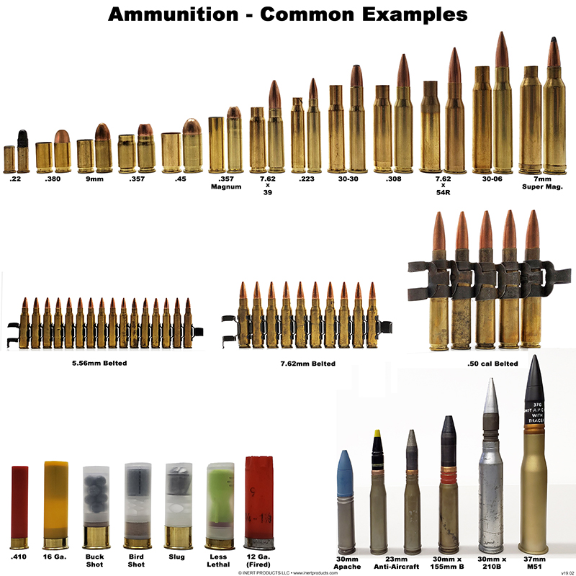
Modern day ammunition
Notes:
-Bullet Sizes and powder charges vary
-Round nose and hollow point, coper or aluminum jacketed
-Rimed for revolvers or no rim for autos
-Tracers are bullets or cannon caliber projectiles that are built with a small pyrotechnic charge in their base. Ignited by the burning powder, the pyrotechnic composition burns very brightly, making the projectile trajectory visible to the naked eye during daylight
-When used, tracers are usually loaded as every fifth round in machine gun belts
-Tracers are also sometimes placed two or three rounds from the bottom of magazines to alert the shooter that his weapon is almost empty
-Tracers also used in WW1 to shoot Zeppelins

Slide 21
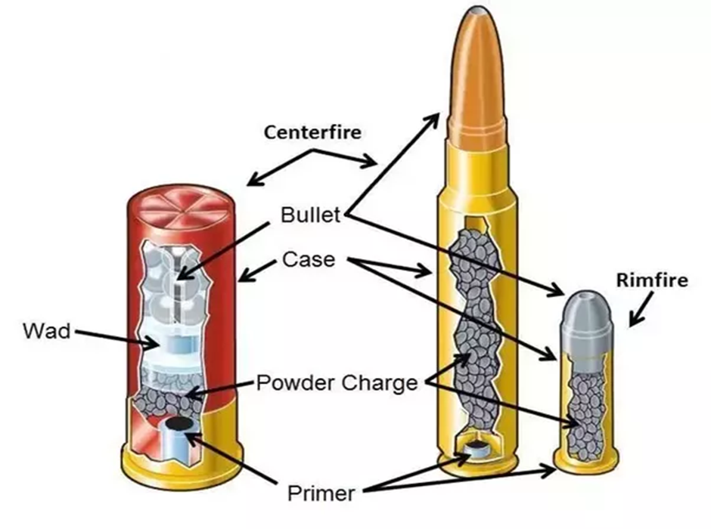
What’s inside an ammo cartridge
A cartridge is made up of a bullet, casing, gunpowder, and a primer. The primer is located on the bottom of the casing, the gunpowder is inside the casing, and the bullet is sticking out the other end of the casing.
The bullet is typically made of lead but could be another type of metal or cased in another type of metal. The casing is generally made from brass but could also be steel.
Notes:
-A cartridge is made up of a bullet, casing, gunpowder, and a primer. The primer is located on the bottom of the casing, the gunpowder is inside the casing, and the bullet is sticking out the other end of the casing. The bullet is typically made of lead but could be another type of metal or cased in another type of metal. The casing is generally made from brass but could also be steel.

Slide 22
What makes ammunition hazardous?
Contains metals such as lead, nickel, copper and zinc
Can contaminate the ground or drinking water with heavy metals (especially lead)
Gun powder is flammable

Slide 23
Why is ammunition problematic waste?
Just like flares, outlets for disposal are limited
Ammunition is also considered a class 1 explosive
Cost of disposal will be around the same as flares
Notes:
General Dynamics Ordnance and Tactical Services. They are a licensed munitions incinerator in Joplin, MO. Decommission and try to recycle all materials that can be
Clean Harbors Colfax, Louisiana permitted incinerator as well

Slide 24
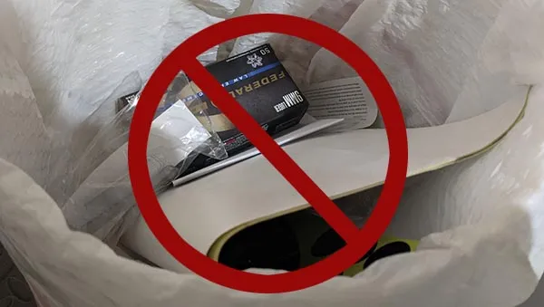
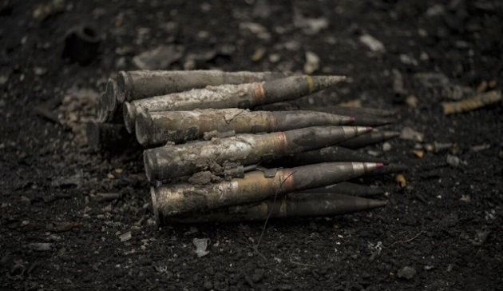
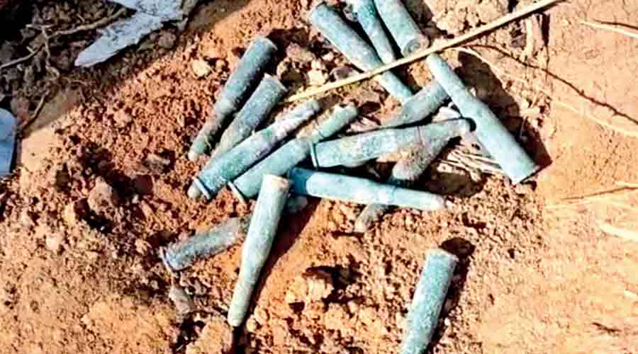
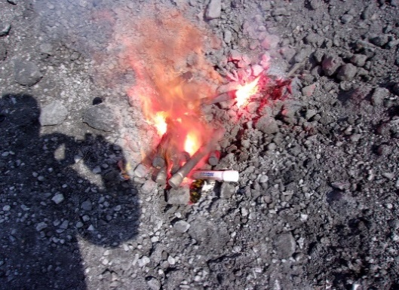
Improper disposal of ammunition
Garbage
Burning
Bury
Throwing ammunition in the trash is dangerous and illegal
Small Components may be expelled
Burying ammo can lead to problems in the water and soil. Bullets are made of lead which can seep into the soil.
Notes:
Trash: Throwing ammunition in the trash is dangerous and illegal. But why? First, a cartridge does not cease working because you decide you no longer want it.
The right amount of force applied in the correct location can cause a round to discharge. Other trash can act as a firing pin in the event a trash compactor or other device is used. This puts sanitary service personnel at risk.
Additionally, trash can end up in a landfill and hazmat is bed for the environment.
Bury: If your household relies on well water, you may inadvertently contaminate your drinking water. Alternatively, burying ammo could impact the local wildlife by poisoning drinking water or seeping into the soil and absorbed by local plant life.
Burning: Although fire will not propel the bullet at dangerous velocities, small components including the primer and shards of the case may be expelled. Usually, only those in close proximity to the cartridge when it detonates are at risk of injury.

Slide 25

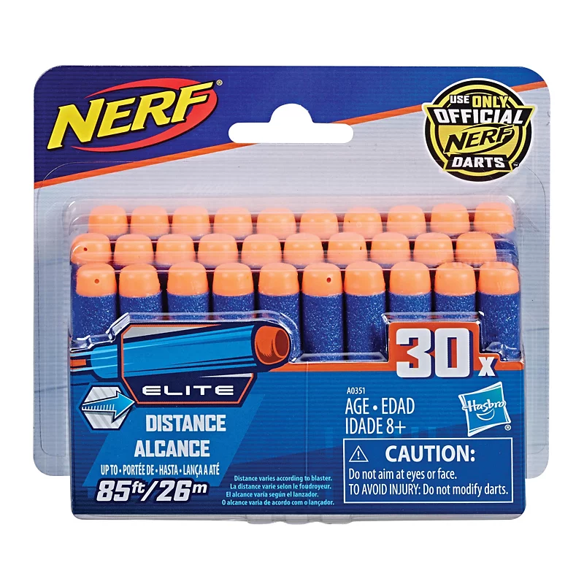
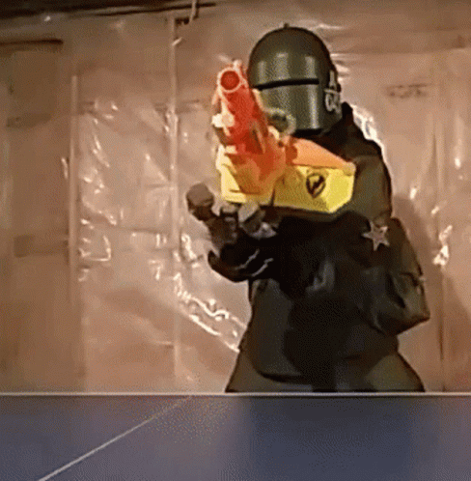
Alternatives for ammunition

Slide 26
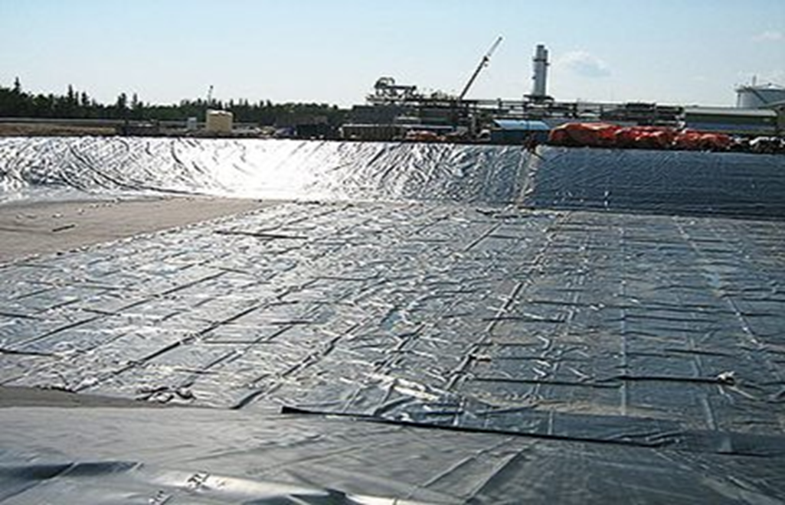
What does Pasco County HHW do with Ammunition?
Just like flares, they are buried in lined ash cell
Notes:
Don’t take from citizens, sheriff offices.

Slide 27
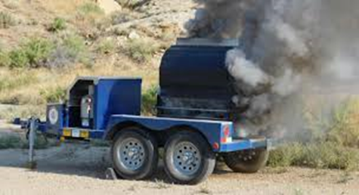
How can we guide people with ammo disposal?
Contact your local gun range
Contact local law enforcement
Contact your local HHW facility
*some counties may have a burn box used to destroy ammunition

Slide 28
Munitions Incinerators
General Dynamics Ordinance and Tactical Services
Corporate Headquarters:
Recovery and resale of recovered metals, plastics and
packaging materials
Main Office & Disposal Facility
4174 County Rd 180 - Carthage, MO 64836
ph. (417) 624-0212 - fax (417) 782-6366
Clean Harbors
7001 Kilo Avenue Bartow, FL 33830
Phone Number: 863-533-6111

Slide 29
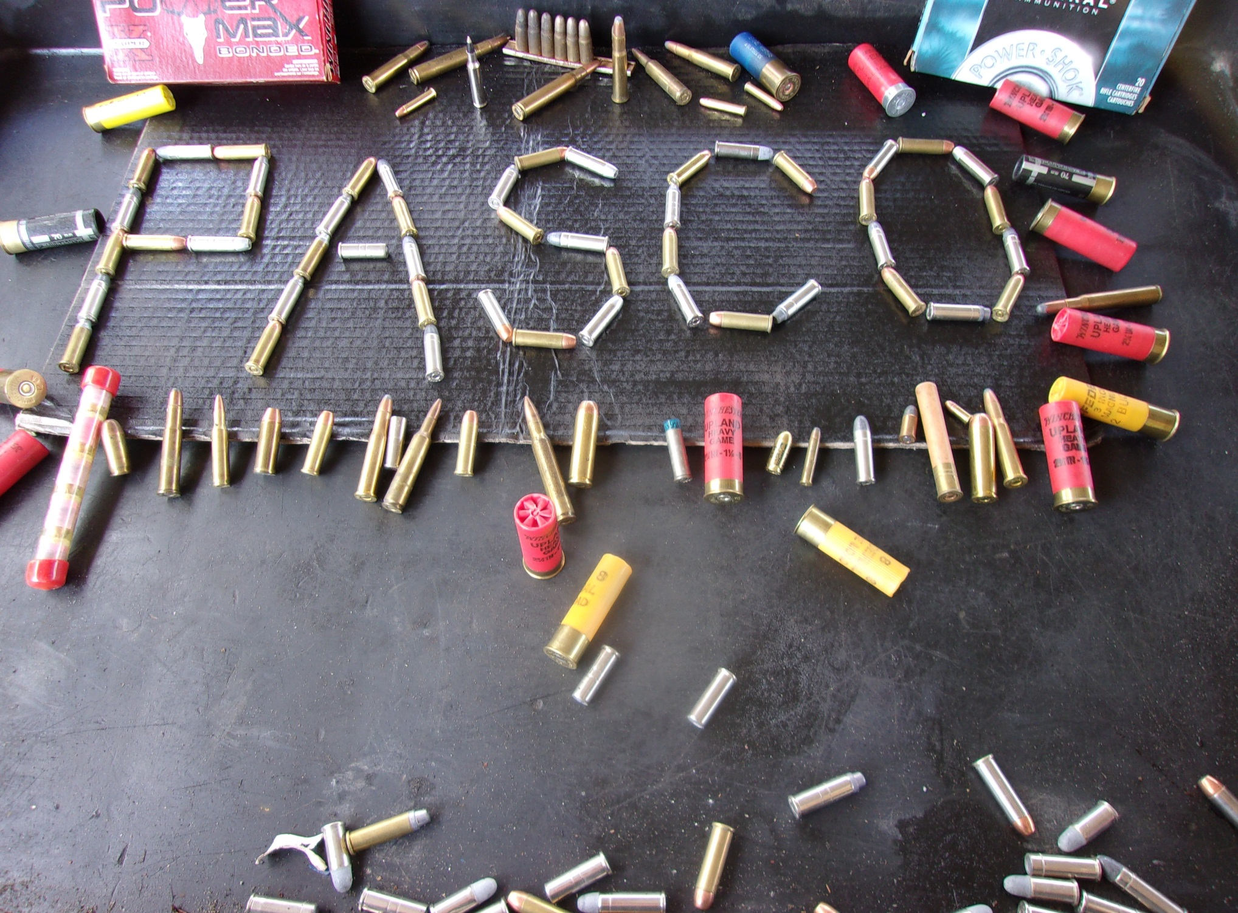

Chris Recio
crecio@PascoCountyFL.net

