Slide 1
Private – Public Partnerships
Alicia Hacker, Environmental Specialist (Pasco and Lake)
Rita Crouch, Environmental Specialist (Lee and Hillsborough)

Slide 2
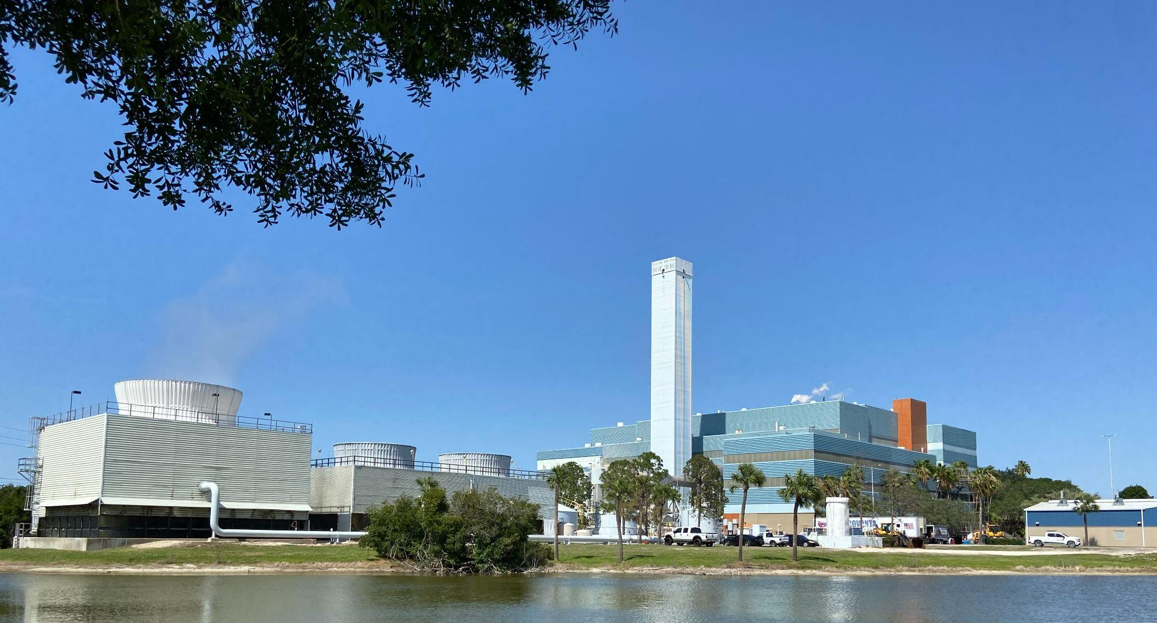

Waste-to-Energy takes non-hazardous waste – otherwise destined for landfill – and combusts it at extremely high temperatures to generate steam for electricity production. Ash is processed to recover metal for recycling while all gases are collected, filtered and cleaned to minimize environmental impact.

Slide 3
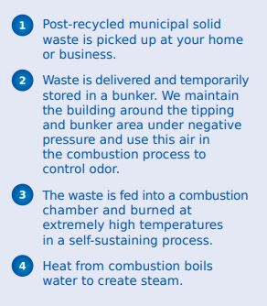
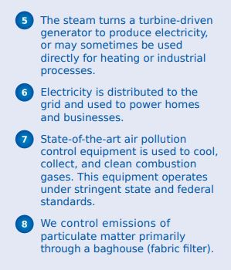
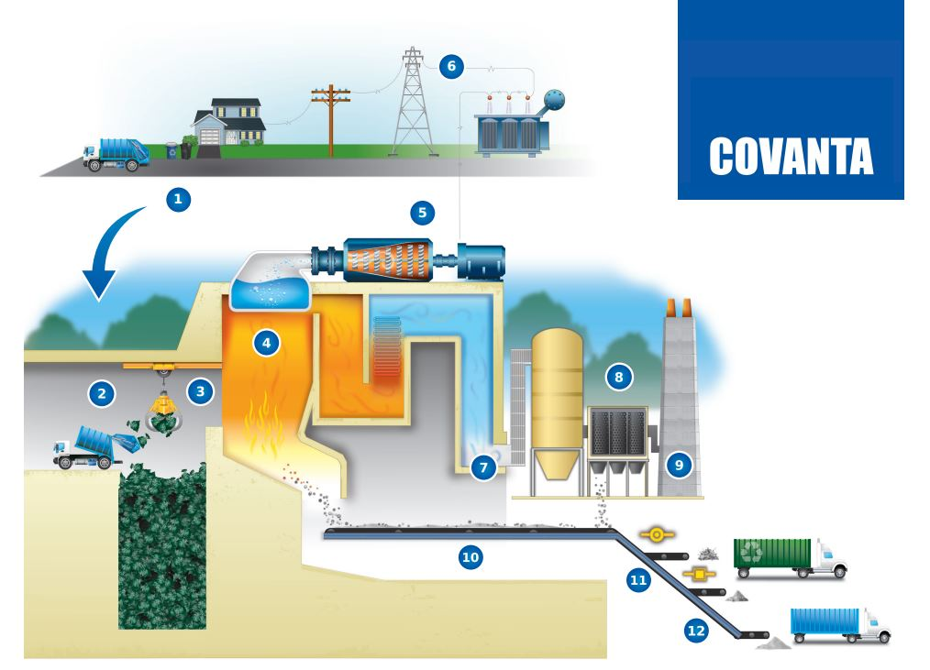
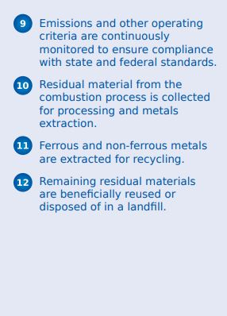

Slide 4
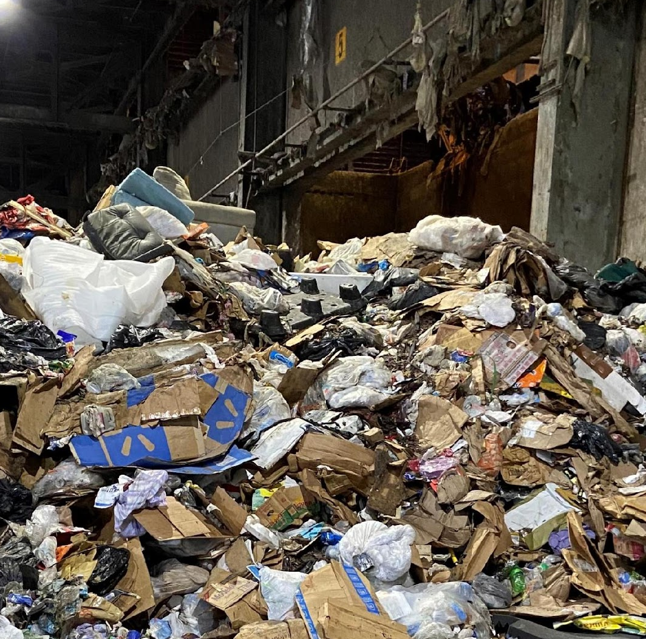
Not all waste can be processed!
Examples include:
Lead acid batteries
Hazardous waste
Radioactive waste
Grease, scum, and grit screenings
Explosives
Segregated biological loads (without unauthorized approval)
Private-public partnerships: working together for sustainable integrated waste management solutions.

Slide 5
Pinellas County Example
https://www.baynews9.com/fl/tampa/news/2021/07/17/red-tide-fish-kills-turned-into-electricity#

Slide 6
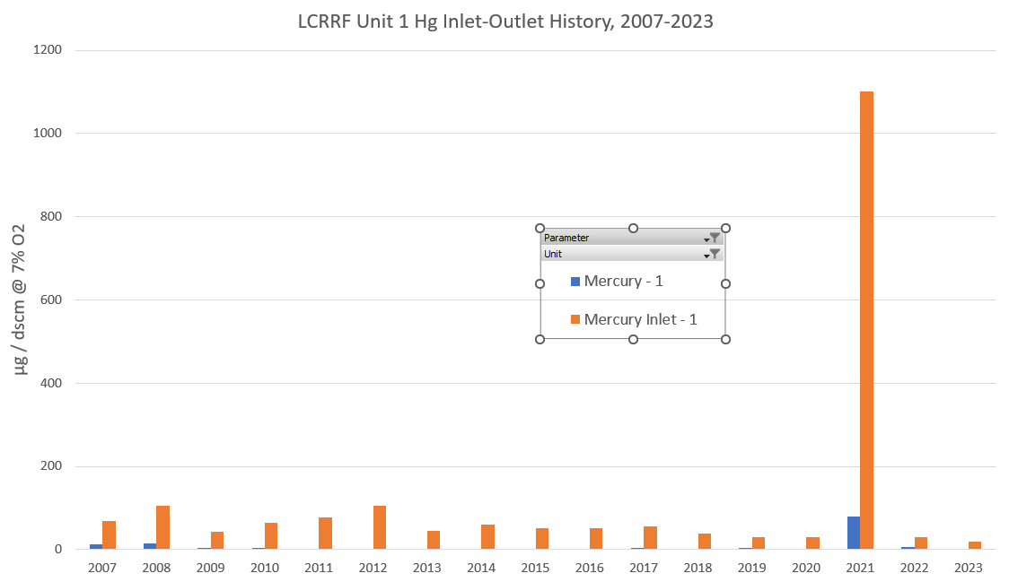
Lee County

Slide 7
Outline
Regs on no bueno trash to burn
  Batteries (ex. buttons)
  Hg (elemental, bulbs, etc.)
“Bounty” program
  County program sponsored by Covanta
  Ad examples?
Outreach and Education on Hg lamps
  Promotions / advertising for this
Keep “x” county beautiful partnership
HHW programs (chemicals & electronics) help our operations! Safety (batteries, incompatibles), emissions
Covanta- now goal driven on community outreach!
  But don’t promote Covanta like a pitch sale

